Slide 1
Thursday 14th September
12:00
CIISec
CyberEPQ
Check out our CyberEPQ (Extended Project Qualification)

Slide 2
CIISec
CyberEPQ
How do I enrol?
now
About
What
Why
Rewards
DSIT
Supervisors

Slide 3
About The Qualification
It is the only Level 3 CyberEPQ available
It is worth half an A-Level
That means you could earn up to 28 UCAS points!
Universities might even lower their offer if you have an EPQ!
It is accredited by City and Guilds
It is delivered online where you complete modules made up of videos, quizzes and games via
the Moodle
You then complete a written project and presentation

Slide 4
Topics You Will Study
Introduction to Cyber
History of Computing & Cryptography
Security Audit, Compliance & Assurance
Cybercrime
Identity & Access Management (Authentication, Authorisation & Accountability)
Risk Assessment, Management & Governance
Incident Response Management
Digital Forensics
Security Testing & Vulnerability Assessment
A module chosen by you:
A Human Aspect of Cyber Security
Software Security & Architecture
Pen Testing

Slide 5
Why?
Did you know 3.5 million cyber workers are needed in the industry
Yes, and they are looking to diversify the cyber community too!
That means they are encouraging all genders and backgrounds to start their cyber career
Also, more than 15% of the cyber industry earn over £100K a year
While also having the opportunity to help keep the nation safe
The cyber industry isn’t going away! Only getting bigger

Slide 6
Rewards & Benefits
After completion, students are offered one year membership to CIISec for free
CIISec have links to academic partnerships like universities and apprenticeship schemes
You can use it to strengthen your personal statement and give you a talking point in interviews
Develops your independent study skills
You can join the CyberEPQ Alumni
Gives you an opportunity to network with cyber professionals
CIISec supports you through your whole cyber career!

Slide 7
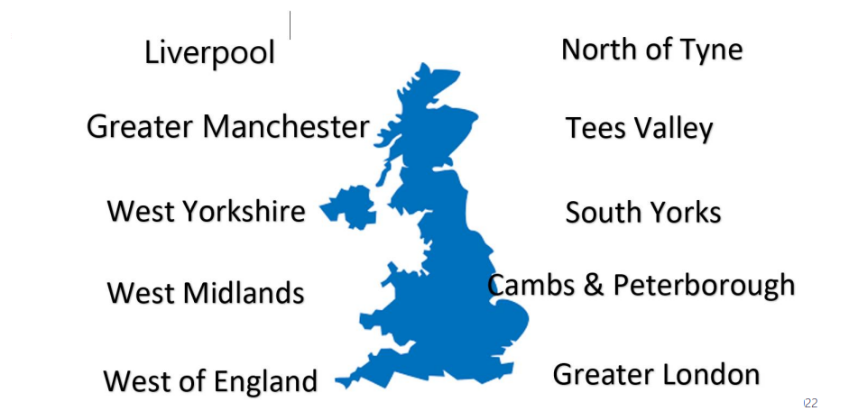
DSIT Funding
Providing FULL FUNDING for sixth form students of state schools in the listed Mayoral Combined Authorites
It is worth half an A-Level
Supporting students to develop an active interest in cyber
Encouraging the diversity of students going into the cyber industry
Making cyber accessible to everyone. Giving students who didn’t think they would have an opportunity an equal chance
Changing and educating the misconceptions of the cyber industry and professionals

Slide 8
Supervisors
Supervisors DO NOT need to be Cyber experts. They just need to complete a marking & standardisation framework
Supervisors will need to meet with their students regularly and provide feedback, as well as marking the final project
CIISec will provide support for supervisors through providing independent cyber experts if needed
Bi weekly support calls will be set up for students and supervisors
Regular email updates and guidance for upcoming milestones and deadlines
Free access to the online study
forum Moodle to help keep
track of students progress

Slide 9
How Do I Enrol?
To arrange a Teams call or ask any questions about the course, funding, timetable or enrolment, email:
cyberepq@ciisec.org
nicky.bodily@ciisec.org (CyberEPQ Lead)
emily.harfield@ciisec.org (School Liaison Officer)
Visit our website by clicking on any of the logo links in the left hand corner!
Course also available without funding for students aged 14+ or those not in a specified Combined Mayoral Authorities
Information about the CyberEPQ can be found on the website. Just click on either two of our logos on our CIISec phone!
We hope to hear from you soon to begin this amazing and exciting opportunity into your cyber career

