Slide 1
Sustainable Travel
EDIT TO FIT YOUR NEEDS
School Assembly

Slide 2
What is Sustainable Transport?
“Meeting the needs of today without compromising the ability of future generations to meet their needs” – UN, 1987
Planet: Transportation that doesn’t rely upon fossil fuels (or other finite resources) – therefore doesn’t harm the planet.
People: Transportation that meets social needs (i.e. ensuring that people get to where they need to get to – enhancing mobility).
Profit: Transportation that supports the economy and helps growth.

Slide 3
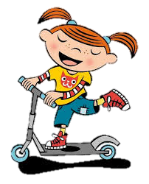
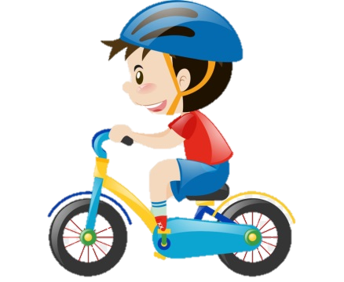
Examples
Walking
Cycling
Mass transit systems (Bus / Tram / Train)
Electric vehicles

Slide 4
Why is Sustainable Travel important?
Using unsustainable modes of travel (e.g. the car) releases air pollution – which harms the environment and may contribute to global warming.
We only have a limited amount of fossil fuels left!
Walking, cycling and walking to public transport stops is great for our health, and can help prevent long term illnesses and health problems.

Slide 5
Video

Slide 6
How can you travel more sustainably?
There are a lot of people in the world (over 7.5 billion!) – if we all made a small change (such as walking to school one day per week) that would make a BIG difference!
How many of you travel to school by car (hands up)?........

Slide 7
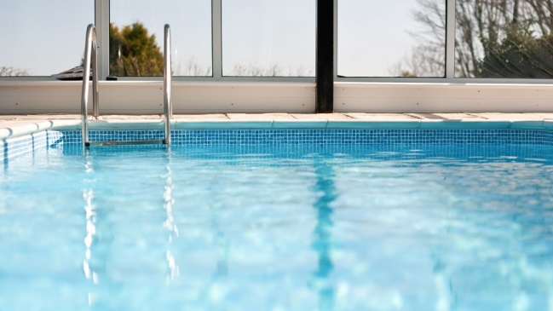
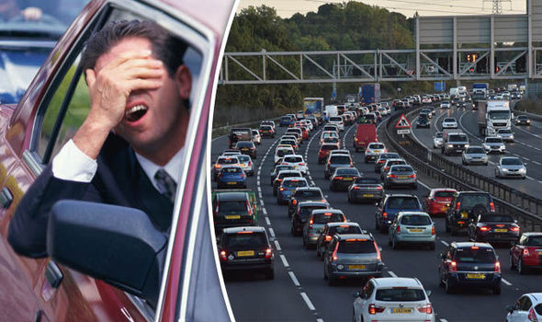
How can you travel more sustainably?
………Quite a lot of people travel by car!
If 100 people walked or cycled instead, we could save enough fuel across the year to fill a swimming pool!
Not to mention the amount of air pollution prevented, and the reduction in congestion!

Slide 8
Walking to school
It is sociable! Lots of your friends will be walking to school, so you can catch up with them on your way in.
It’s good for the environment! Walking to school reduces the number of cars on the road and helps reduce air pollution and global warming.
It’s a great way to exercise! The NHS recommends we get at least 60 minutes of exercise per day – walking contributes to this.
It’s not that far! Most parents/guardians worry that school is too far away, but on average in the UK children in primary school walk 1.2 miles (20 minute walk). If they can do it, so can you!

Slide 9
Cycling / Scooting to school
It is fun! Lots of children travel this way so it’s a good chance to catch up with your friends before school.
It’s a great way to exercise! The NHS recommends we get at least 60 minutes of exercise per day - cycling and scooting contributes to this.
It’s good for the environment! Cycling and scooting to school reduces the number of cars on the road and helps reduce air pollution and global warming.

Slide 10
Driving to school
Some people have no choice but to drive, but there are still ways you can make driving more sustainable:
Try car sharing – this is where you share the journey to/from school with another child / family.
Try Park & Stride – this is where you park slightly further away and walk the remaining distance to school. It’s a great way to get some exercise!
Avoid Idling - This is where a car engine is left on when parked / stationary, and means toxic pollutants are released into the environment.

