Slide 1
School Travel Plan
EDIT TO FIT YOUR NEEDS
School Assembly

Slide 2
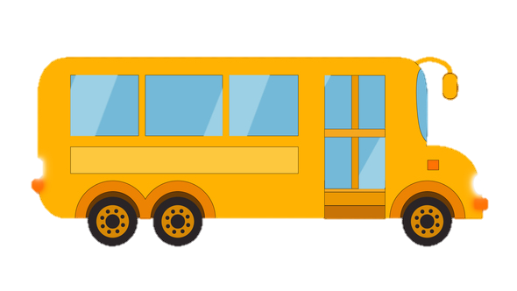
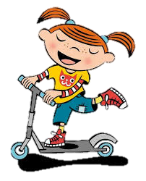
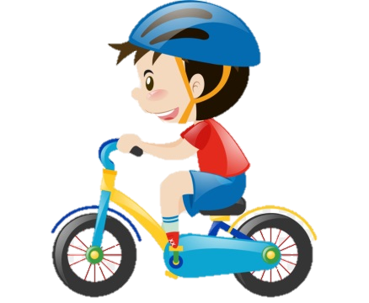
What is a School Travel Plan
A set of actions that the school are adopting to promote safer, active and sustainable travel to school
The key aim is to reduce the number of children and teachers who travel to school by car.
This will lead to reduced congestion, improved air quality and healthier people!

Slide 3
Why do we need a School Travel Plan?
Parking Problems – Excessive parking outside the school gates can be dangerous (especially for pedestrians / cyclists) and takes up valuable road space for people who may need it (e.g. those with a disability that prevents them from walking far).
Pollution – Travelling by car releases dangerous air pollution, which damages our lungs and impacts our health and the health of the planet.
Helping our community – living near a school can be frustrating, especially when people park on your drive, or if you’re delayed at school drop off / pick up times.

Slide 4
What will happen?
The school will do more ‘hands up’ Travel Survey to find out if pupils have changed how they travel
Teachers will tell you that they are introducing a Travel Plan and explain what it is (in an assembly or in class)
You will complete a ‘hands up’ Travel Survey in class to find out how everyone is currently travelling to school
1. Let everyone know!
2. Conduct Site Audit
3. Conduct Travel Surveys
4. Adopt Action Plan
5. Monitoring and evaluation
Teachers will look at what sustainable facilities the school already has (e.g. cycle parking)
The school will run lots of fun activities about travel to get you walking, cycling and scooting to school more.

Slide 5
What can pupils do to get involved?
Pupils in Year 6 can apply to be part of the School Travel Plan Champion team – Contact XXXXX to sign up.
We will be organising loads of activities to encourage walking, cycling, scooting, and car sharing– get involved!

Slide 6
Activities – Walking to School
Park and Stride – The school have identified lots of places where parents / guardians can park away from school. You then walk the rest of the way to school!
Walking Bus – Where you get picked up and dropped off by the school walking ‘bus’ (escorted by an adult). The ‘bus’ follows a set route and timetable.
Car-free walking zone – The school have identified a zone around the school, within which we are encouraging parents / guardians not to drive into! This reduces pollution around the school.
Competitions and challenges - we have loads of fun competitions planned, such as WoW Days, the ALWAYS challenge and the Golden Shoe!

Slide 7
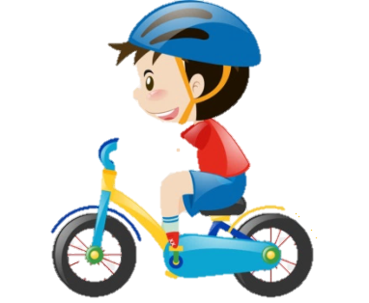
Activities – Cycling / Scooting to school
Cycle Train – This is the same as the school walking bus, but on your bicycles! The ‘train’ follows a set route and timetable, and picks pupils up on route.
Cycle parking – As a school we are providing cycle parking, so that you can bring your bicycle / scooter into school are park it safety.
Cycle Permit Scheme – Those of you wishing to cycle to school will need a ‘permit’. You need to meet certain criteria to get your permit, but once you do you can display it on your bike showing that you have passed the requirements for obtaining a permit!
Bikeability and Dr Bike - The school will be guests to teach you bicycle maintenances as well as undertake cycle training, for which you will receive an award for completion.

Slide 8
Activities – Car sharing
Sometimes there is no option but to drive- but this can still be done sustainably!
Car sharing – Where two or more families travel in the same car to get to school. This halves the number of cars outside the school gates! You can also get a free lift to/from school whenever your parents / guardian can’t pick you up / drop you off!
Safe Parking – If you are coming by car, the school will teach students about safe parking (e.g. not parking on the school zig zag lines etc). This way, you can make sure your parent / guardian are parked safely!

Slide 9
Any Questions?
Speak to XXXX the School Travel Plan Champion!

