Slide 1
Introduction to Drowning and Cold Water

Slide 2
Drowning in the UK and Ireland
Around 700 people drown in the UK and Ireland
Thousands more have non fatal drowning experiences
What do you know about drowning?
Notes:
Before starting, check in anyone in the room has been affected by drowning or near drowning and take appropriate actions to avoid causing unnecessary upset.
Very briefly introduce the subject of drowning using the statistic on the screen.
Organise the class as a whole group, or smaller working groups, and ask then to discuss and/or write down what their initial thoughts are about drowning.
It doesn’t matter what approach pupils take to the question, whether it’s a scientific approach to discuss the mechanics of drowning, recalling stories of drownings that they know about, or a discussion about the behavioural causes of drowning. This is an opportunity for pupils to think freely about the issue and share their thoughts with each other.

Slide 3
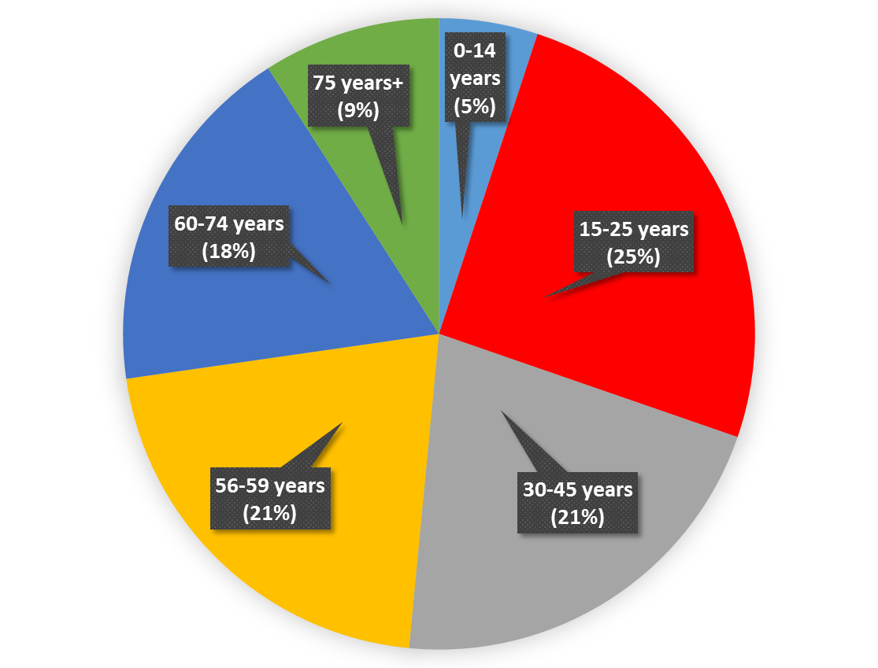
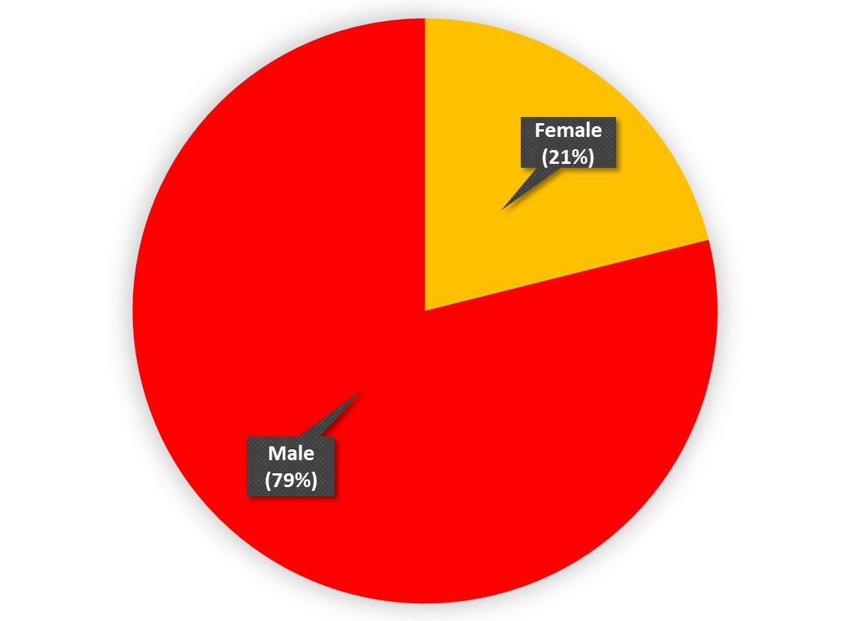
So who drowns?
At what age do you think you are most at risk of drowning?
What percentage of people who drown do you think are male?
Why do you think people aged 15-25 years are the most likely to drown?
Why do you think males are more likely to drown?
Data source: WAID 2013-2014
Notes:
The questions and charts will appear on each click.
Pupils can try to guess the answers to the questions at the top of the slide, and then discuss the questions at the bottom of the slide to explore why they may be at an elevated risk of drowning.

Slide 4
Take a look at these two real drowning cases:
Richard Fellows, 15, drowned after swimming with friends near Arrow Valley Country Park in Redditch. The emergency services rescued him about two hours after the alarm was raised.
His family was left devastated, his dad said “there’s a hole in our lives that can’t be filled”.
Dylan Ramsay, 13, drowned after swimming at Hill Top Quarry in Lancashire. The emergency crews were called to the site but he was pronounced dead at the scene. Dylan’s mother paid tribute to her son who she described as a “bright young man who enjoyed life to the maximum and was a thrill seeker.”
She also said “I want people to know that he was a strong lad and a very capable swimmer, despite this he still found himself in trouble and unable to swim a short distance to safety. This message is to highlight the dangers of open water and the devastation it can bring to any normal family.”
Notes:
Read the two case studies to the pupils, ask a pupil to read to the group, or ask them to read the studies themselves.

Slide 5
How does someone who can swim drown?
Why do you think these, and many other strong swimmers, drown every year?
There are lots of hazards to be aware of, particularly at places such as rivers, lakes, quarries, and the beach…
…but cold water might be the biggest killer of all the hazards.
Notes:
As a whole group, or in smaller groups, ask the pupils to come up with some suggestions to explain why good swimmers drown.
Click to reveal the bottom of the slide, and introduce cold water as a hazard.
If no pupils suggested ‘cold water’ as a hazard, ask them if they can work out how it can be responsible for good swimmers drowning.

Slide 6
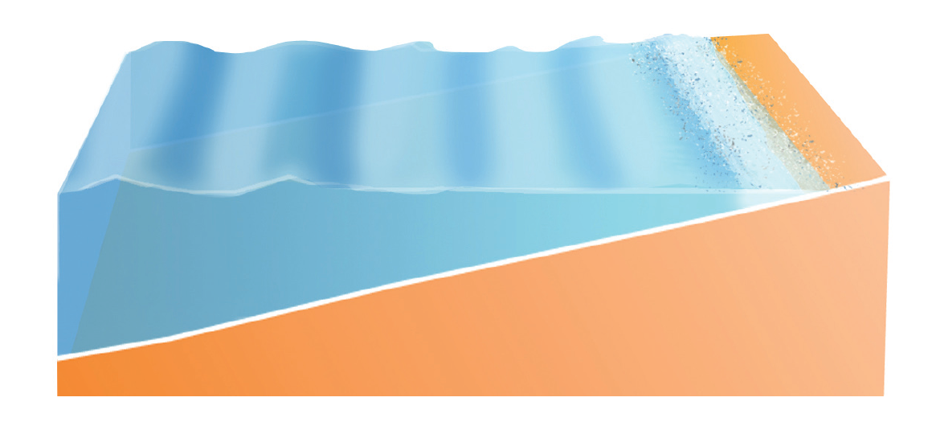
Why do people drown?
Water in rivers, lakes, and the sea around the UK and Ireland is always cold, rarely getting warmer than 15°C (swimming pools are 30°C).
The shallows get warm in the sun, but deeper water just metres from the shore stays very cold
Notes:
Work through the information on the screen.
Click to animate the water temperature.

Slide 7
If you jump in, from a bridge or cliff, the affect of the cold water can get you straight away, or if you walk in from the shallows it can get you when you are just out of your depth.
This is what happens…
Notes:
Work through the information on the screen.
Emphasise that ‘you can feel that it is safe when you enter the warmer shallow water, but you may only feel the affect of the cold water when you are just out of your depth, when it’s often too late to get back’.

Slide 8
When the cold first hits you
In the first 0-3 minutes you will experience…
Dr Gordon Giesbrecht, Professor of Thermophysiology, is a leading researcher in how entering cold water can quickly start the drowning process…
www.coldwaterbootcamp.com
Notes:
Play the video.

Slide 9
When the cold first hits you
Summary
Big gasps followed by hyperventilation
Causing dizziness and panic
If you inhale water you’ll start to drown
Increased blood pressure and heart rate
Can trigger heart attacks in people with medical conditions
Notes:
Briefly run through the summary notes.
Ask pupils if they have experienced a mild ‘gasp response’ when entering the swimming pool (most will have). Suggest that if they can feel a gasp response in a 30 degree swimming pool, imagine how must worse that response would be in a lake or quarry at 5-15 degrees (which they often are even in summer).

Slide 10
After the gasping, muscle cooling
Once your breathing is under control, this starts to happen after 1 minute…
www.coldwaterbootcamp.com

Slide 11
After the gasping, muscle cooling
Summary
Muscle cooling in your arms and legs
Loss of strength
Loss of endurance
Loss of coordination
Loss of ability to swim = drowning
Notes:
Briefly run through the summary notes.
Ask pupils if they have experienced difficult tying their shoelaces, putting a key in a lock, or similar when their hands have been really cold. Suggest they imagine how difficult it is to swim or even hold a floating position, if they had that feeling throughout their arms and legs.
Emphasise that this happens in summer too, not only winter.

Slide 12
Make the most of the water
Not taking too many risks doesn’t mean it’s boring
There are loads of great ways to enjoy open water.
Head to a lifeguarded lake or beach.
Or sign up for something more extreme with an organised group
Notes:
Pupils can read the notes whilst watching the video.

Slide 13
Based on what you have just seen and discussed, what would you consider before going into open water?
Notes:
As a whole group, or in smaller groups, ask the pupils to discuss what they would do if they wanted to go swimming.
What risks are they happy to take, and what risks might they choose to avoid?
Click to reveal the second activity – Create a Facebook post
Working in small groups students should consider:
• Who is most at risk
• Why people drown
• Where people are most likely to drown
• Advice for people to help prevent them from drowning

Slide 14
Other sessions to look at
Introduction to Drowning and Cold Water
Inland Water Sites
Coastal and Beach Water Sites
Orienteering –
Hazard Hunt
Witness Statement
Notes:
There are 4 other sessions in this series.
Please complete as many of these sessions as you have time for, starting with the sessions which link most closely with your local environment.
Thank you for delivering this drowning prevention session on behalf of RLSS UK.

