Slide 1

Coast and Beach

Slide 2
Coast and Beach
Over 30% of drownings occur around the coast, that’s about 115 deaths every year.
Beach Lifeguards also save and help thousands of people who get into difficulty in the water.
The coastline and beaches are very dynamic and changeable environments.
Understanding more about how these environments work makes it easier to enjoy them, and makes you less likely to become one of the statistics.
Whenever you are near water:
Stop and Think
Stay Together
In an emergency:
Call 999 or 112
Float
Notes:
Before starting, check in anyone in the room has been affected by drowning or near drowning and take appropriate actions to avoid causing unnecessary upset.
Very briefly introduce the subject of beach and coastal drowning using the statistic on the screen.
Explain that simply understanding the coastal environment better can help them to make better, more informed decisions about what they can do safely when at the beach.

Slide 3
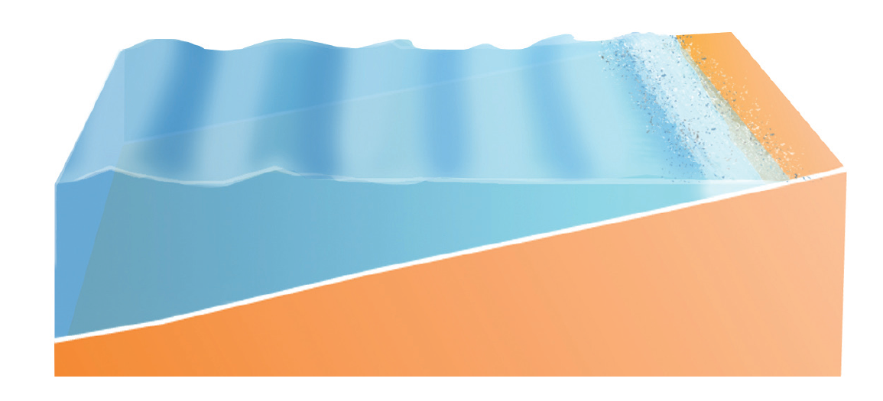

Cold Water
Even during the summer the sea stays very cold, particularly the deeper water just a few metres from the shore.
Swimming parallel with the shore means you can stand up if you start to feel tired or if you inhale water.
If you’re going into deeper water to surf, it’s a good idea to wear a wetsuit.
If you want to swim, try to enter from somewhere shallow, if you want jump from cliffs, docks, or harbours find an organised group with rescue cover (such as lifeguards).
Notes:
Work through the information on the screen.
Ask the group if they know of any, or have taken part in any activity groups such as coasteering or water-sports (or even just swimming in the sea). If they have, ask them to share the experience with the group, particularly focusing on any safety precautions which were followed and if anything didn’t go to plan which they would do differently next time.
(This slide is repeated in other presentations because understanding the affects of cold water is so important to reducing drownings in the UK and Ireland).

Slide 4
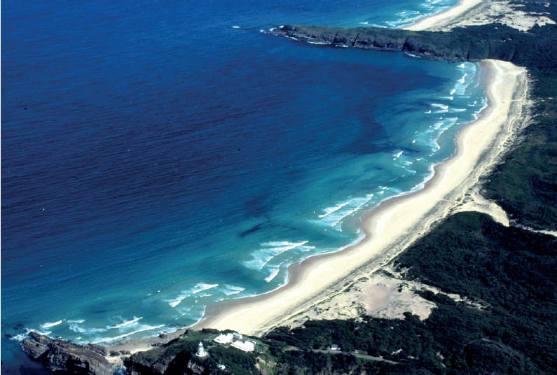
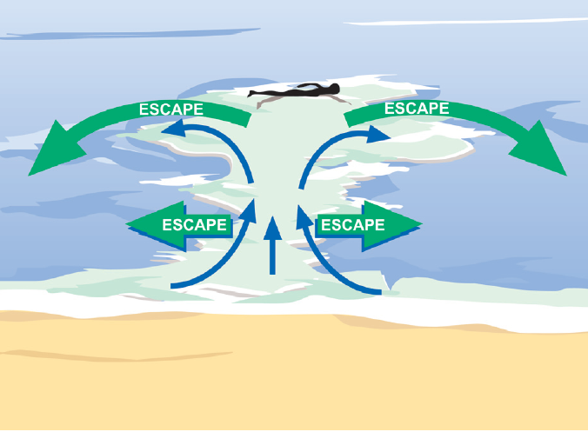
Rip Currents
What is a rip current?
Rip currents are where the water that has been washed onto the beach by the waves flows back out to sea
What is the danger of a rip current if you swim into one?
You could get swept out to sea
Are rip currents always in the same place?
No. Some rip currents always appear in the same place, some move around the beach, others appear and disappear depending on the waves and tide
How can you escape a rip current?
Swim parallel to the beach until you are out of the rip, then swim towards the beach
Notes:
Each ‘click’ will reveal the next question/answer.
Work through the questions, encouraging students in the class to share as much knowledge as they have for each question before revealing the answer.
This can be delivered as a question and answer or as a discussion session.

Slide 5
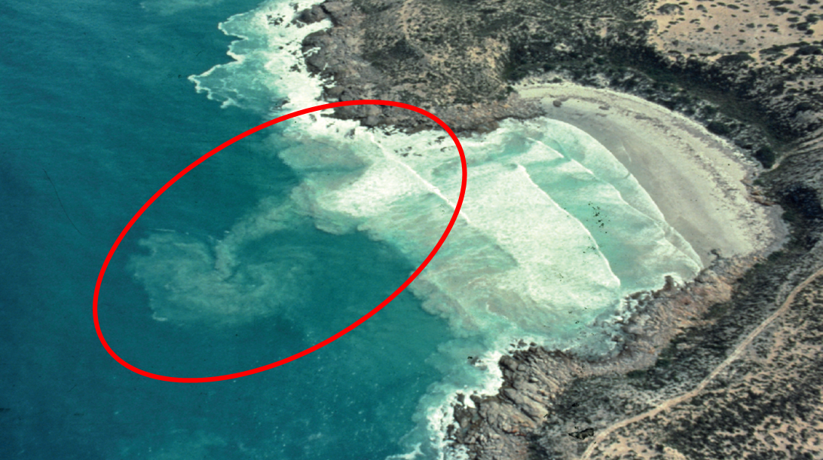
Rip Currents
To spot rip currents look out for:
Darker deeper channels of water
Churned up sea bed
Debris floating out to sea (seemingly against the waves)
Change in the shape of energy of the waves
Rips often flow along cliffs or piers extending into the sea
Notes:
Work through the information on the screen.
Ask the pupils if they would have been able to identify a rip current before seeing this slide, and if not if they think that they can having seen the slide (this sets up the next activity).

Slide 6

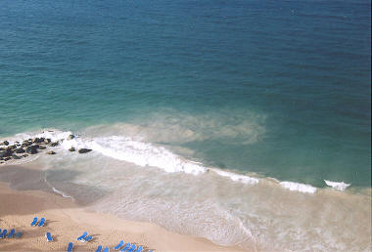
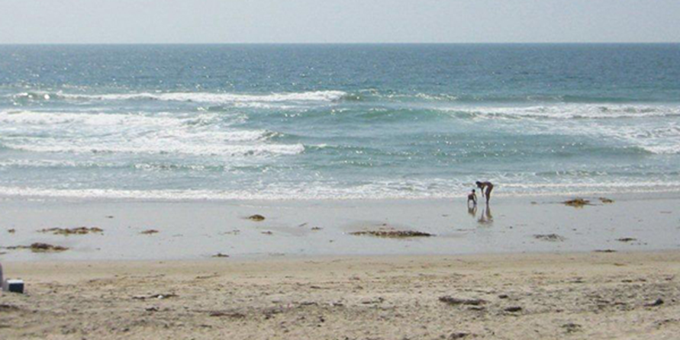
Can you spot the rips in these increasingly difficult examples?
(click or touch where you think the rip current is, some pictures have more than one)
5 to find
1 to find
1 to find
Notes:
Spot the Rip Current Activity
Working individually or in groups, ask the pupils to identify where the rip currents are in the photos.
Students can point (with the teacher operating the mouse), they can take charge of the mouse themselves, or they can touch the images if you are using an interactive whiteboard.

Slide 7
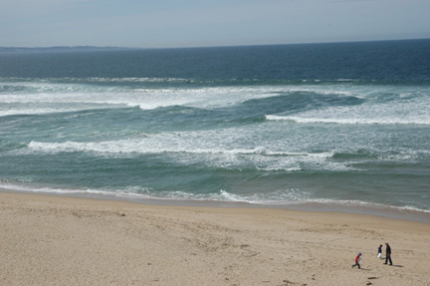
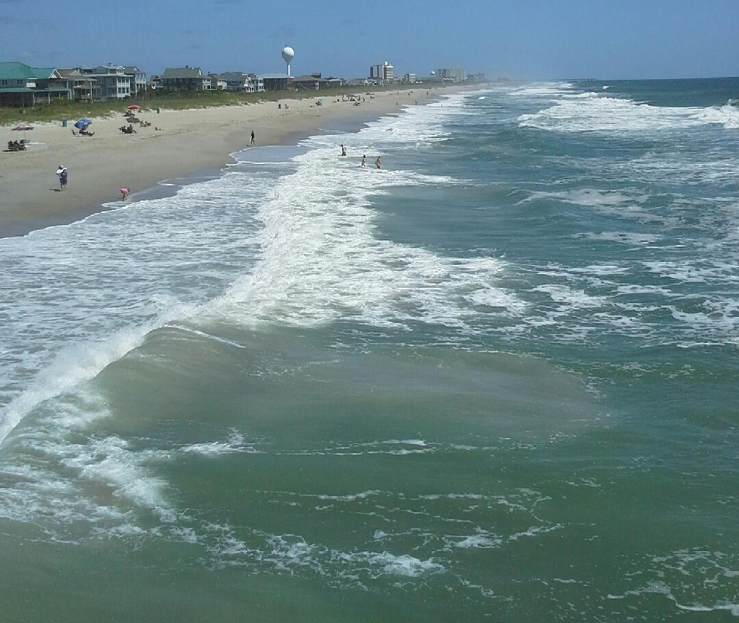
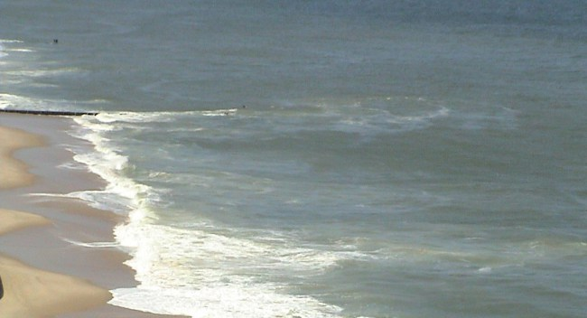
Can you spot the rips in these increasingly difficult examples?
(click or touch where you think the rip current is)
1 to find
1 to find
2 to find
Notes:
…Spot the Rip Current Activity continued

Slide 8
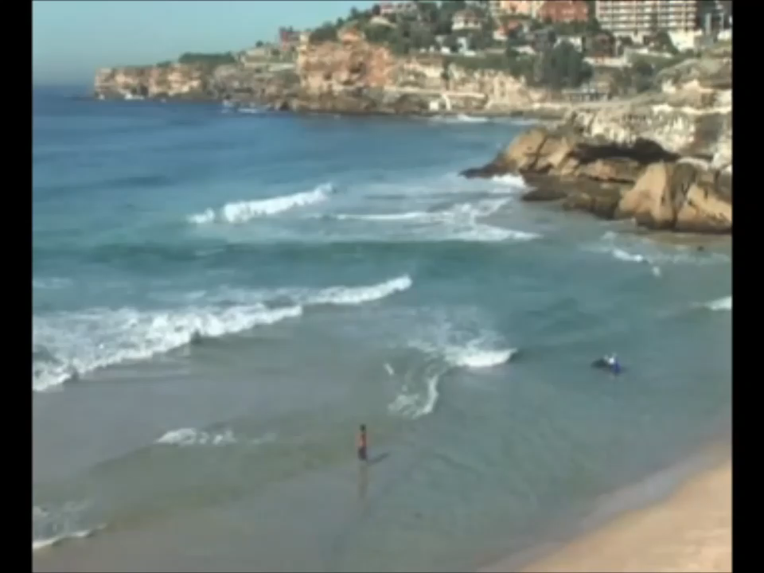
Dye release experiment to expose a rip current
Watch the first video, you have 6 seconds to identify where the rip is
Watch the second video to find out if you were correct
(www.scienceofthesurf.com)
Notes:
Follow the instructions on the slide to give the pupils the opportunity to practice there rip current spotting skills on a real recording.

Slide 9
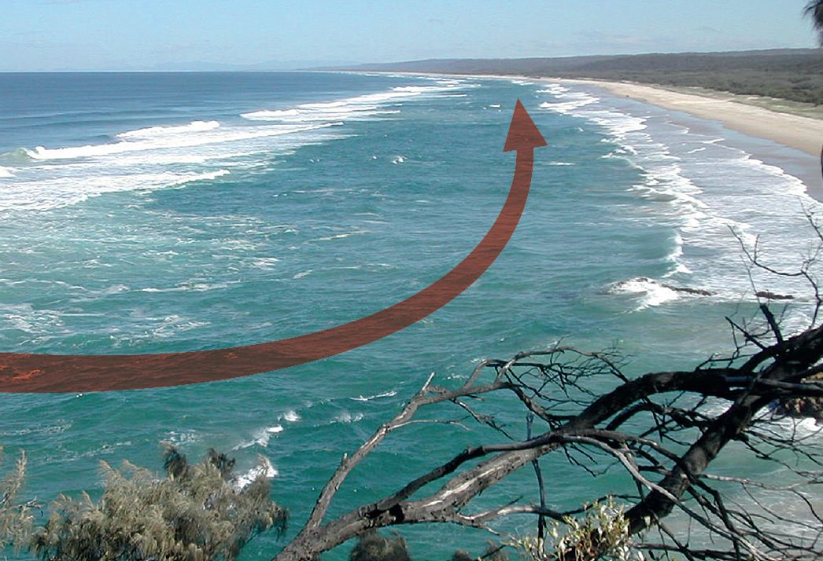
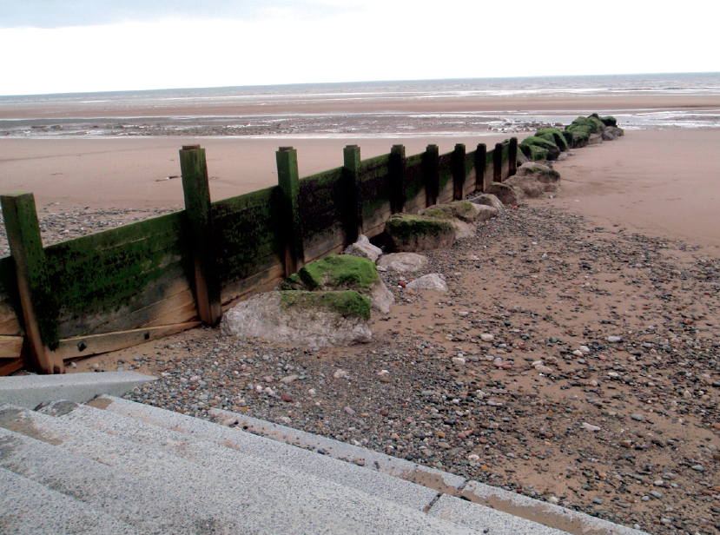
Longshore Currents
Longshore currents run along the beach.
When you’re in the sea these currents can carry you along the beach away from where you got into the water, and may even carry you to an area where you can’t get out or towards a rip current.
Longshore currents can be difficult to spot, but look for the ways coming in at an angle to the beach, and groynes on the beach which are used to stop the sand washing up the beach with the longshore current.
Notes:
Work through the information on the screen.
Ask the group if anyone has been swimming in the sea and looked back to shore only to find that they are considerably further down the beach than they expected to be. What did that feel like?

Slide 10

Tides
How many high and low tides are there per day?
2 high and 2 low, high and low times change every day.
Will a tide flow up a shallow or steep shelving beach the fastest?
Fastest up a shallow shelving beach.
How do the tide and cliffs sometimes result in people needing to be evacuated from the cliffs by helicopter?
People don’t check the tide times and then get cut off from the beach exits when the tide comes in.
Find information about the tide times online or on signs at the beach. Remember they change every day. If in doubt, ask a lifeguard.
Notes:
Each ‘click’ will reveal the next question/answer.
Work through the questions, encouraging students in the class to share as much knowledge as they have for each question before revealing the answer.
This can be delivered as a question and answer or as a discussion session.

Slide 11
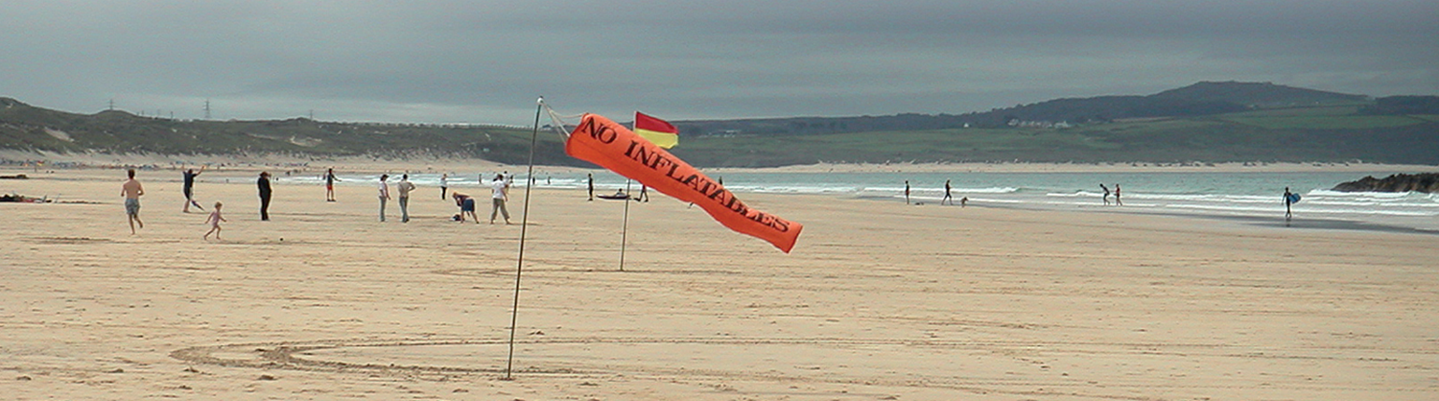
Offshore Winds
Do offshore winds blow towards the land or out to sea?
Out to sea.
The wind can blow people on inflatables out to sea, and surface chop can make it difficult to swim back towards the shore. What is surface chop?
Water blowing off the tops of waves, blowing droplets into your face, making seeing and breathing difficult.
What lifeguard flag is used to help you to identify wind direction (clue below)?
Orange windsock.
Notes:
Each ‘click’ will reveal the next question/answer.
Work through the questions, encouraging students in the class to share as much knowledge as they have for each question before revealing the answer.
This can be delivered as a question and answer or as a discussion session.

Slide 12
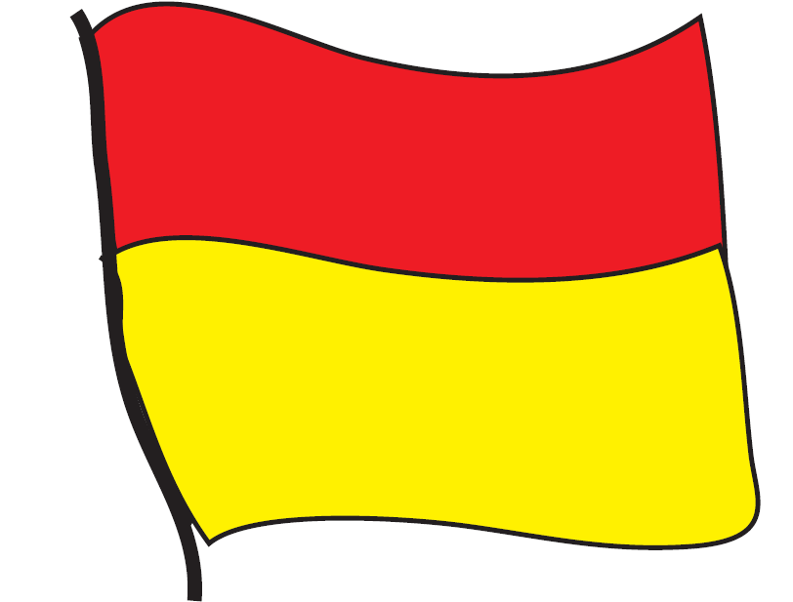
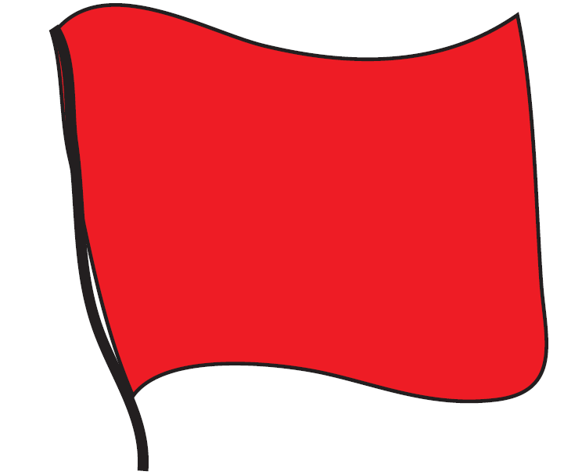
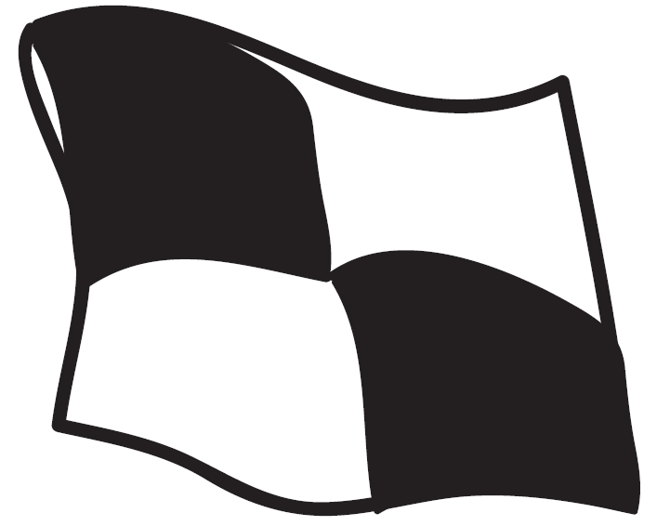
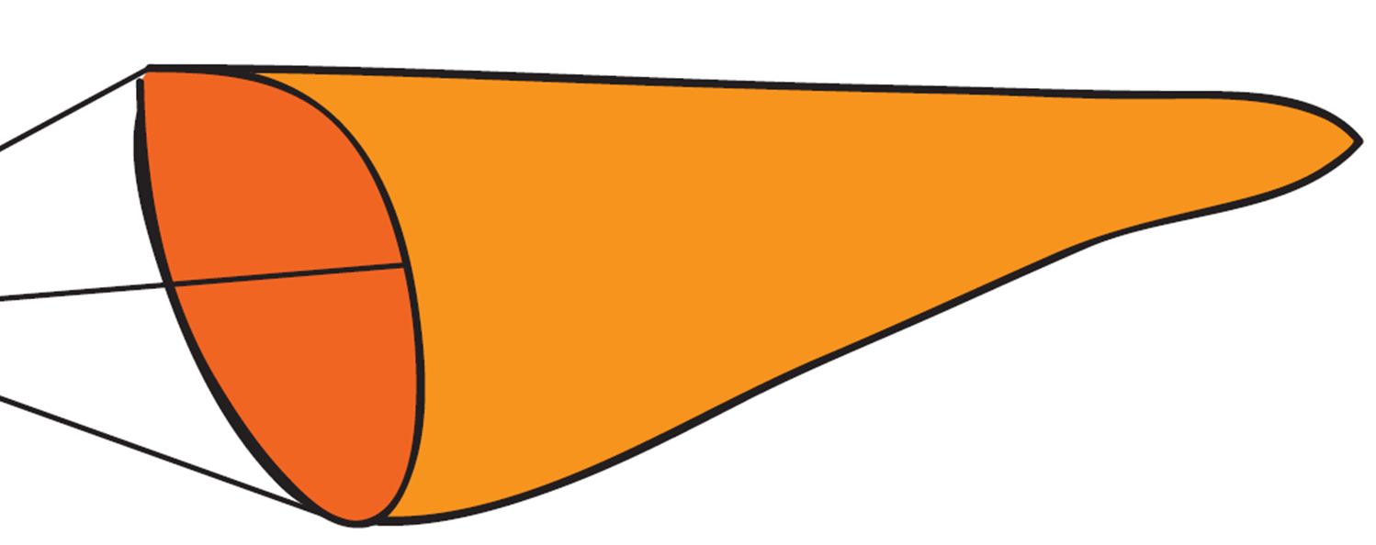
Beach Flags
What do the Beach Flags mean?
1. Red & Yellow
2. Red
Lifeguarded area
Safest place to swim
Danger
No swimming
3. Black & White
Water sports area
No swimming
4. Orange Windsock
Direction and strength of the wind
Notes:
Each ‘click’ will reveal the next answer.
Ask the pupils to guess before you reveal the answer.

Slide 13

Plan a trip to the beach, including as many beach activities as you can think of.
Create a check list for each activity that will help you be aware of any risks that you want to avoid.
Notes:
Complete the activity on the screen to encourage the group to reflect on how they may plan their activities differently now that they understand more about the beach environment.
If there is time, encourage the group to discuss what they have learned.

Slide 14
Other sessions to look at
Introduction to Drowning and Cold Water
Inland Water Sites
Coastal and Beach Water Sites
Orienteering –
Hazard Hunt
Witness Statement
Notes:
There are 4 other sessions in this series.
Please complete as many of these sessions as you have time for, starting with the sessions which link most closely with your local environment.
Thank you for delivering this drowning prevention session on behalf of RLSS UK.

