Slide 1
Spot the Dangers

Slide 2
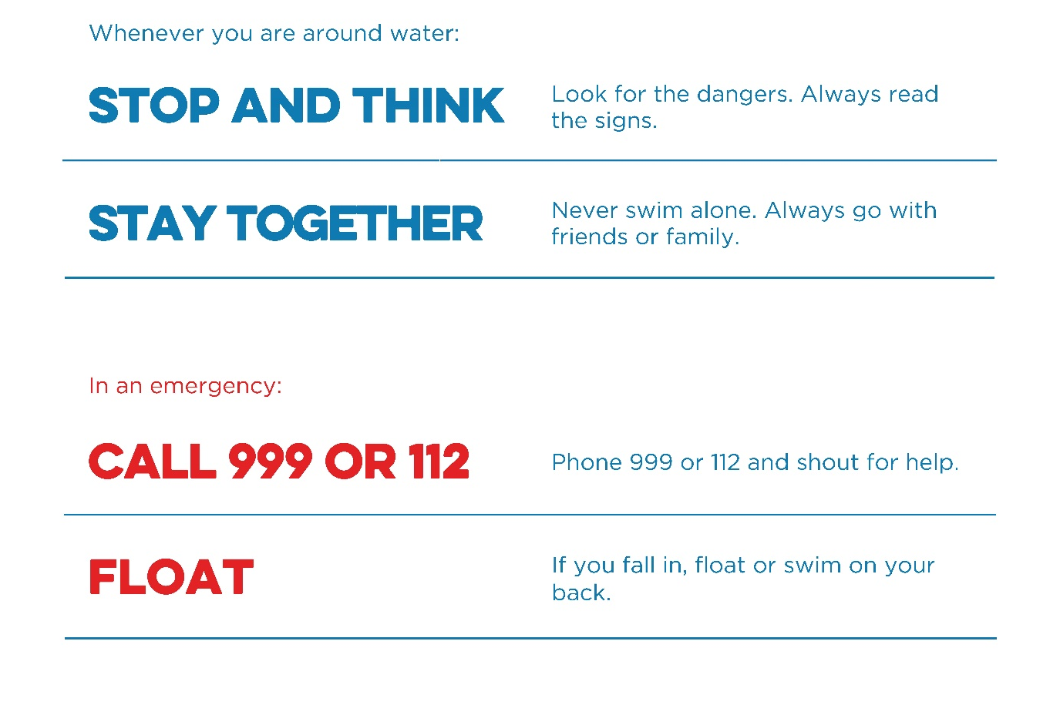
Always follow the Water Safety Code

Slide 3
Can you spot the dangers?
Click on a danger to reveal

Slide 4
CAN YOU FIND ALL 8?
Unknown depth
(Too deep or shallow)
UNSAFE BANKS
WHAT’S IN THE WATER?
Not WEARing A LIFE JACKET
BROKEN lifesaving equipment
Pets near the water without leads
Running NEAR THE EDGE
Cycling NEAR WATER
Notes:
The teacher or pupils can click (or touch) where they think there is a danger, then the information notice will appear.
Pupils can discuss each of the dangers and how they would keep themselves safe.

Slide 5
CAN YOU FIND ALL 13?
CURRENTS and wind
Cliff jumping
Swimming
TOO SOON
AFTER EATING
Drifting out too far
BEWARE OF DEEP WATER
Surfers in swimming zone
UNSAFE EDGES
Drinking ALCOHOL in or near water
Not Wearing SUN CREAM
Not wearing safety equipment
PIPES
Unaccompanied children
Swimming in the red flag zone
Notes:
The teacher or pupils can click (or touch) where they think there is a danger, then the information notice will appear.
Pupils can discuss each of the dangers and how they would keep themselves safe.

Slide 6
CAN YOU FIND ALL 8?
Running on SLIPPERY FLOORS
Glass by the pool
Jumping IN to SHALLOW WATER
STAY AWAY FROM BOTTOM OF SLIDES
Unaccompanied CHILDREN
Drifting INTO DEEP WATER/diving area
Swimming IN THE DIVING AREA
DEEP WATER
Notes:
The teacher or pupils can click (or touch) where they think there is a danger, then the information notice will appear.
Pupils can discuss each of the dangers and how they would keep themselves safe.

Slide 7
CAN YOU FIND ALL 7?
DON’T SWIM WHERE THERE ARE NO ADULTS
DON’T LEAVE CHILDREN ALONE IN WATER
COVER WATER BINS
Fix BROKEN FENCES
TIP WATER OUT
WATCH CHILDREN
PAY ATTENTION NEAR WATER
Notes:
The teacher or pupils can click (or touch) where they think there is a danger, then the information notice will appear.
Pupils can discuss each of the dangers and how they would keep themselves safe.

Slide 8
Did you spot all 36 dangers?
Did you spot any dangers that
didn’t have a label?
Well done!

