Slide 1
Joint Strategic Needs Assessments (JSNAs)
Rebecca Atchinson
Sue Coleman
Steph Morrissey
Jane O’Brien

Slide 2
What is a JSNA
The Joint Strategic Needs Assessment (JSNA) provides a picture of the current and future health and wellbeing needs of the local population.
The JSNA is split into four themes
  Adults and vulnerable adults,
  children and young people
  older people
  cross-cutting themes
  https://www.nottinghamshireinsight.org.uk/research-areas/jsna/

Slide 3
What is a JSNA cont…
Each chapter outlines the local picture for the topic of interest, evidence of what works, unmet need, assets and recommendations for consideration.
All completed JSNAs are signed off by the Health and Wellbeing Board

Slide 4
Recent JSNAs
In March 2019 three JSNAs were signed off by the Health and Wellbeing Board
  Avoidable injuries in children and young people
  Self-harm
  Domestic abuse
Notes:
Not all JSNAS that link to children are in the Children and Young People section
Avoidable injuries in children and young people (CYP)
Self-harm (cross cutting)
Domestic abuse (adults)

Slide 5
Engaging with the Alliance
Bring on the signed off JSNAs with an impact on children for the Alliance to;
  Consider the findings and recommendations
  Identify areas of influence and partners can add value
  Identify areas for further investigation (deep dives)
  Feedback to the Health and Wellbeing Board

Slide 6
JSNAs in progress
Cross cutting themes
Children and Young People
Sexual health and HIV
Health and Homelessness
Oral Health
Tobacco
Early Years
1001 Days
Children and YP with special educational needs and disabilities
Emotional health and wellbeing

Slide 7
JSNA
Self-harm
Jane O’Brien
Public Health and Commissioning Manager

Slide 8
Self-harm - all ages
Self-harm is
A complex behaviour
Defined as “…an intentional act of self-poisoning or self-injury irrespective of the type of motivation or degree of suicidal intent.” (Public Health Fingertips definition).
An indicator of unbearable emotional or psychological distress
Not confined to CYP - 49% of A&E attendances for self-harm in Nottinghamshire were for people over age 30 (Jan 2013-Dec 2016)
There is evidence of association between Adverse Childhood Experiences (ACEs) and self-harm

Slide 9
Focus on CYP – Key messages (1)
The UK has the highest CYP self-harm rate of any country in Europe, with a rate of 400 per 100,000 population
22% of 15 year olds reported in surveys that they had self-harmed (32% of girls and 11% of boys)
Research shows an increase of self-harm in childhood and adolescence in recent years with 68% increase in girls aged 13 to 16
Research suggests that self-harm increases the probability of someone dying by suicide within 12 months, by between 50 and 100 times above the rest of the population (NICE 2016) – significant risk factor

Slide 10
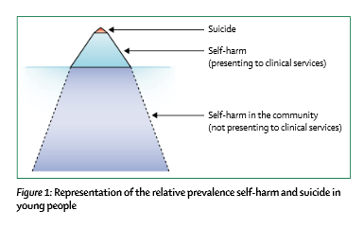
Focus on CYP – Key messages (2)
Self-harm is a largely hidden issue + inconsistent & incomplete data = difficult to measure.
Often not recorded as a presenting need – or not considered as a need on its own (a behaviour not a mental illness).
Self-harm Iceberg Model
Source: Hawton K et al (2012)
Public Health analysis estimated potentially over 2,500 12 to 17 year olds in Notts who self-harm and are unknown to clinical services.

Slide 11
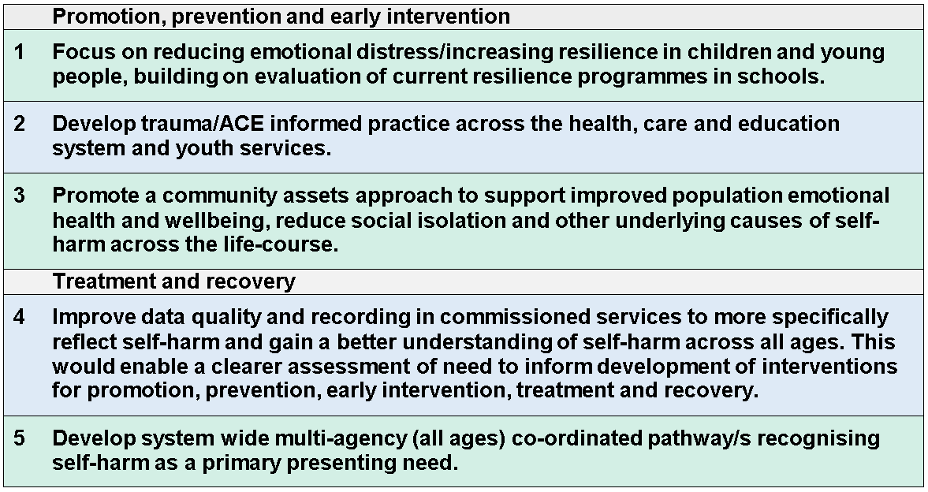
Recommendations
Note: Self-harm as a risk factor for suicide is a priority within the refreshed Nottingham City and Nottinghamshire Suicide Prevention Strategy, public consultation now open until 07/08/19:
https://www.nottinghamcity.gov.uk/engage-nottingham-hub/open-consultations/suicide-prevention-strategy/

Slide 12
JSNA
Domestic Abuse
Sue Coleman
Public Health and Commissioning Manager

Slide 13
Domestic Abuse
Definition
DA …is defined as any incident or pattern of incidents of controlling, coercive or threatening behaviour, violence or abuse between those aged 16 or over who are or have been intimate partners or family members regardless of gender or sexuality.
Domestic Abuse
Notes:
DA represents at least 20% of violent crime (March 2017)
Gendered crime – women are much more likely to experience than men.

Slide 14
Children and Young People
75% (approx.) of children living in households where DA occurs are exposed to actual incidents.
These children have an increased risk of developing acute and long term acute physical and emotional health problems.
Domestic Abuse

Slide 15
Children and Young People
Proportion of children on a Child Protection Plan with DA is high – 58%.
Lack of evidence on what interventions can help protect children from the effects of DA.
Outcomes. Safety and wellbeing, ability to express feelings, increased school performance and positive peer relationships.
Domestic Abuse
Notes:
The need.
Psychotherapy
Psychoeducation
Advocacy
Guided self-help
Parenting skills plus advocacy
Advocacy plus psychoecudation

Slide 16
Specialist Community Based Services
IDVAs support adults at high risk (often when children are involved) going through the MARAC.
Children and Young People’s workers offering one to one support and group work of children ‘Hands are not for Hurting’.
Prevention work in schools.
Dedicated service for teenagers experiencing domestic abuse within their own relationship.
Domestic Abuse

Slide 17
Encompass
Process of informing schools of reported DA, where a child is in h/hold or affected, the next day at school.
1,036 calls made to schools in 2017 (723 to primary).
Managed by MASH.
Domestic Abuse

Slide 18
Primary Prevention
Addressing DA before it happens, through awareness campaigns and working in schools.
Primary schools. GREAT: Good Relationships are Equal and Trusting.
Secondary schools (targeted). Equate, Choices and Know More.
Equation - Specialist DA training provider
Domestic Abuse

Slide 19
GREAT
Good Relationships are Equal and Trusting.
Years 5 & 6
4 wks for 2hrs.
Specialist provider Equation, and quality materials
£750 cost to school.
Ashfield & Broxtowe – separate funding and schools being contacted.
Domestic Abuse

Slide 20
Equate
Whole school approach/ Year 7, 8 & 9
Educating about DA, gender equality and healthy relationships.
Targeted Secondary schools (to-date) in County (VAWG & RC Bid Lottery)
9 schools, 4,500 pupils.
Staff trained - 180
Domestic Abuse

Slide 21
Equation
Member of Nottinghamshire Domestic and Sexual Abuse Executive, and Specialist Training Provider.
Email: info@equation.org.uk
Phone: 0115 9623 237
Post: Equation, 2 First Avenue, Nottingham, NG7 6JL
Domestic Abuse

Slide 22
DA JSNA Recommendations
No | Recommendation (7/19)
3 | All agencies to develop and promote policy and procedures for work with survivors, children and perpetrators, including workforce training and employee domestic violence policies.
6 | Assess the implications of the Domestic Abuse Bill published January 2019.
7 | Continue to support and promote campaigns to promote healthy relationships, gender equality and raise awareness of domestic abuse.
8 | Encourage more schools to take up specialist early intervention and prevention programmes for children and young people, building on mandatory healthy relationships and sex education (RSE) from September 2020.
9 | Develop targeted interventions to support at risk victims and young people that harm.
14 | Improve identification and response across healthcare settings, including mental health (women, men, teenagers and children) e.g. therapeutic counselling.
17 | Increase capacity for support for children affected by domestic abuse, both in the community and in refuge.

Slide 23
JSNA
Avoidable Injury in Children and Young People
Stephanie Morrissey
Public Health and Commissioning Manager

Slide 24
Introduction
Why this chapter?
Definition:
  ‘an injury that occurs as a result of an accident, so injury is not deliberately caused and could have been avoided/prevented’
What the chapter covers
Themes
Notes:
This a new JSNA, previously these themes were covered in the Road Safety JSNA and Children and YPs (2013) . Partners from the Nottingham City and Nottinghamshire Children’s Avoidable Injury Strategy Group have contributed to the development of this chapter. These include Notts Fire and Rescue Service, Nottingham University Hospital Trust, Via East Midlands and University of Nottingham.
Avoidable injuries in Children and young people are a leading cause of serious harm, hospital admission, and death, often resulting in long term physical disability and emotional distress and impact felt not only for the child but for family/friends.
Most injuries are preventable and strategies to prevent injuries are usually inexpensive to implement and are show to have beneficial ROI.
The chapter provides an insight into the scale and size avoidable injuries in children and young people in Nottinghamshire, an overview of current activity and services provision and assets as well as the evidence of effective interventions
Avoidable injuries tend to occur, in the home, on the roads and in leisure time, this is how the chapter has been set out.

Slide 25
Picture for Nottinghamshire
Hospital admissions
  Lower than England average rate since 2010/11 for 0-4 and 0-14. 15-24 age group similar or lower than England rate.
  Geographical differences
  Inequalities
In the home
  Falls
  Burns & scalds
  Poisoning

Slide 26
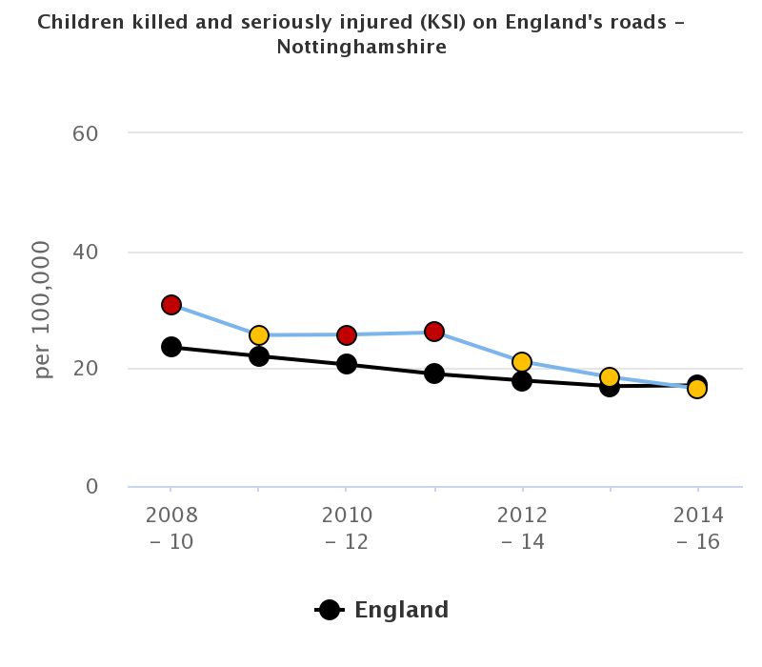
Picture for Nottinghamshire (2)
On the roads
  Age differences
  Geography
  Mode of transport
Leisure activities
  WAID data

Slide 27
Current activity, Service Provision and Assets
Children and Young Peoples Avoidable Injury Strategy Group
In the home
  Mansfield CHES
  County CHES
On the road
  Nottinghamshire Road Safety Partnership
  VIA East Midlands road safety education work (and partnerships)
Leisure activities
  Nottinghamshire Water Safety Partnership
  School swimming service
Assets
  University of Nottingham
  Road Accident Investigation

Slide 28
Recommendations
General
  Mechanism for strategic leadership and co-ordination
  Reduction of inequalities
  Combination of interventions - education, engineering, enforcement and empowerment
In the home
  Opportunities for funding
  Future commissioning
  Implement evidence based, standardised, age appropriate home safety messages across the system

Slide 29
Recommendations
On the road
  Continuation of needs lead, evidence based interventions
  Allocating recourses where evidence of need has been identified
Leisure activities
  Development of partnership action plan relating to water safety and safety education plan

