Slide 1
INTRODUCTION
PSYCHOLOGICAL WELL-BEING
Psychological Well-being - Locally, Nationally
Psychological Well-being and Young People
Psychological Well-being Ageing
Physical Health and Mental Health
1

Slide 2
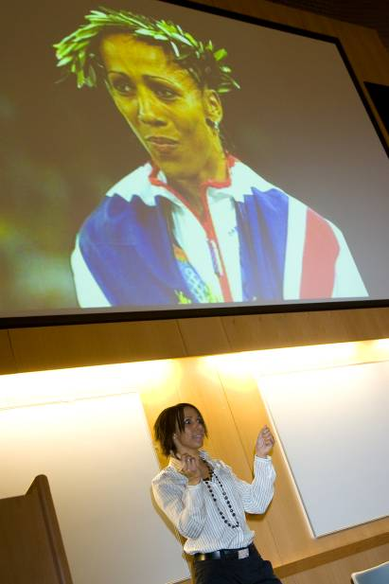
Dame Kelly Holmes – An inspiration
2

Slide 3
Psychological Well-being
Locally, Nationally
Professor Mike Cooke, CBE
Chief Executive
Nottinghamshire Healthcare NHS Trust
3

Slide 4
Mental Health and Well-being in context
National population measures of mental well being – mixed picture
increase in measured psychiatric morbidity from 1993 by 2% to almost 1 in 5 of the population in 2007
Long term fall in suicide rates until 2011 – but rose 6% in 2012 back to 2002 levels
UK life-satisfaction good by European standards
Personal well-being increased v slightly between 2011/12 and 2012/13 – 31% of the population were very happy and 10% very unhappy
Personal well being lowest in black people and those aged 45-49
4
Notes:
Sources
Community mental health profiles – public health england
Personal Well-being Across the UK, 2012/13 Office of National Statistics
NHS confed factsheet 2011 trends in mental health

Slide 5
Mixed picture locally as well
The pattern of wider determinants of good mental health mainly positive in Notts but very challenging in the City
Particularly Limiting long term illness, unemployment, and rates of entry into the Criminal Justice system
45-54 population (with the worst mental well-being scores) will fall by 5% by 2020 so overall well being will naturally rise
5

Slide 6
What is Psychological Well-being?
Mental wellbeing can be defined as: “a dynamic state, in which an individual is able to develop their potential, work productively and creatively, build strong and positive relationships with others and contribute to their communities” (Nottingham City JSNA 2011)
“Our strategy illustrates the wide range of individual local needs, such as mental health and emotional wellbeing, smoking or obesity. In practice, we know that people often have multiple needs. Therefore we encourage a person-centred approach to deliver services that tackle the multiple needs of an individual, their families and communities and promote joined up services across our health and wellbeing partners”. [Nottingham County Health and Wellbeing Strategy 2012/13]
Word Count - ‘mental health’ x 30 throughout whole document
6

Slide 7
Context
Mental Health Services for Older People
Over 65 population will grow 12% - County and 5% in City by 2020
Children and Young People
1 in 10, 1 in 12 self harm
Health and Well-being
Recovery model – hope, opportunity, taking back control
Mindfulness + link to physical health
7

Slide 8
Suicide Prevention
Evidence base suggests that health service actions alone may affect <5% of suicides
Safer mental health services prescribing and risk assessment practices continue to support falling rates
Wider determinants very important
Nationally saw the first rise in a decade in 2011 by 6% [1333 deaths]
Certain groups much more vulnerable
Substance misuse, severe mental illness, social isolation or exclusion, bereavement, unemployment, certain age, gender and ethnic groups
8

Slide 9
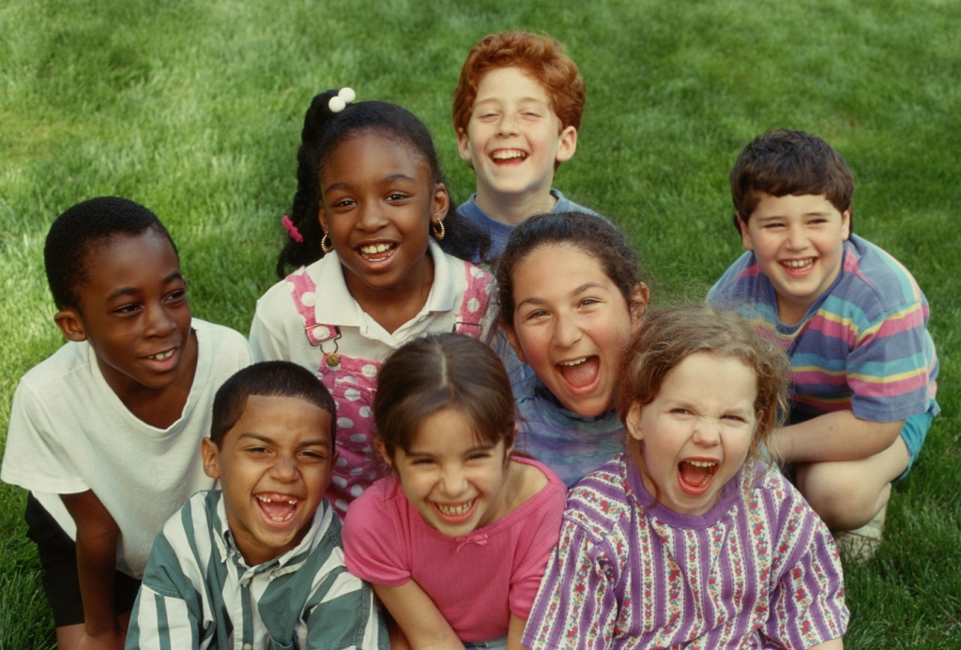
9

Slide 10
Section 2
Psychological Well-being
and Young People
Dr Lucy Morley, Consultant Psychiatrist
Children and Adolescent Mental Health Services
10

Slide 11
Introduction:
10% of children and young people have a mental disorder (ONS) increased in certain groups 40% LAC
Early intervention and prevention
Child mental health is everyone’s business
Underpinned by safeguarding
Multi-agency working: CAF, education and social care
Good models locally
11

Slide 12
Self harm:
Recent steep increase across the county
Harmless and other voluntary agencies
Suicide prevention
Research
12

Slide 13
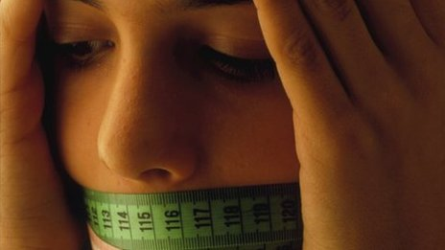
Hospital admissions for eating disorders up 8%
Eating disorders
Hospital admissions for eating disorders rose by 8% in England from 2012 to 2013, official figures show.
The data, from the Health and Social Care Information Centre, showed there were 2,560 admissions.
That compares with 2,370 in 2011-12 - which was a rise of 16% on the previous year.

Slide 14
Achievements:
Children’s strategy in NHT
Self harm team nominated for a Royal College of Psychiatrist award
We provide a good quality of care for children and young people on the inpatient unit and are developing plans for a newer more fit for purpose building
Electronic record system & prescribing
We have nationally recognised research
Children Looked After team for County
13

Slide 15
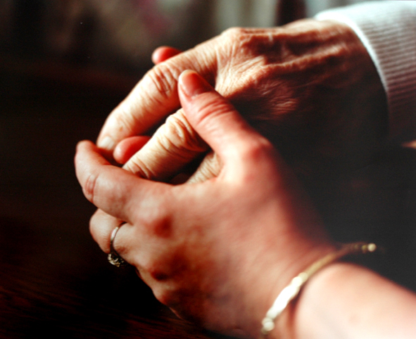
14

Slide 16
Psychological Well-being and Ageing
Section 3
Dr Ola Junaid, Clinical Director
Mental Health Services Older People
15

Slide 17
Psychological well being is an absence of a mental disorder
Mental health is a state of well being in which the individual realises their own abilities, can cope with the normal stresses of life, can work productively and fruitfully, and is able to make a contribution to their community
WHO
16

Slide 18
Well-being has been defined from two perspectives. The clinical perspective defines well-being as the absence of negative conditions and the psychological perspective defines well-being as the prevalence of positive attributes.
The active pursuit of well being
Positive affect
Life satisfaction
Personal optimisation
17

Slide 19
Quality of Life
Quality of life has also been defined “as the satisfaction of an individual’s values, goals and needs through the actualisation of their abilities or lifestyle” (Emerson, 1985)
18

Slide 20
An individual’s perception of their position in life in the context of the culture and value systems in which they live and in relation to their goals, expectations, standards and concerns. It is a broad ranging concept affected in a complex way by the person’s physical health, psychological state, personal beliefs, social relationships and their relationship to salient features of their environment”(Oort, 2005).
WHO
19

Slide 21
Dementia
Dementia presents a huge challenge to society, both now and increasingly in the future. There are currently 700,000 people in the UK with dementia,
Dementia costs the UK economy £17 billion a year and, in the next 30 years, the number of people with dementia in the UK will double to 1.4 million, with costs of over £50 billion a year.
20

Slide 22
Dementia results in a progressive decline in function, including memory, reasoning, communication skills and the skills needed to carry out daily activities. And, individuals may develop behavioural and psychological symptoms such as depression, psychosis, aggression and wandering, which complicate care and can occur at any stage of the illness.
Family carers of people with dementia are often old and frail themselves, with high levels of depression and physical illness, and a diminished quality of life. Dementia is a terminal condition but people can live with it for 7–12 years
21

Slide 23
Living well with Dementia
Implementation of the Strategy means that all people with dementia and their carer’s would have the best possible healthcare and support.
Early diagnosis, effective intervention and support can enable people to live well with dementia.
Improving health and social care outcomes in dementia can have significant benefits for society both now and in the future.
22

Slide 24
Old age is often portrayed as a time of rest, reflection and opportunities to do things that were put off while raising families and pursuing careers.
Unfortunately, the aging process is not always so idyllic. Late-life events such as chronic and debilitating medical disorders, loss of friends and loved ones and the inability to take part in once-cherished activities can take a heavy toll on an aging person's emotional well-being.
23

Slide 25
An older adult may also sense a loss of control over his or her life due to failing eyesight, hearing loss and other physical changes, as well as external pressures such as limited financial resources. These and other issues often give rise to negative emotions such as sadness, anxiety, loneliness and lowered self-esteem, which in turn lead to social withdrawal and apathy.
24

Slide 26
DEPRESSION
Chronic depression has both physical and mental consequences that may complicate an older adult's existing health condition and trigger new concerns.
The mortality rate for elderly men and women suffering from both depression and feelings of loneliness is higher than for those who are report satisfaction with their lives.
APA
Treatment programs for depressed elderly patients suffering from cardiovascular disease and other major illnesses usually take longer than normal, and are less successful.
APA
25

Slide 27
While aging is an inevitable part of life, depression need not be part of it. Researchers agree that early recognition, diagnosis and treatment can counteract and prevent depression's emotional and physical consequences
APA
26

Slide 28
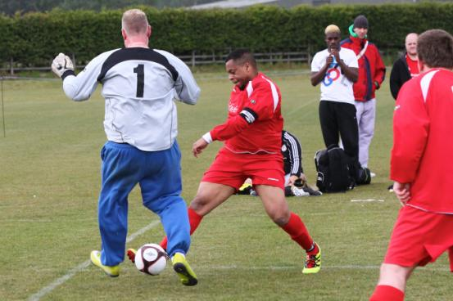
POSITIVE GOALS
27

Slide 29
Physical Health and Mental Health
Section 4
The issues
Professor Patrick Callaghan
Professor of Mental Health Nursing
28
Notes:
Warm welcome to all delegates
Special welcome and thanks to keynote speakers , workshop presenters, stall holders, artists
Thanks to Julie Grant and Comms team
Thanks to Karen Sugars and IMH team

Slide 30
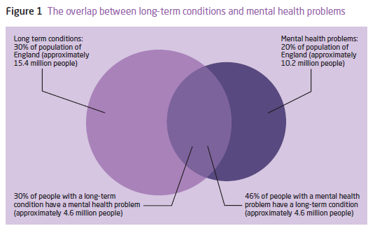
Naylor, C et al (2012) Long-term conditions and mental health problems. The King’s Fund/Centre for Mental Health
29

Slide 31
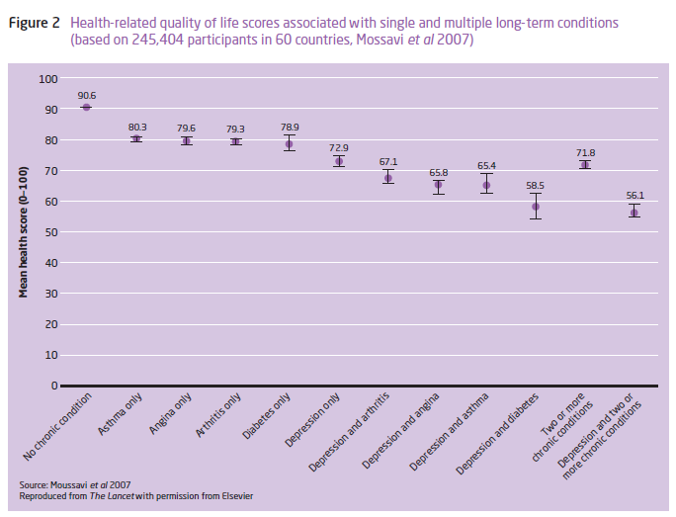
30
Mousasavi, S. Et al, (2007) Depression, chronic disease and decrements in health: results form the World Health Surveys. The Lancet, 370, 9590, 851-88

Slide 32
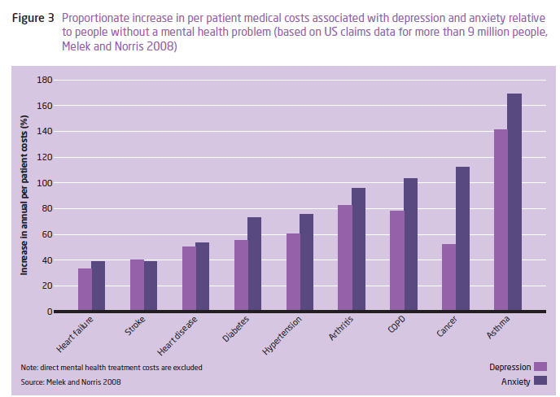
31
Melek, S. & Norris, D. (2008) Chronic conditions and Co-morbid Psychological Disorders. Seattle: MacMillan.

Slide 33
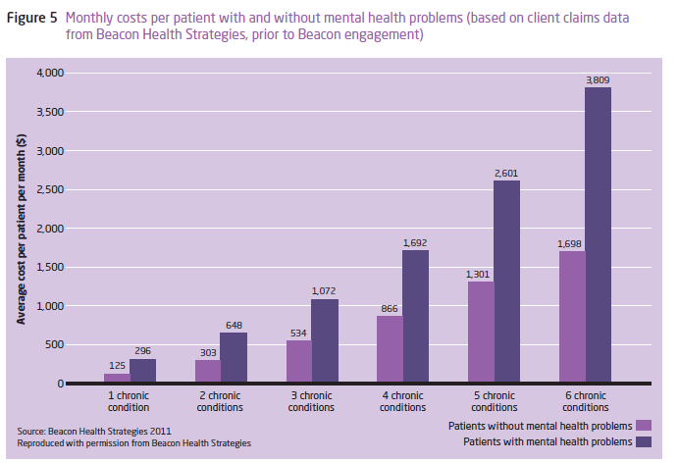
32
Naylor, C et al (2012) Long-term conditions and mental health problems. The King’s Fund/Centre for Mental Health

Slide 34
Physical Health and Mental Health
The response: A case for integrated health care?
33
Notes:
Warm welcome to all delegates
Special welcome and thanks to keynote speakers , workshop presenters, stall holders, artists
Thanks to Julie Grant and Comms team
Thanks to Karen Sugars and IMH team

Slide 35
Integrated models with promise
Detection
Self-management
Integrating mental health and primary care
Liaison mental health services in acute care
Working with voluntary sector
Harrison, et al, 2011; Naylor, et al (2012); Nice (2010) Clinical Guideline 101;
34

Slide 36
However.........
Not sure what type of integration produces better outcomes
Treatment for mental illness can increase physical health problems
Integration appears to be more than simply layering services on top of one another
Evidence-based interventions not always in use
35

Slide 37
What is Psychological Health?
36

Slide 38
Absence of ill-health
Resilience
Social capital
Self esteem
Self-efficacy
Sufficient income
Self acceptance
Huppert, F.A. (2009) Psychological Well Being: Evidence regarding its cause and consequences. Applied Psychology: Health and Well Being, 1 (2): 137-164
Callaghan, P. (2013) Health-behaviour theory. In T.Stickley & N.Wright Theoreis for mental health nursing. London: Sage p. 324-343
37

Slide 39
Psychological well being - typology
Hedonic
Joy
Happiness
Evaluative
Life satisfaction
Quality of life
Eudaimonic
Sense of purpose
Autonomy
Pleasure
Self-realisation
Social Support
38

Slide 40
39

Slide 41
40

Slide 42
Summary
41

