Slide 1
Nottinghamshire’s High Needs Block 2019/20
Presentation to Schools Forum

Slide 2
Overview and ESFA Guidance
High needs funding is provided to local authorities through the high needs block of the dedicated schools grant (DSG). Local authorities must spend that funding in line with the associated conditions of grant, and School and Early Years Finance (England) Regulations
The high needs funding system supports provision for children and young people with special educational needs and disabilities (SEND) from their early years to age 25, enabling both local authorities and institutions to meet their statutory duties under the Children and Families Act 2014.
High needs funding is also intended to support good quality AP for pre-16 pupils who, because of exclusion, illness or other reasons, cannot receive their education in mainstream or special schools.
The High Needs Block can also fund high needs services delivered directly by the authority or under a separate funding agreement with institutions (including funding devolved to institutions), as permitted by regulations.
High Needs Block 2019/20

Slide 3
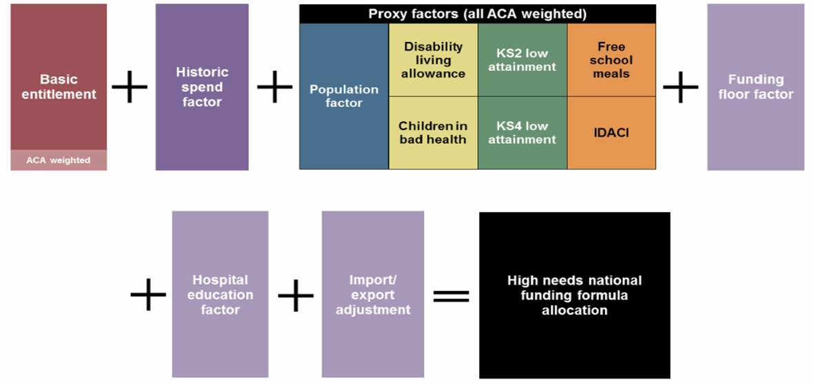
ESFA Funding of the High Needs Block
Since 2018/19 the ESFA have been calculating Local Authorities High Needs Block using a national funding formula:
High Needs Block 2019/20

Slide 4
ESFA Funding of Nottinghamshire’s High Needs Block
Nottinghamshire’s provisional High Needs Block for 2019/20 is £66.53 million. This represents an increase of £2.55 million against the 2018/19 allocation of £63.98 million.
Factor | Pupils | Per Pupil Funding | Funding
 |  | £ | £ millions
Basic Entitlement | 1,146.50 | 4016.63 | 4.605
Historic Spend Factor |  |  | 28.902
Population Factor | 157,856.00 |  | 18.573
FSM Factor | 12,960.00 |  | 3.193
IDACI Factor | 55,257.00 |  | 2.918
Bad health Factor | 816.00 |  | 2.529
Disability Factor | 6,510.00 |  | 3.332
KS4 Low Attainment Factor | 1,529.00 |  | 2.704
KS2 Low Attainment Factor | 1,672.00 |  | 2.429
Funding Floor Factor |  |  | 0.000
Import/ Export Adjustemnt | -284.50 | 6000.00 | -1.707
Formula Total Before gains Cap |  |  | 67.478
Gains Cap (at 6.09% compared to 2017/18) |  |  | -2.688
Provisional High Needs Allocation 2019/20 |  |  | 64.790
Additional Funding Announced Dec 2018 For 2019/20 |  |  | 1.737
Revised Provisional High Needs Allocation 2019/20 |  |  | 66.527
High Needs Block 2019/20

Slide 5
Nottinghamshire’s Transfer of 0.5% of Schools Block
The 2019/20 provisional High Needs Block allocations show Nottinghamshire to be funded less per head of population than all of our statistical neighbours:
Due to continued growth in financial pressures on Nottinghamshire’s High Needs Block, Schools Forum agreed to transfer 0.5% of the schools block to the High Needs Block for 2019/20. This increased Nottinghamshire’s High Needs block to £68.937 million.
High Needs Block 2019/20

Slide 6
Nottinghamshire’s Indicative Use of The High Needs Block 2019/20
Service | Budget Allocation 2019/20 £000
Special School Budgets (Including Academy place funding paid directly by ESFA) | 23,735
Special School Equipment | 323
Special School Hub | 129
Place Funding for AP, CCP and FE providers | 1,200
Mainstream Enhanced Provision | 193
Inclusion Services | 3,018
Devolved Partnership Funding | 4,257
Partnership Team | 657
SEN Home to School Transport | 1,764
Post 16 High Needs (outside of special schools and academies) | 4,469
Independent Non Maintained Schools and Alternative Provision (EHC Plan) | 12,000
Independent Non Maintained Schools and Alternative Provision (Non EHC Plan) | 1,183
Targetted HLN | 5,549
Additional family needs | 7,314
Family Network Funding | 1,117
Health Related Education Team, Physical Disability unit and Residential | 1,210
SEND Divisional Costs | 818
Total | 68,937
High Needs Block 2019/20

Slide 7
Special School and Academy Budgets £23.735 million
Nottinghamshire County Council will be funding 1,017 pupil in our Special Schools and Academies in 2019/20 using budget of £22.295 million. This represents an additional 26 places from those funded for 2018/19.
Special School budgets are made up of Core (place) funding and Top up Funding.
Core funding is £10,000 per place based on number of places to be funded.
Top up funding is agreed per pupil based on their HN banding (1-5). Pupil’s HN bandings are agreed with schools during the annual moderation process.
Schools may also be allocated a ‘setting factor’ if they meet NCC’s split site criteria.
Place funding for Academies is recouped from Nottinghamshire’s DSG and paid directly by the EFA (£3.35 million).
Nottinghamshire County Council pay top up funding for all pupils in our Special Schools and Academies. Where the child resides in another Authority NCC will recoup the funding from that Authority. Similarly OLAs will charge NCC for our Children placed in their Special Schools. Nottinghamshire are currently a net ‘exporter’ of children (Budgeted £0.766 million).
Nottinghamshire has plans to create an additional 82 places across six special schools within year at a cost of £0.674 million
High Needs Block 2019/20

Slide 8
Special School Equipment £0.323 million
This budget will be used to contribute to specialist ad hoc expenditure incurred by Nottinghamshire’s Special Schools and Academies.
Much of this expenditure would have previously been funded by the NHS but their contributions have now been withdrawn.
The budget will pay for specialist nursing, therapies and equipment.
High Needs Block 2019/20

Slide 9
Special School Hub £0.129 million
In order to create additional LA maintained places for children with SEND in Nottinghamshire, it is proposed that NCC will create two ‘Special School Hubs’.
The Hubs could be operational from September 2019.
Each Hub could educate up to five pupils at any time.
The revenue expenditure of the Hubs will be the cost of employing one teacher and two teaching assistants.
It is proposed that capital costs of setting up the hubs will be meet by the Specialist Provision Capital Grant.
High Needs Block 2019/20

Slide 10
Place Funding for AP, CCP and FE providers £1.2 million
The ESFA recoup place funding from Nottinghamshire’s High Needs Block to directly fund places in AP Academies , Commercial and Charitable Providers and Further Education Colleges that are based within Nottinghamshire.
The number of places that the ESFA to recoup is subject to the annual High Needs Place return that is completed by Nottinghamshire County Council following discussions with providers.
A breakdown of Nottinghamshire’s recouped places is below:
  £0.09 million for 9 AP Free School Places – Channelling Positivity (7) and Stone Soup Academy (2).
  £1.11 million for 185 Further Education Places – West Notts College (165) and Skills For Employment (20).
High Needs Block 2019/20

Slide 11
Mainstream Enhanced Provision £0.193 million
In order to create additional LA maintained places for children with SEND in Nottinghamshire, it is proposed that NCC will create three ‘Enhanced Provisions’ for pupils in mainstream schools.
The provision would be spread across the County and could be operational from September 2019.
Each location could educate up to five pupils at any time.
The revenue expenditure of the Hubs will be the cost of employing one teacher and two teaching assistants.
It is proposed that capital costs of setting up the hubs will be meet by the Specialist Provision Capital Grant
High Needs Block 2019/20

Slide 12
Inclusion Services £3.018 million
The Schools and Families Specialist Services (SFSS) is a team of specialist teachers and teaching assistants who are qualified to work with children and young people with severe and complex special education needs. These include hearing and visual impairments as well as autism and learning difficulties. SFSS also provides training and resources to schools, which is intended to build and enhance their capacity to support children and young people in mainstream settings. (The total DSG allocation for this team is £3.549 million of which £2.993 million is from the High Needs Block)
For 2019/20 it is proposed to add 7 district coordinators into the structure as per the outcome of the High Needs consultation
The service also holds a budget for funding specialist equipment for children and young people with sensory needs and additional ICT equipment to support inclusion. (£0.025 million).
High Needs Block 2019/20

Slide 13
Devolved Partnership Funding £4.257 million
Nottinghamshire County Council devolves funding to develop effective partnerships of schools with the aim of them working together to ensure that children with SEMH continue to be educated in Nottinghamshire’s schools and not in Alternative Provision.
For 2019/20 it is proposed that overall funding is returned to 2017/18 levels to ensure that partnerships can continue to operate effectively
  Multi School Partnerships - £0.258 million
  Primary devolved funding - £0.617 million
  Secondary devolved funding - £3.382 million
For 2019/20 it is also proposed that the formula for allocating funding to partnerships will be amended to more closely align distribution with the method used by the ESFA for allocating High Needs Funding to Local Authorities.
High Needs Block 2019/20

Slide 14
Partnership Team £0.657 million
This team employs 7.7 Personal Social and Emotional Development teaching staff to work collaboratively with School Partnerships to try to ensure that pupils are kept in their educational placement and limit the number of children excluded from schools and placed in highly expensive alternative provision.
The team also employs two pupil monitoring and support officers, 2 partnership development officers and a behaviour attendance associate.
High Needs Block 2019/20

Slide 15
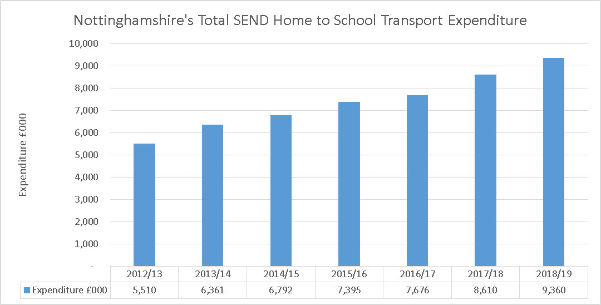
SEN Home to School Transport £1.764 million
The High Needs block of the Dedicated Schools Grant annually contributes £1.764 million to Nottinghamshire’s SEND home to school transport expenditure.
This figure was agreed by schools forum in January 2011 and due to constraints imposed by the EFA via the section 251 budget return, it has not been increased since despite transport cost increasing.
The total expenditure on SEND Home to School transport in 2018/19 is forecast to be £9.36 million
High Needs Block 2019/20

Slide 16
Post 16 High Needs (outside of special schools and academies) £4.469 million
This budget is used to pay for the education of pupils between the ages of 16 and 25 in Colleges and other FE providers.
NCC works collaboratively with the provider to agree suitable study programmes for the young people receiving further education.
The cost of further education to NCC has risen in recent years due to a combination of the trend for increasing numbers of children accessing post 16 provision and the cost of education packages rising.
High Needs Block 2019/20

Slide 17
Independent Non Maintained Schools and Alternative Provision (EHC Plan and LAC) £12 million
This budget is used to pay for education provision for children with EHCPs who can not be educated in a maintained setting.
Since 2018/19 approval to spend the High Needs Budget on alternative placements are signed off at service director level.
Funding can follow a child out of county if the most suitable provision dictates or if a LAC is placed out of county.
During the last 3 years, the numbers of young people with an Education Health and Care Plan whom it has been deemed necessary to place in a INM / AP setting have increased by 50%. At the same time, the average costs for such a placement have also increased by 50%.
High Needs Block 2019/20

Slide 18
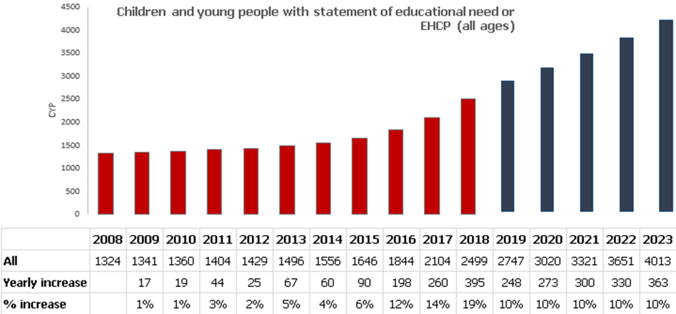
Independent Non Maintained Schools and Alternative Provision (EHC Plan and LAC) £12 million

Slide 19
Independent Non Maintained Schools and Alternative Provision (Non EHC Plan) £1.183 million
This budget pays for provision for any child without an EHCP for whom the LA commissions alternative provision. This includes children and young people permanently excluded from schools.
Funding can follow a child out of county if the most suitable provision dictates.
It should be noted that NCC consulted with schools during the Autumn term 2015 on a full cost recovery mechanism for exclusions from secondary schools. This was implemented in September 2016.
High Needs Block 2019/20

Slide 20
Targeted HLN £5.549 million
This funding is allocated to mainstream schools and academies on a per pupil basis in instances where the cost of educating a child is greater than the £6,000 allocated via notional SEN in the individual schools budget.
Funding is allocated on a per pupil basis based on the decision of a HLN panel.
For 2019/20 HLN payments will remain at 2018/19 levels
  HLN 1 - £10,000
  HLN 2 - £15,000
  HLN 3 - £19,000
High Needs Block 2019/20

Slide 21
Additional family needs £7.314 million
Funding that is allocated to families of schools on a formula basis that can be used to address the following:
  Structured learning opportunities in small groups.
  Teacher or teaching assistant support to address individual targets.
  Opportunities for peer support and interaction; and/or
  Support for equal access to break, lunchtime activities, out-of-hours learning and other opportunities.
For 2019/20 it is proposed that overall funding is returned to 2017/18 levels to ensure that families of schools can continue to operate effectively.
For 2019/20 it is proposed that the formula for allocating funding to families of schools will be amended to more closely align distribution with the method used by the ESFA for allocating High Needs Funding to Local Authorities.
High Needs Block 2019/20

Slide 22
Family Network Funding £1.117 million
Funding that is allocated to families of schools on a formula basis that can be used to address the following:
  SEN training and development.
  Management and co-ordination time for the Family SENCO (equivalent to 18 half days).
  Providing support for pupils with complex needs in mainstream settings during transition.
  It can also be used to give schools flexibility for unexpected admissions, changes in need and to give extra flexibility in resourcing pupils with more complex needs.
In 2018/19 it was decided that family’s budget allocations for AFN and FNF be merged in order to remove bureaucracy, however after discussions with families of schools and SENCOs it has been decided that separate allocations are more effective and easier for families to manage.
High Needs Block 2019/20

Slide 23
Health Related Education Team, Physical Disability unit and Residential £1.210 million
This funding is paid annually to Fountaindale Special School to run three specialist services.
  The Health Related Education Team (£0.9 million) provides short term education for pupils aged 5 – 16 who live in Nottinghamshire and who are temporarily unable to attend school for health related reasons.
  The Physical Disability Specialist Service (£0.194 million) works closely with NCC employees in assessing children’s educational and physical access support needs; planning adaptations to buildings; advising on and providing specialist equipment; training and support to school staff, including training in safe manual handling.
  The residential unit (£0.116 million) provides educational experiences which would be difficult to provide fully within the school day, or at home because of the nature of the complex needs involved. Students have access to a fully equipped flat where they can develop their skills for independence.
High Needs Block 2019/20

Slide 24
SEND Divisional Costs £0.818 million
The cost of the commissioning element of the SEND team and the Business Support staff who support the services funded by the High Needs Block and those who are required for allocation of HLN, AFN, FNF and partnership funding to schools and Academies.
High Needs Block 2019/20

Slide 25
Forecast Expenditure 2019/20
Service | Budget Allocation 2019/20 £000 | Forecast Expenditure 2019/20 £000
Special School Budgets (Including Academy place funding paid directly by ESFA) | 23,735 | 23,735
Special School Equipment | 323 | 323
Special School Hub | 129 | 129
Place Funding for AP, CCP and FE providers | 1,200 | 1,200
Mainstream Enhanced Provision | 193 | 193
Inclusion Services | 3,018 | 3,018
Devolved Partnership Funding | 4,257 | 4,257
Partnership Team | 657 | 657
SEN Home to School Transport | 1,764 | 1,764
Post 16 High Needs (outside of special schools and academies) | 4,469 | 4,859
Independent Non Maintained Schools and Alternative Provision (EHC Plan) | 12,000 | 13,857
Independent Non Maintained Schools and Alternative Provision (Non EHC Plan) | 1,183 | 1,183
Targetted HLN | 5,549 | 5,549
Additional family needs | 7,314 | 7,314
Family Network Funding | 1,117 | 1,117
Health Related Education Team, Physical Disability unit and Residential | 1,210 | 1,210
SEND Divisional Costs | 818 | 818
Total | 68,938 | 71,183
High Needs Block 2019/20

Slide 26
Forecast Expenditure 2019/20 (continued)
The purpose of this presentation is primarily to inform the Schools Forum of how Nottinghamshire County Council plans to allocate the High Needs Blocks between the services and provisions for 0-25 year with SEND in 2019/20.
The table on the previous slide illustrates that the budget available to pay for these services is not enough and based on forecast levels of growth in demand the High Needs Bock will overspend by £2.246 million in 2019/20. NB this is with the transfer of 0.5% of the schools block into the High Needs Block.
It is expected that the Non ISB reserve will end 2018/19 with a surplus balance of £1.051 which could be used to offset some of the 2019/20 but doing so would create a deficit on the reserve of £1.195 million at the end of 2019/20.
High Needs Block 2019/20

