Slide 1

Adverse Childhood Experiences (ACE’s): developing trauma informed services & support for CYP & families
Children & Families Alliance
Presentation 9.20-10.30am
Thursday 22nd November 2018
Ann Berry, Public Health & Commissioning Manager Public Health Nottinghamshire ann.berry@nottscc.gov.uk

Slide 2
Children & Families Alliance
In Nottinghamshire
Families are supported to keep their children and young people safe from harm
Children and young people are healthy and happy
Families are supported to access opportunities to achieve
Notes:
Introduction to self: Ann Berry, Registered Nurse, Teacher ,Therapist and Public Health Practitioner. I am a Public Health and Commissioning Manager in the Nottinghamshire Children’s Integrated Commissioning Hub Led by Kate Allen
I was invited to come to talk to you today about Adverse Childhood Experiences as it meet the 3 criteria of the Alliance. I understand from Karen Talbot that you are a group who wants to act for change to meet these criteria as well as sharing information and to say what I think needs to be done for Children Young People and Families in Nottinghamshire in relation to ACE’s .
The session will define Adverse Childhood Experiences, known as ACEs, take you through the science behind it, and the impact they have throughout the course of our lives life , then the developments and application.
Ill then outline an approach to consider in Nottinghamshire and there will be an opportunity for questions and a discussion

Slide 3
Adverse Childhood Experiences (ACE’s): Definition
‘Adverse Childhood Experiences (ACEs) refer to some of the most intensive and frequently occurring sources of stress that children may suffer early in life. Such experiences include multiple types of abuse; neglect; violence between parents or caregivers; other kinds of serious household dysfunction such as alcohol and substance abuse; and peer, community and collective violence.’
World Health Organisation (WHO)

Slide 4
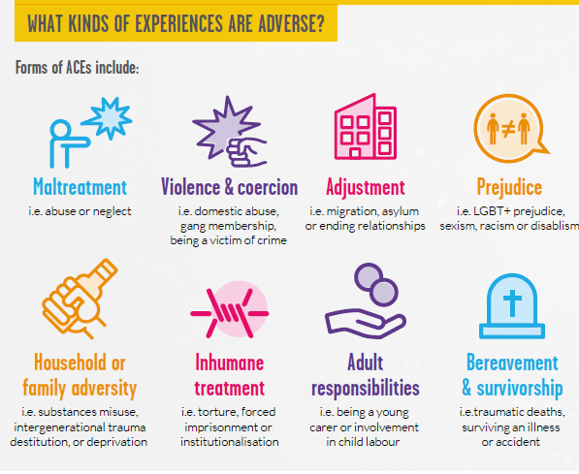

Slide 5
Commonly cited & researched ACE’s we know most about
Vincent Filetti et al (1998) : Centers for Disease Control and Prevention ACE Study
Childhood defined as 0-18 years
Active Abuse: Verbal, physical and sexual abuse
Active or passive neglect: physical and psychological neglect
Absent or not emotionally available parent(s): Parental death, divorce, substance misuse (including alcohol), mental health & attempted suicide and incarceration
A combination of Domestic Violence, Mental Health and Substance Misuse is known as the ‘toxic trio’ and this links to crime so in Nottinghamshire we are taking a ‘toxic quartet’ approach.

Slide 6
5 ACE’s Science
1.Epidemiology: a population approach
2. Neurology: trauma, toxic stress, childhood brain development & dysregulation
3.Epigenetics: ‘the body keeps the score’; commonly known as ‘above the gene’ and a chemical modification arising from historical, intergenerational trauma & sustained toxic stress.
4. Inequalities: biopsychosocial impact on physical health & emotional mental health and holds wellbeing, learning, education & financial health; ‘more ACEs=more impact’
5. Homeostasis: the brain is plastic and the body wants to heal
Adversity to Assets

Slide 7
1 Epidemiology: a population approach

Slide 8
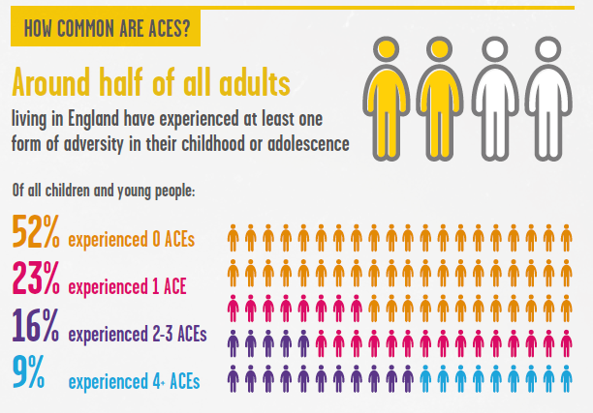
Notes:
Nottinghamshire
8.3-13.6% of UK population have 4 or more ACEs
Experience of multiple ACEs correlation to areas of greatest need
Adults in lowest income group are 3 x more likely to report 4 or more ACEs

Slide 9
The Nottinghamshire Landscape
In a population of 646,625 of people over the age of 18 years
336,245 will have experienced 0 ACE’s
291,000 will have experienced1 ACE
64,000 will have experienced 4 or more ACE’s

Slide 10
Adversity will affect learners in every class, so in every classroom…
1 in 10 will experience 4 or more ACEs
1 in 20 have been sexually abused
1 in 14 have been physically abused
1 in 5 have been exposed to domestic abuse
1 in 10 will experience neglect
1 in 3 have experienced cyber-bullying

Slide 11
2 Neurology: trauma, toxic stress & childhood brain development & dysregulation

Slide 12
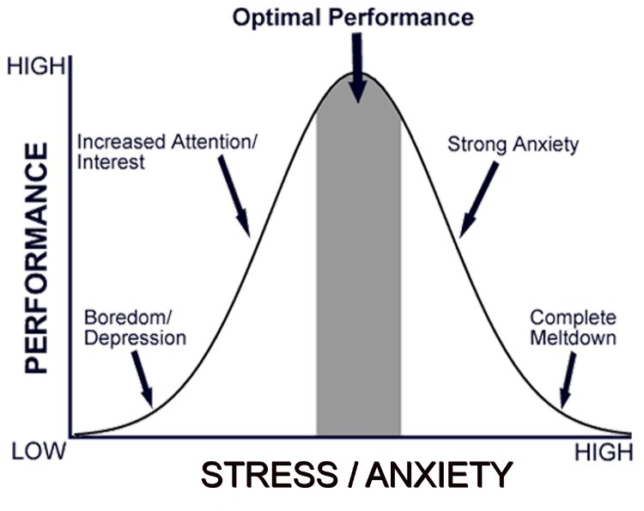
Healthy Stress Response

Slide 13
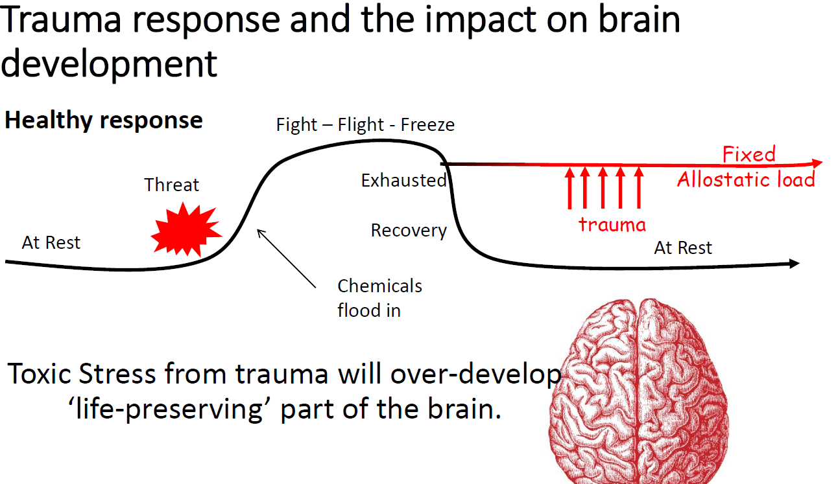
Notes:
Explain the process and that it leads to DYSREGULATION

Slide 14
The role of connection and compassion
It was believed that children can’t remember early experiences, and this may be so, but the brain and body does
Following a traumatic event, connection to others who show empathy and compassion is key in minimising the impact and process of dysregulation. This is usually the role of caregivers but if they are also the source of the toxic stress then a child has no access to this healing process

Slide 15
3 Inequalities: biopsychosocial impact on health & wellbeing, learning, education & financial health

Slide 16

ACE’s: trauma, toxic stress & the impact on the life-course.
DEATH
Early Death
Non Communicable Disease, Disability, Social Problems, Low Productivity
Adopt Health Harming Behaviour' s and Crime
LIFE COURSE
Social, Emotional and Learning Problems
Disrupted Nervous, Hormonal and Immune Development
ACEs Adverse Childhood Experiences
BIRTH
Bellis 2016 Developed from Felitti et al. 1998

Slide 17
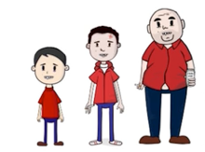
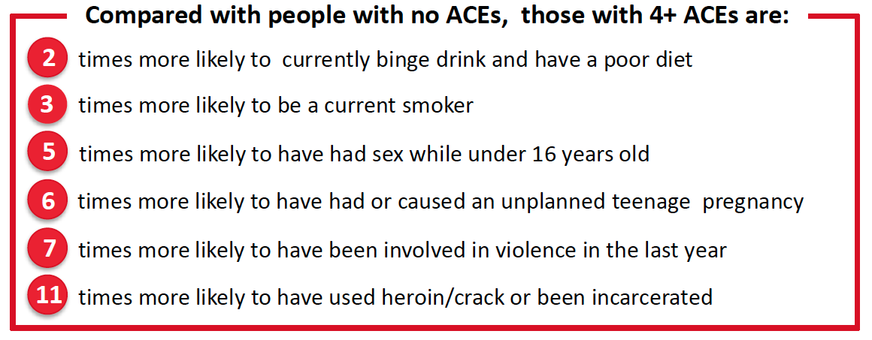
National Study of ACEs in Wales (18-69 yrs)
Bellis et al. 2015
Compared with people with no ACEs, those with 4+ ACEs were:
4
times more likely to be a high risk drinker▼35%
6
times more likely to smoke tobacco or E-cigs▼24%
11
times more likely to have smoked cannabis▼42%
16
times more likely to have used crack cocaine or heroin▼66%
20
times more likely to have been incarcerated in their life▼65%
This is independent of poverty but exacerbated by it
Bellis et al. 2015, n=2028
Notes:
Figures in green show the projected reduction in health harming behaviours if an ACEs prevention approach is implemented
People are self-medicate in their distress;
Alcohol is a relaxant , induces a sense of well-being and said to ‘take the edge off life’
Nicotine is an anti-anxiety substance
Cannabis, cocaine and heroin bring a sense of escape, joy and elation
Sex brings pleasure and a sense of connection and wellbeing with the release of dopamine in the brain
A relief from and counter to the toxic effects of stress

Slide 18
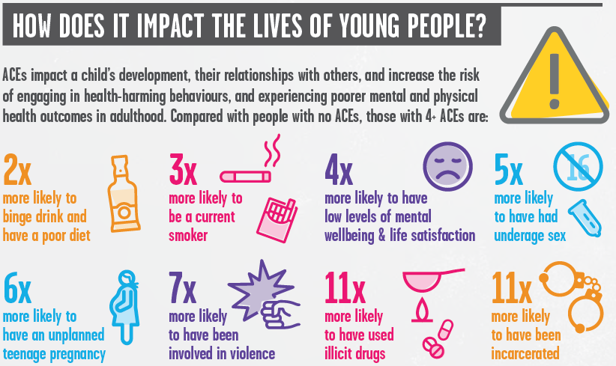
Notes:
And the adults they live with ….
So parents with a history of high ACEs - a mother 4+ ACEs and a father with 2+ ACEs means that this will impact on their relationship and they may create their own too.
The child or children are are growing up in a household where this is potentially significant dysfunction and this will impact upon them

Slide 19
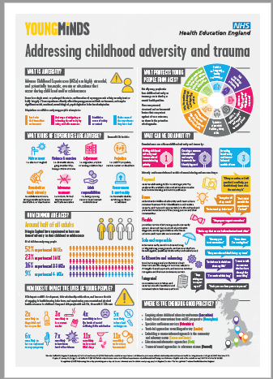
Notes:
I’ve found that this is always well received and acts as a prompt for ongoing discussions with colleagues and teams and has even been used in supervision sessions.

Slide 20


WHO: 52,000 participants from 21 countries
(Kessler et al. 2010)
The authors estimate that the absence of childhood
adversity would lead to reduction in:
22.9%
of mood disorders
31%
of anxiety disorders
41.6%
of behavioural disorders
27.5%
of substance-related disorders
29.8%
of mental health diagnosis overall
33%
of Psychosis (Varese et al 2013)
ACEs Adverse Childhood Experiences
Notes:
However this slide from a WHO – world wide research in 2010 shows the impact of the absence of ACEs would have.
I am not naïve in believing that ACEs can be irradiated ,but we can reduce them by talking about it, intervening to improve life experiences AND importantly teach self-care and parenting skills for those new parents who don’t know what ‘good’ looks like.

Slide 21
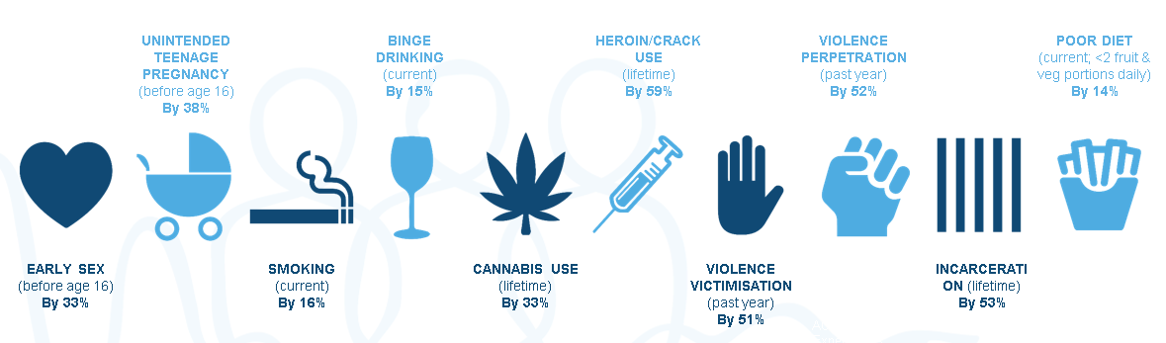
Preventing ACEs in future generations could reduce levels of:
The English national ACE study interviewed nearly 4,000 people (aged 18-69 years) from across England in 2013. Around six in ten people, who were asked to participate, agreed and we are grateful to all those who freely gave their time. The study is published in BMC MEDICINE: Bellis MA, Hughes K, Leckenby N, Perkins C, Lowey H. National household survey of adverse childhood experiences and their relationship with resilience to health-harming behaviours in England.Centre for public Health, Liverpool John Moores University – WHO Collaborating Centre for Violence Prevention – May 2014 – Web:www.cph.org.uk – Tel:0151 231 4510
Notes:
Potential: to increasing the quality and quantity of life - healthy and productive

Slide 22
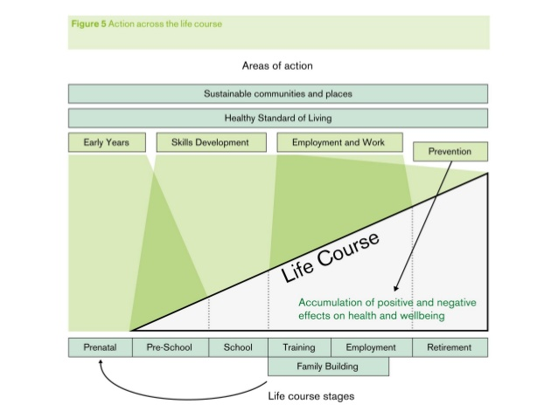
Fair Society, Healthy Lives:
The Marmot Review (2010)
Notes:
In Public Health we hold the Marmot Review in high esteem it was a ground breaking report when published in 2010
This is a pivotal slide for me in relation to working with Children parents and the ‘Family Building’ part of the life course and a crucial time to impact on the effect of ACEs

Slide 23
4 Epigenetics: historical & intergenerational trauma & toxic stress. The body keeps the score

Slide 24

Nature v Nurture/Environment
New scientific evidence to support both sides of the long standing Nature v Nurture debate
Genetics: DNA from sperm and egg
Epigenetics: commonly known as ‘above the gene’ and a chemical modification arising from historical, intergenerational trauma & sustained toxic stress.
Notes:
There are a few processes that are responsible epigenetic regulation that we know most about;
Methylation is a biochemical marker which is like a ‘do not disturb’ sign & prevents the gene from being turned on.
Histones are like ‘chastity belts’ keeping the genetic material locked up preventing the DNA transcription.
Telomeres are like ‘car bumpers’ protect the DNA but when compromised by toxic stress dysregulates this process & this leads to disease & dysfunction.
Analogy: DNA is a piece of music
The genome is like the musical notes, and the epigenetic markers are like the notations that tell you how loudly, quietly, quickly or slowly to play the notes.
There may be a notation to skip and entire section or to repeat it.
The epigenetic notations are subject to experience, to be rewritten by the environment.

Slide 25
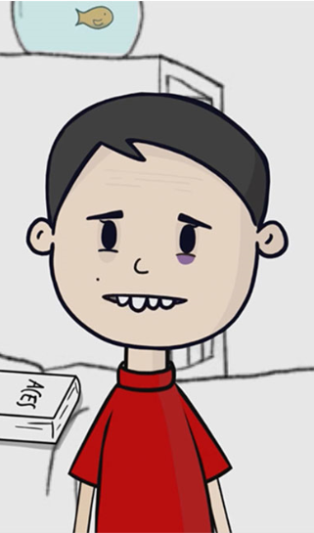
ACE’s VT (5.43mins)
http://www.aces.me.uk/in-england/

Slide 26
5 Homeostasis: the brain is plastic and the body wants to heal

Slide 27
Homeostasis
The human body has a tendency toward equilibrium between independent physiological elements
Neuroplasticity is important as it allows the brain to modify connections or rewire itself and heal
People are not broken and the body and brain can heal
Notes:
Examples of this are…
If the left hip is injured over time the body will compensate to be able to keep functioning and is likely to impact on the right lower back
By the same biomechanical process, lower back pain can in time trigger neck and shoulder pain
Following physical trauma which occludes the major arteries in the lower leg, smaller arteriols will expand to accommodate the increased blood flow
Physical touch, love , care, time and attention can soothe our emotions. Its known as The Haptic System and reinforces our sense of ourselves, where we end and the world begins. It prevents the effects of toxic stress in the brain and body.

Slide 28
Summary of Key Research Findings
Adverse Childhood Experiences are unfortunately common yet rarely asked about in routine practice (Felitti et al.,1998; Read et al 2007)
In the English National ACE study, nearly half (47%) of individuals experienced at least one ACE with 9% of the population having 4+ ACES (Bellis et al 2014.)
There is a casual and proportionate (dose-response) relationship between ACE and poor physical health, mental health & social outcomes (Skehan et al 2008; Kessler et al, 2010; Varese et al 2013; Felitti & Anda, 2014)
Biopsychosocial impact
High ACEs score & when supported with ACE informed processes there is high resilience in reducing impact

Slide 29
‘Raw Nerve’? Scepticism & Criticism
FEAR: approx. 50% of us or our children have experienced childhood adversity….so we are talking about ‘us’- it’s the ‘elephant in the room’?
Everyone is equal and have self determination - ‘its your fault that you are poor and ill’?
Currently deal with symptoms and not the root cause, offering a range of generic support like a broad spectrum antibiotic to cure all infections – expensive and irresponsible?
We currently offer support to change lifestyle choices without acknowledging that people are self medicating in their distress and then not offering an alternative – unethical?
There is now scientific evidence to support behavioural evidence – research, epidemiology, MRI scans etc.
We currently identify natural resilience but we also know that there are aspects of resilience that can be taught
People are not ‘broken’ and have an inherent ability to heal, grow, develop, survive and thrive given the right opportunities
The impact of ACEs are not unsolvable or intractable

Slide 31
Director of Public Health Report 2017-18 http://www.nottinghamshire.gov.uk/media/129275/dph-annual-report-2017-final.pdf
Recommendations
Training for all health [& social] care, education and policing staff on ACEs and impact of trauma
A systematic approach: all agencies should work together to prevent ACEs and traumatising already traumatised people
Develop trauma informed professional practice across all services
Continue to invest in programmes that support a trauma informed way of working e.g. routine enquiry and resilience building
Trauma Informed /Trauma Safe/Trauma Smart
Notes:
All healthcare, education and policing staff in Nottinghamshire should receive regular training in how to recognise and appropriately respond to signs of abuse and other types of trauma in children & young people. The ACE model should be used as a way of thinking about the impact of childhood trauma on psychological, physical and social health for both professional and public audiences
All agencies should work together to prevent ACEs in order to reduce health and social inequalities, and to address the root causes of a significant proportion of police call-outs, A&E attendances and benefits dependence in Nottinghamshire
Develop trauma informed professional practice in schools, policing and healthcare in Nottinghamshire, in order to begin to break the ACE cycle for affected children
Continue to invest in programmes that a) support at-risk parents and families to reduce the likelihood of ACEs, and b) provide positive mentorship and resilience building for young people in order to mitigate the effects of ACEs that they may have experienced

Slide 32
‘Trauma Informed’: what does that mean?
This means an organisation system or community that incorporates an understanding of the pervasiveness of trauma and its impact into every aspect of its practice and programmes. It emphasises physical and emotional safety for both providers and survivors, and creates opportunities for survivors to rebuild or maintain a sense of control and empowerment.

Slide 33
Trauma Informed Staff & Organisations
Trauma Safe Processes & Systems
Trauma Smart Practice

Slide 34
‘Start where we are & do what we can’
Policy and guidance
Future in mind: promoting, protecting and improving our children and young people’s mental health and wellbeing Department of Health and NHS England (2015) https://assets.publishing.service.gov.uk/government/uploads/system/uploads/attachment_data/file/414024/Childrens_Mental_Health.pdf
Transforming Children and Young People’s Mental Health Provision: a Green Paper Department of Health and NHS England (2017) https://assets.publishing.service.gov.uk/government/uploads/system/uploads/attachment_data/file/664855/Transforming_children_and_young_people_s_mental_health_provision.pdf
Rapid review on safeguarding to inform the Healthy Child Programme 5-19 (2018) https://assets.publishing.service.gov.uk/government/uploads/system/uploads/attachment_data/file/680391/Rapid_Review_on_Safeguarding_to_Inform_the_Healthy_Child_Programme_5_to_19.pdf
Evidence-based early years intervention (2018)
https://publications.parliament.uk/pa/cm201719/cmselect/cmsctech/506/506.pdf

Slide 35
Commissioning Interventions: a
Public Health prevention approach
PH Commissioning Response
On the horizon
HCP and FNP Programme
Resilience Building in Schools
Each Amazing Breath CIC – ‘Take 5 in Schools’ Programme Trauma safe (http://www.eachamazingbreath.org/services/take-five)
YoungMinds – ‘Academic Resilience Approach’ - Holding the child in mind (https://youngminds.org.uk/what-we-do/our-projects/academic-resilience/)
Emerging data from evaluation
EMH&WB Pathways in Schools and Colleges supporting Emotional Health
Routine enquiry and supported early disclosure in Substance Misuse
The Routine Enquiry about Adversity in Childhood (REACh) Programme (https://warrenlarkinassociates.co.uk/what-we-do/routine-enquiry-about-adversity-in-childhood-reach-programme/)
Resilience building as part of recovery and prevention of relapse
Influencing in many other projects with partners
Notes:
Public Health Prevention
University of Birmingham and MH Policy commission: ‘Investing in a Resilient Generation’ (2018)
The frequency of mental health problems in children and young people is increasing
1 in 10 children has a diagnosable mental health condition
50% of all mental health problems manifest by age 14 and 75% by age 24 year
1 in 3 diagnosed mental health conditions in adulthood relate directly to ACEs
Social exclusion and social disadvantage increase the risks of all types of mental health difficulties in children and young people, from depression to psychosis
Making the economic case for prevention:
7p in every £1 is spent on children’s mental health but only 1p of this is spent on early intervention
People with high resilience resources are 50% less likely to have a diagnosable mental health condition
There is good evidence for interventions which need adopting and scaling up
Description of current commissioning
What is on the horizon?
Description of the REACh Programme
Early disclosure
People who actively disclose wait on average 8-16 years to do so with some never disclosing it

Slide 36
So, now that we know this, what do we do?
Epidemiology: in relation to schools populations & communities: JSNA prevalence data & Schools IDACI, high EMH&WB needs (anxiety depression, conduct disorders, violence and aggression and ADHD) & poverty
PHE East Midlands may be able to support this
Neurology: What does that feel like? How does it present? Consider that the behaviour arising from trauma is a normal natural response,
Consider policy and processes and review through an ACEs lens and prevent traumatising already traumatised children
Build on existing good practice, tools and services through an ACEs lens and make appropriate modifications

Slide 37
This is how dysregulation feels
‘It’s like wearing a pair of headphones with AC/DC music blasting in my ears, while wearing somebody else’s Coke-bottle glasses that make everything blurry. I have to pretend that I feel fine and that I am “in” the conversation or that I am concentrating and ready to learn.
I feel disconnected, but I try to say things connected people would say. I have to think about how to hold my face so it looks appropriate to whatever the other person is saying or what is happening around me or expected of me. Only I can’t really see what is happening and hear what they’re saying, because the noise in my head is so loud…’
Secondary school student (2018)

Slide 38
Trauma Informed Primary Schools
& Edu-care
A Prevention & Early Intervention Strategy
A whole schools community approach: staff & pupils, parents/carers & children with the expressed aim to build capacity to cope in adversity
Addressing well-being in the environment and use of The EMH&WB Schools Pathways
Whole schools resilience building taught techniques AND daily practice for staff & pupils (breathing & movement, meditation and quiet time)
Routine/targeted enquiry about ACEs for early disclosure and early intervention for the most impact in the short and long term
Intergenerational ACE aware trauma informed parenting programmes
Measuring impact and outcomes
Notes:
So, lets look at potential work schools and supporting edu-care
There is a developing interest from schools in the county to become trauma informed -‘A Trauma Informed School’
Discussions with exec heads, heads, the SEND co-ord and ELSA trained staff have led to greater knowledge and understanding .
They have looked at their schools needs and resources and have planned to make incremental changes toward a trauma informed school
RESOURCES and options
Somethings are FREE of cost to implement - CREATIVE & INNOVATIVE
Some have a FINANCIAL cost implications but low cost per pupil
Some are INNOVATIVE and BOLD
Impact on
Attendance
Attention
Behaviour
Relationships
Agrression and violence
Inclusion
Achievement

Slide 39
Trauma-sensitive?
‘The term “trauma-sensitive” school/college describes a school/college in which all students feel safe, welcomed, and supported and where addressing trauma’s impact on learning on a school/college-wide basis is at the center of its educational mission. The focus is on creating a whole-school culture that serves as a foundation for all students/learners to learn and experience success at school/college.’
Trauma and Learning Policy Initiative (TLPI)

Slide 40
Why trauma-sensitive?
Toxic-stress caused by unsafe home or abusive parent is damaging to health & wellbeing
Short-term a child who is in ‘fight, flight or freeze’ mode, will struggle to self-regulate and cannot learn
They are hyper-vigilant to threat, so over-react and live in a state of fear
Punishing ‘bad’ behaviour doesn't work – it just compounds the trauma
Notes:
Traumatising already traumatised people
Exclusion isolates and further isolates already isolated people

Slide 41
Trauma-sensitive schools
Helping traumatised pupils/students and learners learn in the classroom should be subject of educational reform
Trauma sensitive schools/colleges can buffer the impact of the ACEs children experience at home
Children and young people need love – unconditionally; people need love and respect – teachers/lecturers are often the only adult in a vulnerable isolated persons life that can offer that. Acting in ‘loco-parentis’
Whole school/college approach is required – a change in culture

Slide 42
Loco-parentis
The term in loco parentis, Latin for "in the place of a parent" refers to the legal responsibility of a person or organisation to take on some of the functions and responsibilities of a parent. Originally derived from English common law, it is applied in two separate areas of the law.
First, it allows institutions such as colleges and schools to act in the best interests of the students as they see fit, although not allowing what would be considered violations of the students' civil liberties.
Consider our role and actions in this context

Slide 43
Trauma-sensitive schools: key ingredients
The teaching staff have to be ready to change: if they want to cling onto punitive measures & they are burnt out - it is not going to work
Be honest, is there some preparation work to do?
Readiness assessment is key - use the REACh/TEACh 5 step model
Building strong caring relationships with children – ’in loco parentis’
Holding to account with compassion – not punishment
Then move into ‘ACEs to Assets’ or ‘resilience trumps ACEs’ phase

Slide 44
Asking the right questions
What’s happened to you?
rather than
What’s wrong with you?

Slide 45
What do does Capacity Building mean?
Your capacity for something is your ability to do it, or the amount of it that you are able to do.
Then measuring the nuances and the impact with the intervention

Slide 46
What is the prize?
Learning how to get along with others is crucial
Self regulation, self soothing, reciprocation, self appreciation compassion/self-compassion & responsibility are the skills that need to be learned.
Better safety, emotional wellbeing, & resilience does not always equal better test scores! But does build well-rounded individuals who thrive!
But, these factors predict success in adult life better than test scores at school/college…

Slide 47
Enabling and measuring success
‘The most powerful childhood predictor of adult life-satisfaction is the child's emotional health, followed by the child's conduct. The least powerful predictor is the child's intellectual development. This may have implications for educational policy.’
Layard, R., Clark, A. E., Cornaglia, F., Powdthavee, N. and Vernoit, J. (2014), What Predicts a Successful Life? A Life-course Model of Well-being. Econ J, 124: F720–F738. doi:10.1111/ecoj.12170

Slide 48
Summary: getting it right
Raise Awareness
Work across sectors
Consider ACEs in every situation
Establish routine enquiry
Tackle parental and family risk factors
Build Resilience
Collect data and advance the science

Slide 49
So, lets start where we are
& do what we can…
Vision
‘What we need in Nottinghamshire is compassion in an education public care and protection system that stands in awe of the burdens those children, young people and families with both high adverse experiences in childhood and poverty have to carry, rather than stand in judgement of the way that they carry them.’
Ann Berry (2018)

Slide 50

Questions
& discussion
Notes:
I hope you have found this presentation interesting and food for thought., consider the work we could do in Nottinghamshire for our children young people and families.
This PPP will be circulated and I’ve put some links to more information and brief VT clips from some of the researchers developers and implementers of this work FYI
Karen has my contact details if you have any further thoughts comments or questions I can help with.
Thank you for your questions, time and attention this morning.

Slide 51
USA: Research & application (from 1998)
Research: original Research by Filetti et al, in 1998
Dr Vincent Filletti (Physician) and Dr Robert Anda (Physician & Epidemiologist);
Application: Filetti, developed & used routine enquiry as part of health checks with adults in privately funded healthcare clinics
Anda Parenting Programmes (Triple P)
Dr Nadine Burke-Harris, Paediatrician & Public Health Consultant using Routine Enquiry with CYP & Families in highly deprived and traumatised communities

Slide 52
UK: Research & application (from 2006)
Research: Public Health Wales and Public Health England ACE’s Report (2014) & VT (2017) Dr Mark Bellis, et al. Dr Warren Larkin, Clinical Lead DOH ACEs
Guidance: Future in Mind (2015), Green Paper on Children’s Mental Health (2017& 2018), Rapid Review on safeguarding to inform the HCP (2018) & Evidence-based early years intervention ( 2018)
Application: Resilience Building in Schools Programmes (NCC 2016), EMH&WB in Schools & Colleges Pathways (NCC 2018)
Routine Enquiry & Targeted Enquiry about ACEs, e.g. Dr Warren Larkin (The REACh and TEACh Modes)
Parenting Programmes through an ACEs lens, e.g. Dr Robert Anda and Matt Buttery (Triple P Programmes)

Slide 53
If you want to know more….
Additional Media Resources & Information
USA
Vincent Filletti, Director of the California Institutes of Preventive Medicine, ‘Reflections on the Adverse Childhood Experiences (ACE) Study’ - YOU TUBE (2016): https://www.youtube.com/watch?v=-ns8ko9-ljU
Dr Nadine Burke-Harris, Founder and CEO of the Center for Youth Wellness, ‘How trauma affects health across the lifetime’ - TED MED (2014): https://www.ted.com/talks/nadine_burke_harris_how_childhood_trauma_affects_health_across_a_lifetime
UK
Harry Burns, What Causes Wellness (2014) Director of Global Public Health and is based in the International Public Policy He is the chair of the Scottish government’s review into targets for health and social care and was Chief Medical Officer for Scotland until 2014. TEDxGlasgow: https://www.youtube.com/watch?v=yEh3JG74C6s
PH England and PH Wales supported by the Welsh Govt, Mark Bellis, Warren Larkin - ACEs VT (2017): http://www.aces.me.uk/in-england/

