Slide 1

Safety in Schools
Thursday 27th September 2018

Slide 2
Sarah Lee – Team Manager Tackling Emerging Threats to Children

Slide 3





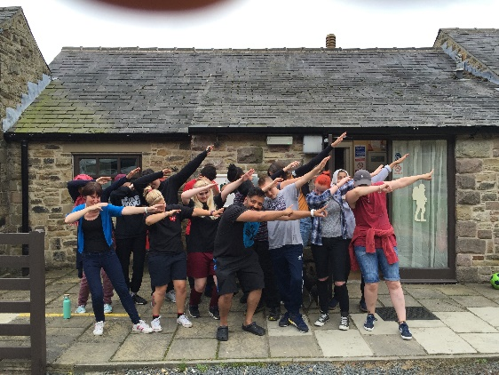

Tackling Emerging Threats to Children/School Health Hub

Slide 4
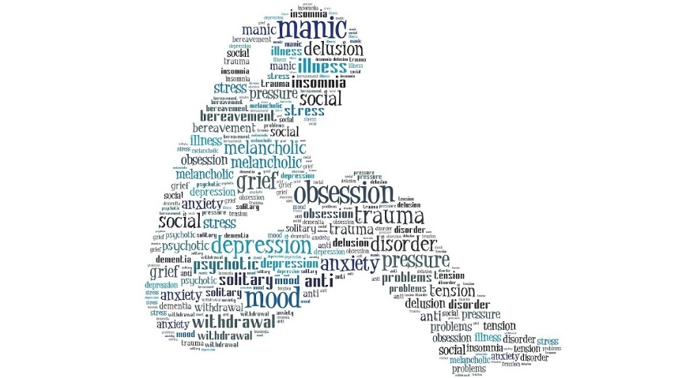
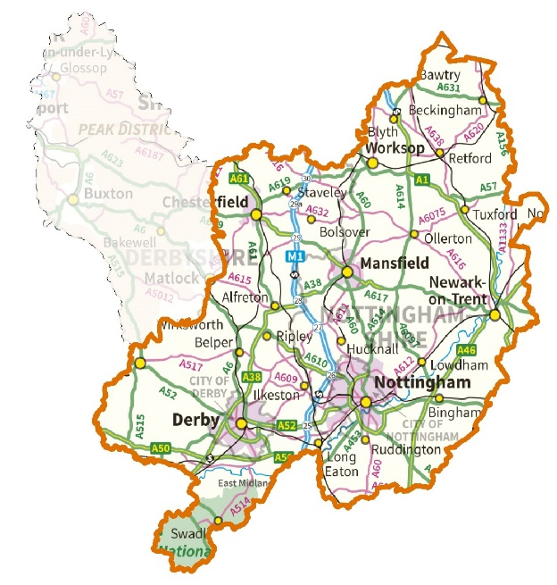





Main concerns

Slide 5
Leah Sareen
Programme Officer Communities Team,
Place Department

Slide 6


Resilience and Safety Education
Local Improvement Scheme
Children Young people funded projects
Summer Playschemes
Talented Athlete Schemes
N.C.C Authority Lead for Prevent Duty & Joint Chair for Channel panel
N.C.C Chair
Youth Crime Prevention Advisory Group
Vice Chair National Safety Education Committee

Slide 7
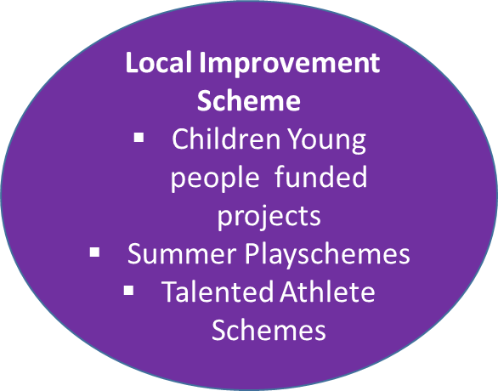
Local Improvement Scheme L.I.S Fund: 400 + Community projects applied and 220 funded: Youth, Community, Play, Diversionary, Sport, Heritage
Safety Education outcome: safe delivery, Safe guarding in place, robust monitoring, opportunity for wide communication reach with engaged children, young people and families.

Slide 8
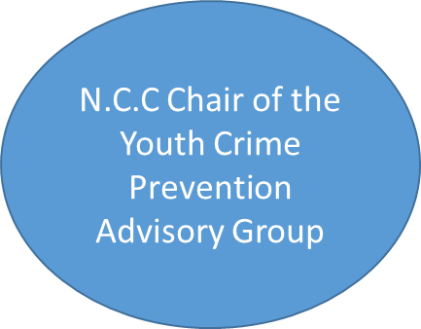
Informed by practitioners working with children, young people and families, to share best practice, pool resources and providing a platform for young people to have a voice and influence at a local and national level.
40+ Partners
23+ Links with Strategic Groups
1000’s of children and young people
Outcomes:
National Crimebeat Awards
Dragon’s Den Style Project
Youth Commissioners
I Pledge and the Justice Project
Take Five

Slide 9
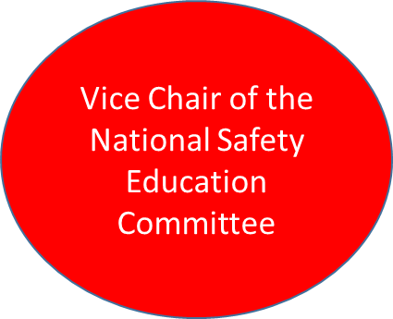
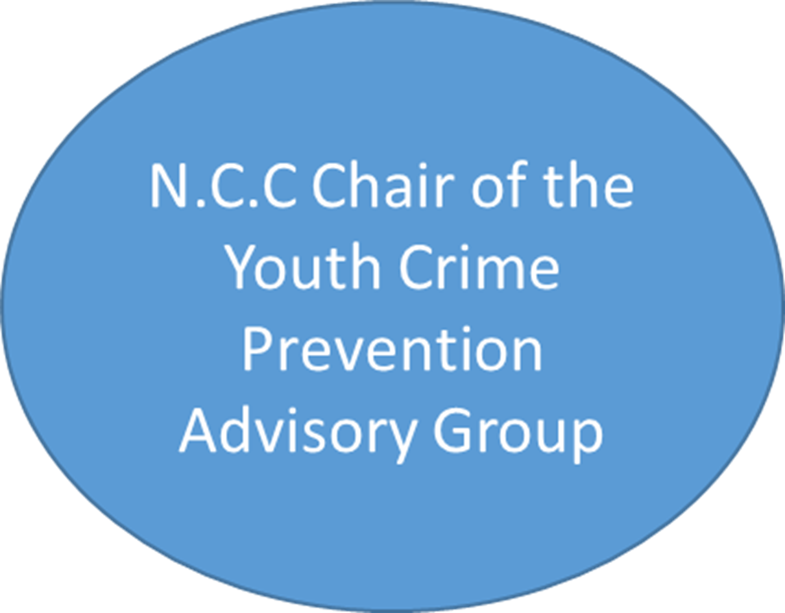
Local High Quality Safety Education tackling range of issues; bullying, knife crime, water safety, fire safety, prevent. Strength based approach building resilience with individuals and communities.
Access to best practice nationally to High Quality Safety Education and National platform to showcase Nottinghamshire best practice. Currently developing next 10yr National Strategy, Notts included as Case Study.

Slide 10
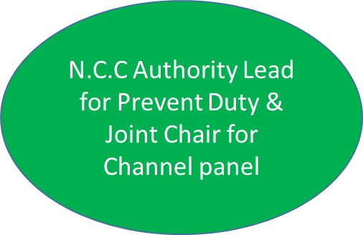
Currently reviewing and up-dating delivery plan for County and Districts. Communicating with all Service Leads. Reviewing Training and links with Safe Guarding.
Channel panel joint Chair with City and central point of contact for Local authority and liaison with districts. Reviewing referral pathway. Two week Channel panel meetings.
Safety Education starts with prevention and building resilience, working with colleagues to ensure universal messages include the most vulnerable children and young people.

Slide 11
Take Five Case Study
https://vimeo.com/248344492

Slide 12

SAFETY IN SCHOOLS

Slide 13
What we do to keep
children safe ?
Delivery of key messages
SEIOs
Mini Police / cadets
Community engagement / clubs.
Working with others
Training
Safety zone
Evaluation

Slide 14
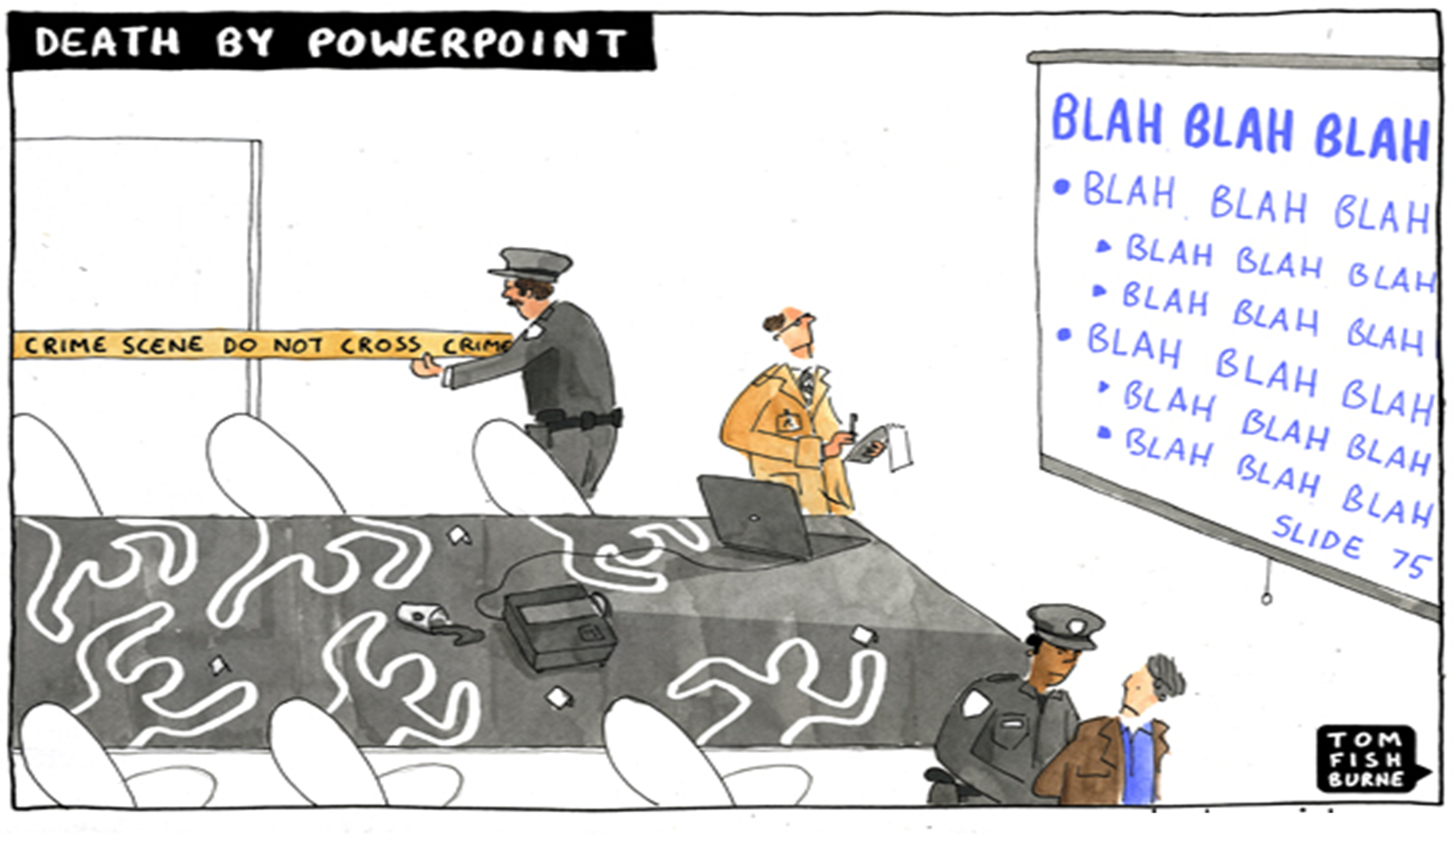

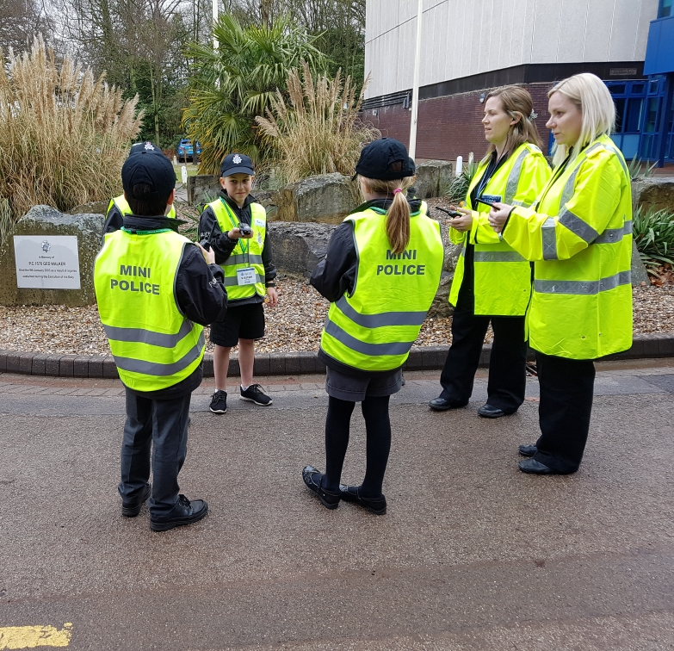
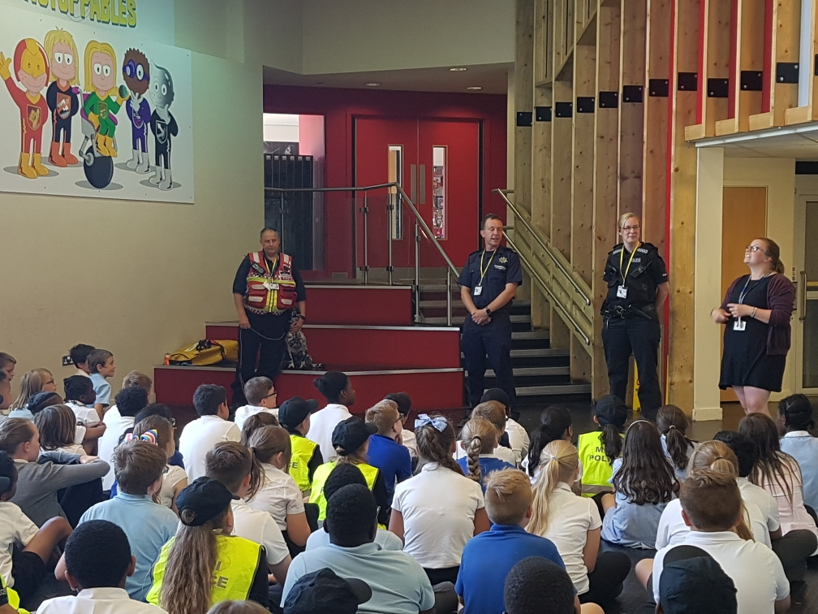
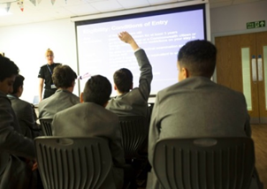

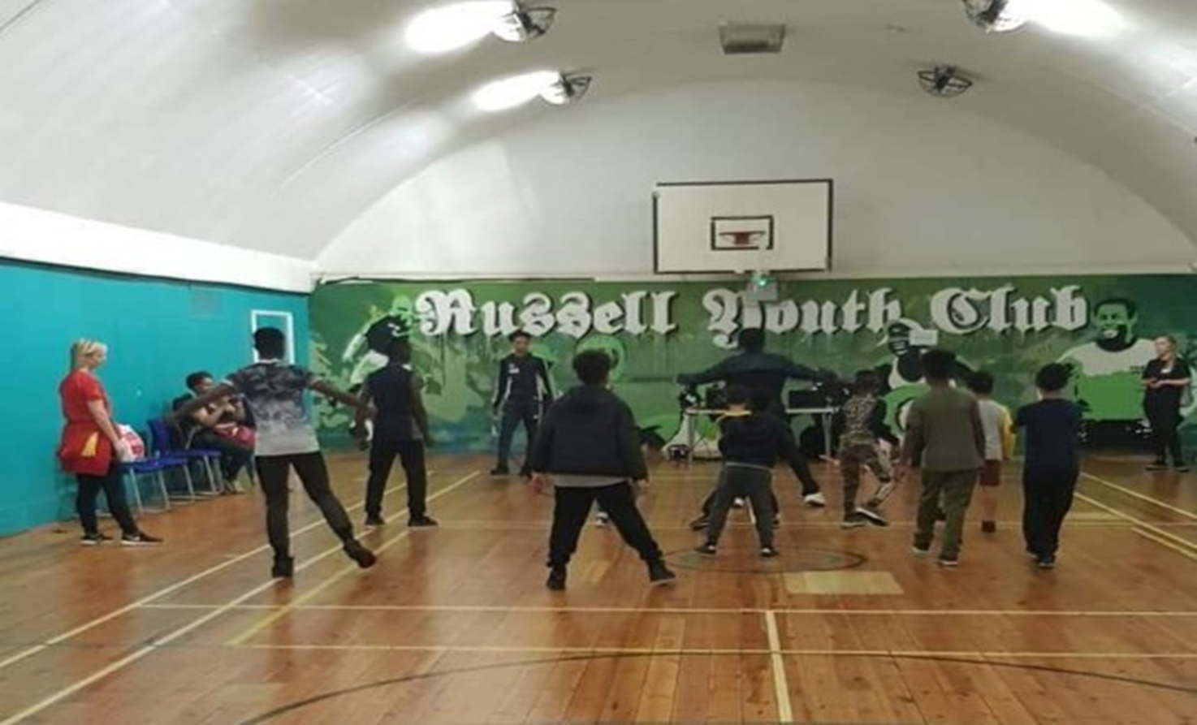

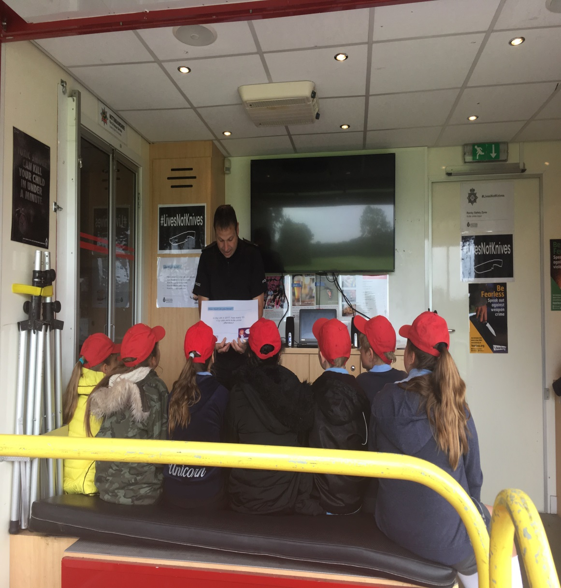
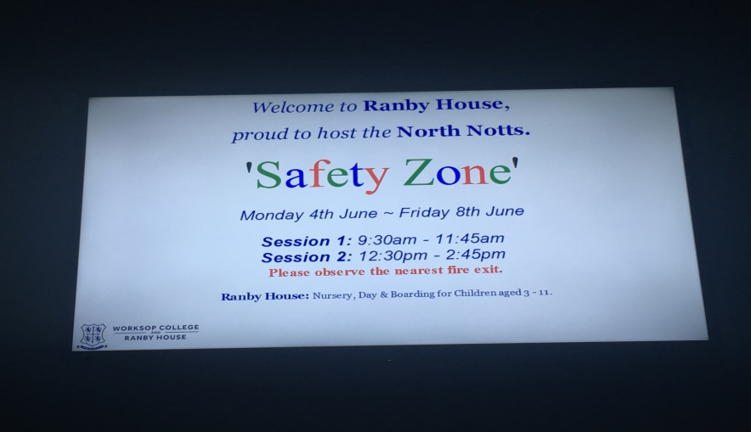


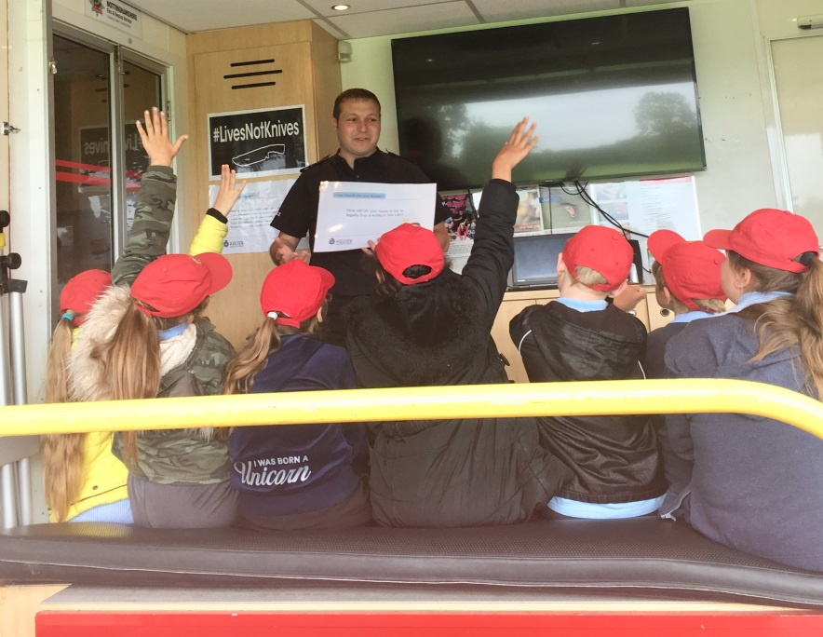


Slide 15


Slide 16
Support for existing high impact initiatives
How can we all improve communications about what TETC team do?
Strategic steer & support for YCPAG
Our asks….
Better ways to avoid duplication & build capacity
Best contact in schools? Heads get too many emails
Any other schools we should be in?

