Slide 1
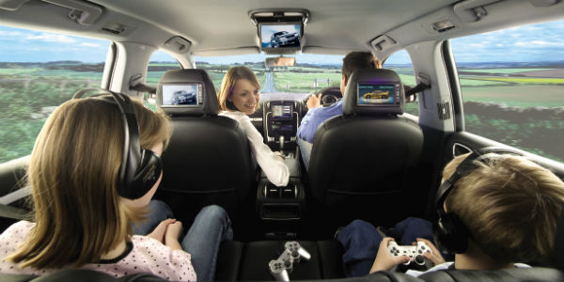
In Car Safety

Slide 2
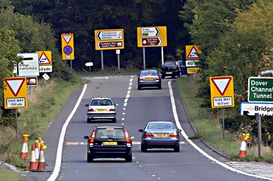
Drivers have a lot to look out for when they are driving:
Busy junctions or roundabouts
Cyclists and pedestrians
Road works
Road signs
So, they don’t need distractions from passengers

Slide 3
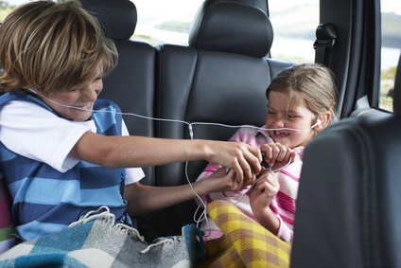
So, hands up if you have ever
Argued with your brother or sister in the car
Kicked the back of the drivers seat
Changed the music or radio station
Complained because you are bored
Unfastened your seatbelt whilst the car is moving
Opened the windows without permission

Slide 4
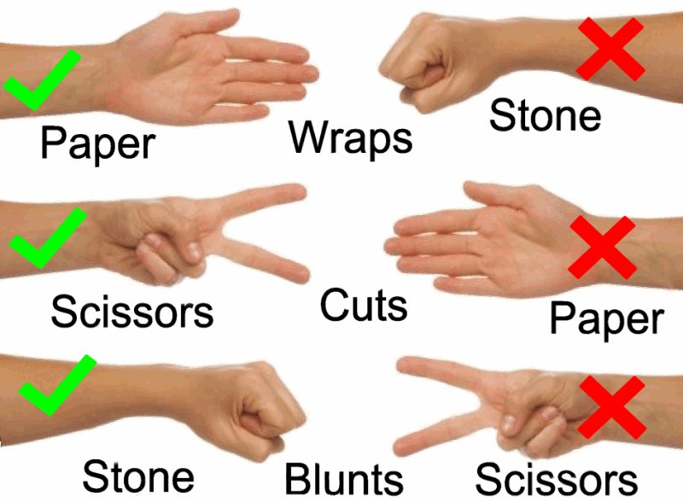
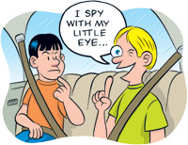
How can we help?
We can help to prevent boredom ?
Play I Spy, or
Rock Paper Scissors
Take a book to read
Play a game on your tablet or phone (with headphones if it’s noisy)

Slide 5
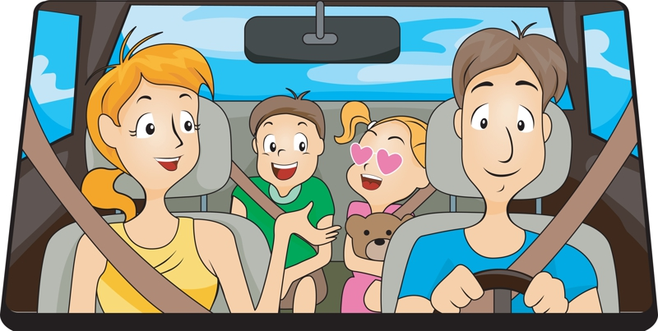
How can we help?
We should always wear our seatbelts, even if it’s only a short journey
You will also help the driver if you check that other people in the car are wearing theirs

Slide 6
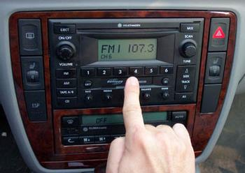
How can we help?
We shouldn’t touch any controls without the drivers permission.
This includes:
The heating
Windows
The radio, or whatever music is playing

Slide 7
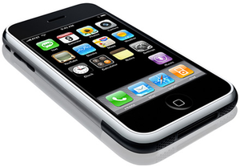
How can we help?
Drivers should never use a hand held mobile phone. It’s against the law and it’s dangerous
The mobile phone should be out the way. In a bag or in the glove box
The law changed on March 1st. Ask the drivers at home if they know that there is a bigger fine and more points

Slide 8
You can help to keep your car journey safe

Slide 9
In Car Safety
Thank You!

