Slide 1
The Green Cross Code

Slide 2

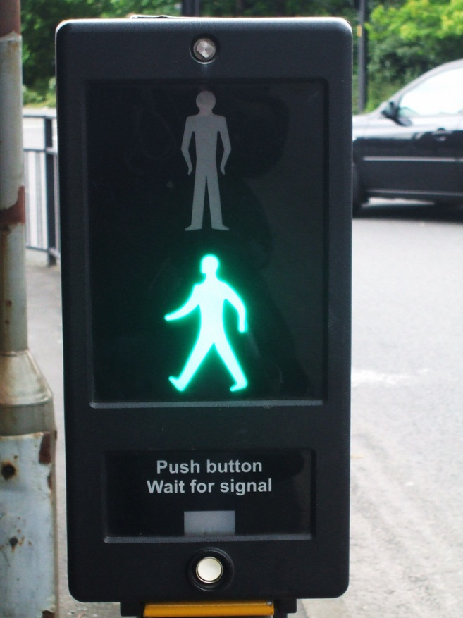
Crossing the road can be dangerous!
The Green Cross Code will help you remember how to cross the road safely
Notes:
When we are out and about we often have to cross roads. Crossing the road can be dangerous, but if we learn and remember the Green Cross Code it will help us to cross the road safely.

Slide 3
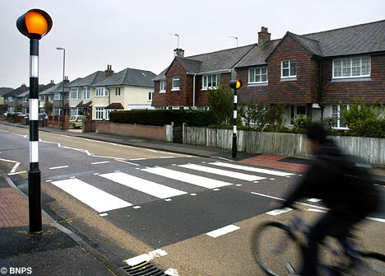
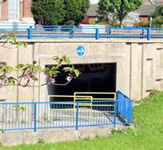
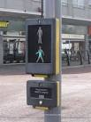
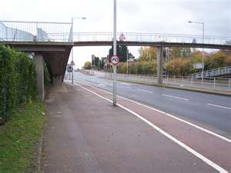
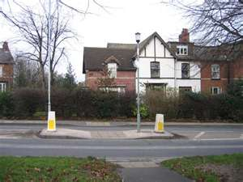
First find a safe place to cross
Always think about where you cross the road
If a crossing is provided use it
Notes:
The first thing to do is find a safe place to cross. If there is a crossing to help you always use it. Puffin crossings, zebra crossings, central refuges, footbridges and subways are all safer places to cross. You still need to take care and make sure all the traffic has stopped before crossing.

Slide 4
First find a safe place to cross
If there isn’t a crossing, find a space without parked cars where you can see in both directions
Make sure it is clear on the other side of the road
Notes:
If there isn’t a crossing near where you want to cross, try to find a space without parked cars where you can see clearly in all directions. Make sure it is clear on both side of the road.
Try not to cross in between parked cars.

Slide 5

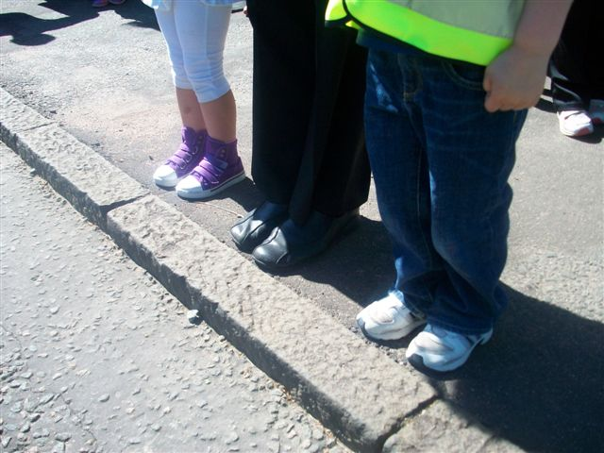
Stop! - Just before you get to the kerb
Notes:
When you have found a place to cross, always stop. Stop just before the kerb, where you are protected from passing traffic, but you can see clearly in all directions.

Slide 6


Look all around for traffic and listen
Look All Around
Listen as well because sometimes you hear traffic before you see it
Notes:
Always look all around, in all directions for traffic. Make sure you double check for cyclists as well as vehicles. Listen as well, you can often hear traffic coming before you can see it.

Slide 7
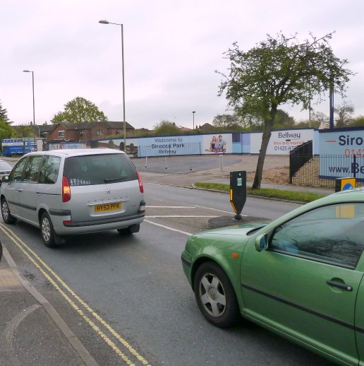
If traffic is coming let it pass
Then, look all around and listen again
Wait until you are sure there is a big enough gap in the traffic for you to safely reach the other side
Notes:
If traffic is coming let it pass. Look all around again and keep listening. Wait until you are certain there is a big enough gap in the traffic for you to safely reach the other side in plenty of time. Keep looking and listening. Remember even if traffic is a long way off, it can be approaching very quickly

Slide 8
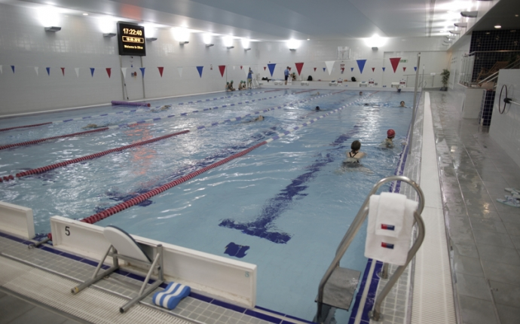
If traffic is coming let it pass
Remember that even if traffic is a long way off, it could be approaching very quickly
At 30mph it takes around 23 metres to stop a car
That’s almost the length of a swimming pool
Notes:
Remember that even if traffic looks a long way off, it can be approaching very quickly. Also when a driver starts to brake the car does not stop straight away. If a car is travelling at 30 miles per hour, then it will take about 23 metres to stop. A swimming pool is 25 metres, so always remember that it will take about the length of a swimming pool for a car to stop.

Slide 9
When it is safe, go straight across the road
Do not run
Keep looking and listening for traffic
Bikes and motorbikes are harder to see, so be extra careful
Go straight across, not diagonally
Notes:
When you are sure it is safe to do so, walk straight across the road to the other side. Do not run. Keep looking and listening as you cross. Never walk diagonally across the road.

Slide 10
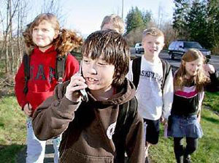
Don’t Get Distracted
Concentrate on the road – and make sure your friends do
Never use a phone
Take your headphones out
Give the road your full attention
Notes:
It is really easy to get distracted when you are crossing the road. Friends, phones and music are just a few of the things that can take your mind off the traffic. What ever you are doing can wait until you are safely away from the traffic – always remember to give the road your full attention, especially when you are crossing the road.

Slide 11
The Green Cross Code
Thank You!

