Slide 1
Be Safe Be Seen

Slide 2
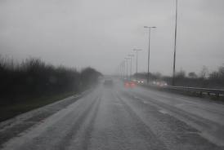
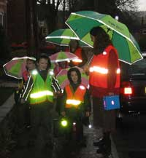
It’s that time of year again!
Autumn and winter days can be dark and gloomy
So, if you are walking or cycling you need to be seen by drivers to help keep you safe
Notes:
We can’t avoid using the roads because it’s dark, or the weather is not good, but are we likely to be at an increased risk if other road users cannot see us.

Slide 3
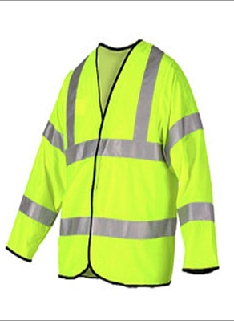
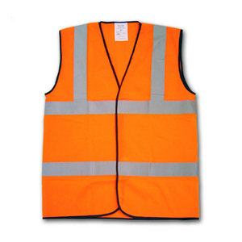
What can we do to help us be seen?
Well, we can start by wearing high visibility clothing, which has two materials to help us
Fluorescent material that shows up bright during the day
Reflective strips that show up in car headlights when it’s dull or dark
Notes:
High visibility clothing is the answer - it’s not just jackets and tabards. Fluorescent materials and reflective strips can be found on all sorts of clothing. Some of it can be quite trendy.

Slide 4

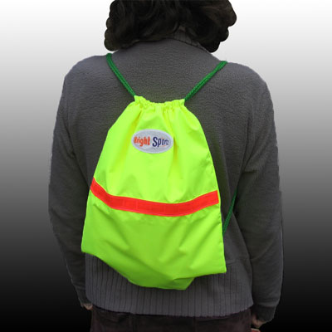
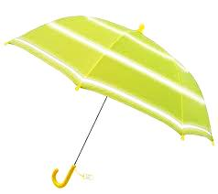
There are other things we can wear, or carry….
We could add reflective stickers or badges to our clothes, hats or bags
Carry a bag made of high vis materials
A high vis umbrella is good when it rains
Notes:
There are also lot’s of accessories.

Slide 5
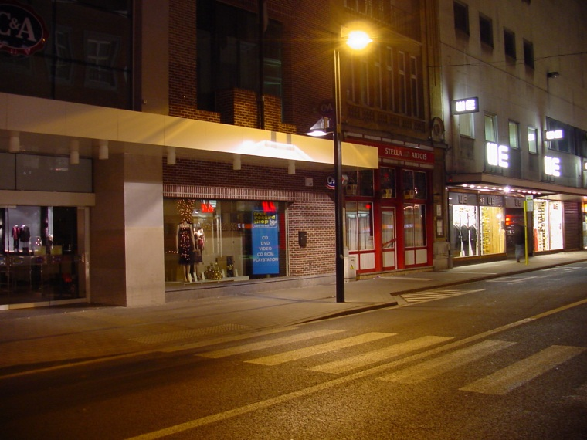
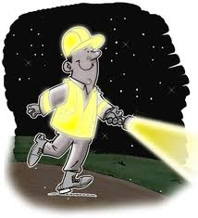
And there are things we can do
Cross at bright places if you can. Puffin and zebra crossings are usually in lit up areas.
Take a torch if you are on poorly lit roads
Notes:
If it’s dark or gloomy well lit crossings are best, but if there isn’t one nearby a well lit stretch of road is the next best thing. When we’re out on country roads we usually find there are fewer streetlights, if any. So carry a torch.

Slide 6
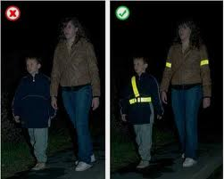
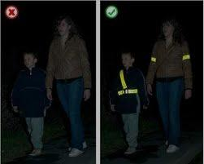
Now you see them
Now you don’t!
Notes:
High visibility clothing really does make a difference, as you can see in these pictures.

Slide 7
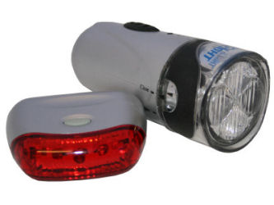
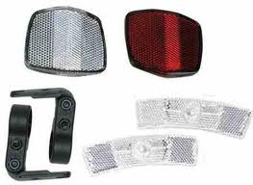
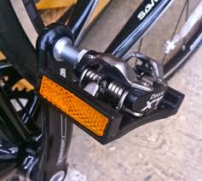
What about when we are on our bike?
Lights
Front and back of course
Reflectors
Front, back, on the wheels and the pedals
Notes:
It makes sense to make sure our bikes are fitted with things to help other road users see us. In fact it’s silly not to.

Slide 8
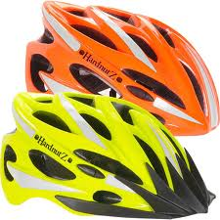
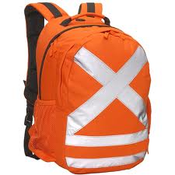
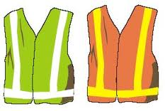
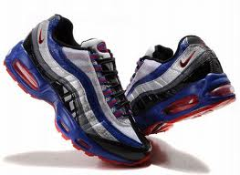
What’s good for us to wear when we are cycling?
Ruck sack If you carry one, make sure it’s high vis
A high vis Helmet
Trainers with reflective strips
High vis clothing
Notes:
Then of course we need to think about what we wear when we are on our bikes.

Slide 9
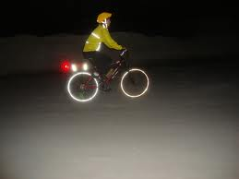
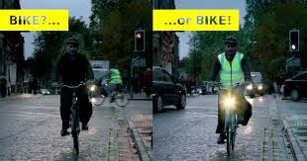
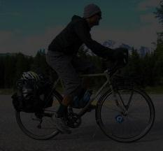
Now you see him…
Now you
don’t!
Notes:
Have you ever been in somebody’s car when they’ve commented on nearly not seeing a cyclist? See the difference that the right clothes and accessories can make.

Slide 10
Be Safe Be Seen
Thank You!

