Slide 1
Introducing a common approach to assessment and planning
Jon Hawketts
Group Manager, Quality & Improvement

Slide 2
Nottinghamshire Assessment Toolkit
Nottinghamshire Assessment Principles
‘Nottinghamshire branded’ assessment tools and guidance
One assessment form – on Frameworki case recording system
One Consent Form / Information Leaflet
Developed by early help and social care colleagues for use by their practitioners …
Family Service from November 2015
CSC from the introduction of the SA in early 2016 (principles and assessment tools available from November 2015)

Slide 3
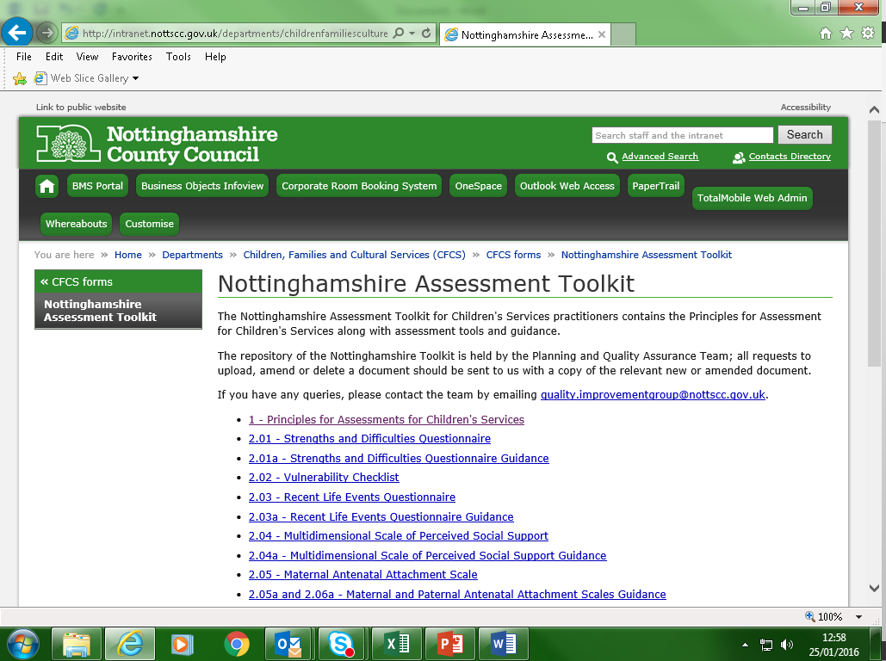
http://intranet.nottscc.gov.uk/departments/childrenfamiliesculture/forms/nottinghamshire-assessment-toolkit/

Slide 4
Assessment Principles
The welfare of the child is paramount
Assessments are child-focussed and family-based
Assessments are consent based
Assessments are part of one continuing process
Assessments are proportionate
Assessments promote change
Assessments are holistic
Assessments are completed by skilled practitioners

Slide 5
Initial Toolkit
Freely available, non-copyrighted tools
Generic assessment tools
Already used by practitioners and evidenced to be effective
Process in place to refine and add to toolkit
Specific tools to support specialist assessments
Interventions toolkit?

Slide 6
What’s in the initial toolkit?
Strengths and Difficulties Questionnaire & Guidance
Vulnerability Check-list
Recent Life Events Questionnaire & Guidance
Multidimensional Scale of Perceived Social Support & Guidance
Maternal Antenatal Attachment Scale & Guidance
Paternal Antenatal Attachment Scale & Guidance
Genogram Assessment & Guidance
Ecomap Assessment & Guidance
Parenting Daily Hassles Scale & Guidance
Home Conditions Assessment & Guidance
Family Activity Scale & Guidance
Adolescent Wellbeing Questionnaire & Guidance
Adult Wellbeing Questionnaire & Guidance
Alcohol Use Questionnaire & Guidance
Three Houses – Signs of Safety Assessment & Guidance
Wizard or Fairy – Signs of Safety Assessment & Guidance

Slide 7
How will it all work …
Tools, forms, guidance etc. is available on-line
forms on-line; OneSpace
Practitioner Portal to be developed for partners?
… and off-line, too, e.g. via tablet devices
Practitioners pick the appropriate tool/s for each case from the ‘approved Nottinghamshire toolkit’
Consistency of approach
Toolkit to be promoted to staff via:
Induction process for new staff; and
The children’s workforce development offer

Slide 8
Part of the ‘master plan’ …
Integrating our systems, processes and planning alongside the integration of our services
common approach to assessment and planning
… plus
mobilisation of social work and early help practitioners
establishing Frameworki to be the single case recording system across children’s services
developing the children’s workforce

Slide 9
Our Ambition
All EH and SW practitioners using the same form of assessment for their work with children & families 
… and selecting from the same set of assessment and intervention tools 
… and all recording their casework on the same system – Frameworki / Mosaic 
… and all using tablet devices to record information on to the system ‘on-the-job’ 
… and in the meantime, to incorporate case holding practitioners from SEND and other parts of the ‘children’s system’ into this model, too
… and incorporating partners into this model, too

