Slide 1
Inland Water Sites

Slide 2
Inland Water Sites
Over half of drownings occur at inland water sites which include rivers, lakes, quarries, reservoirs and canals.
That’s over 200 drownings every year!
Many of these drowning occur because people assume that swimming or jumping into open water is similar to using a swimming pool.
Open water can be used safely, but there are a lot more things to consider when going into open water compared to a swimming pool
Whenever you are near water:
Stop and Think
Stay Together
In an emergency:
Call 999 or 112
Float
Notes:
Before starting, check in anyone in the room has been affected by drowning or near drowning and take appropriate actions to avoid causing unnecessary upset.
Very briefly introduce the subject of drownings at inland water sites using the statistic on the screen.
Explain that simply understanding water sites better can help them to make better, more informed decisions about what they can do safely when around rivers, lakes, reservoirs, and quarries.

Slide 3
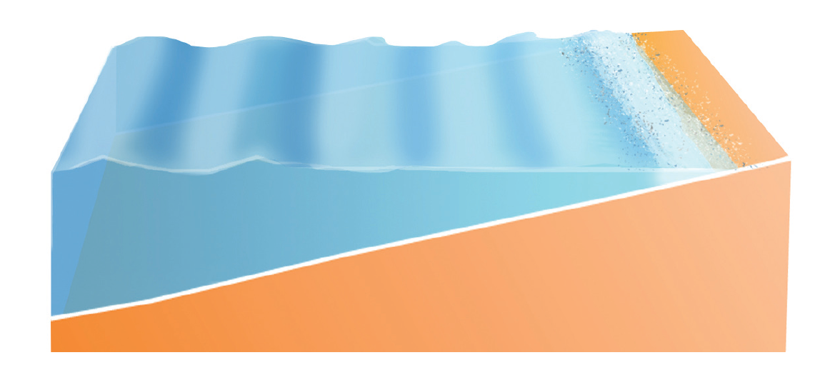
Cold Water
Even during the summer the open water sites stay very cold, particularly the deeper water just a few metres from the shore.
If you want to swim, try to enter from somewhere shallow, and swim parallel with the shore so you can stand up if you start to feel tired or if you inhale water.
If you’re going into deeper water, or jumping in, it’s a good idea to go with an organised group with rescue cover, get used to the temperature first, and wear a wetsuit.
Notes:
Work through the information on the screen.
Ask the group if they know of any, or have taken part in any activity groups such as coasteering or water-sports (or even just swimming in the sea). If they have, ask them to share the experience with the group, particularly focusing on any safety precautions which were followed and if anything didn’t go to plan which they would do differently next time.
(This slide is repeated in other presentations because understanding the affects of cold water is so important to reducing drownings in the UK and Ireland).

Slide 4
Cold Water
After the gasping and hyperventilation response to getting into cold water has passed (0-3mins), how much can cold water reduce your ability to swim?
A research study took 10 good swimmers and asked them to swim in water of 25°C, 18°C, and 10°C for 90mins.
How many do you think completed the swims:
Water Temperature | Number of swimmers who completed the swim
25°C
18°C
10°C
10
8
5
How long can you swim continuously for in a standard 30°C swimming pool?
Considering the standard of the swimmers in the research, how long do you think you could swim in 10°C water?
If you are not experienced swimming in cold water, it’s probably just a couple of minutes
‘Immersion deaths and deterioration in swimming performance in cold water’: Michael Tipton, Clare Eglin, Mikael Gennser, Frank Golden
Notes:
Work through the information on the screen.
Each ‘click’ will fill in a blank in the table, and will then reveal further questions for the group to answer whilst considering their own abilities (hopefully reflecting on the information they have just learned).

Slide 5
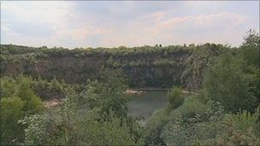
Who Drowns in Open Water?
Teenage boy drowns in a Lancashire quarry
A 13-year-old boy has drowned after swimming at
Hill Top Quarry in Whittle-le-Woods, near Chorley.
Emergency crews were called to the site but the boy was
pronounced dead at the scene, according to a police
spokesman. The boy’s mother paid tribute to her son who she described as a "bright young man who enjoyed life to the maximum and was a thrill seeker. He was funny, special and a talented athlete, was loved by all his family and friends and was a brilliant big brother to his brothers and sister and a fantastic son.
“ He was a ‘very capable swimmer‘. She said the family had been left "totally devastated". "It has left a massive hole in our lives and our family is incomplete without him, though he will never be forgotten. Life will never be the same.“
“I want people to know that he was a strong lad and a very capable swimmer, despite this he still found himself in trouble and unable to swim a short distance to safety. This message is to highlight the dangers of open water and the devastation it can bring to any normal family."
A Councillor of Chorley Council, said the local areas of open water had always been popular with young people. "We are surrounded by water and the water is a big attraction to kids when it is nice weather," he said. "This is used quite a lot and has been for many years.“
Source: http://www.bbc.co.uk/news/uk-england-lancashire-14010665
Notes:
Ask a member of the group to read the newspaper article aloud.
Ask the group to discuss:
Why would such a good swimmer drown?
Would you risk going swimming in a quarry? If you already have, would you do it again now you know how quickly you could drown?

Slide 6
Menu
Identify the Hazards at Open Water Sites
CANAL
LAKE
QUARRY
RESERVOIR
RIVER
END ACTIVITY
Produced for RLSS UK by
Back
Forward
Exit
Notes:
Spot the Dangers Activity
Working individually or in groups, ask the pupils to identify where the hazards are in the following slides, and to read aloud the information as it is revealed on the slide.
Students can point (with the teacher operating the mouse), they can take charge of the mouse themselves, or they can touch the images if you are using an interactive whiteboard.

Slide 7
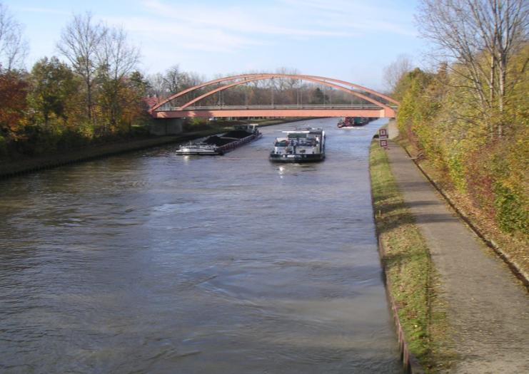
Canal
Hazards:
4 to find!
Resetting Hazards
Reveal All
Reset
Menu
Exit
Notes:
Spot the Dangers Activity

Slide 8
Canal
Hazards:
4 to find!
Currents
Risk:
Danger of being swept away from the edge and into deep, cold water.
Precautions:
Only enter rivers as part or an organised swimming or activity event with safety cover.
Canal
Traffic
Currents
Bridge
Canal Traffic
Risk:
Danger of being hit by boats if you fall in.
Precautions:
If you do fall in, swim directly towards the bank and climb out. If you can’t climb out shout and signal for help, and to make boat aware of your presence.
Bank
Bridge
Risk:
Danger of broken legs and/or spinal injury from falling or jumping from bridge.
Precautions:
Don’t lean over the side of the railings, and don’t jump from bridges.
Bank
Risk:
Bank may be slippery and may collapse due to erosion.
Precautions:
Keep yourself, children, and pets away from the edge.
Reveal All
Menu
Exit
Reset
Notes:
Spot the Dangers Activity

Slide 9
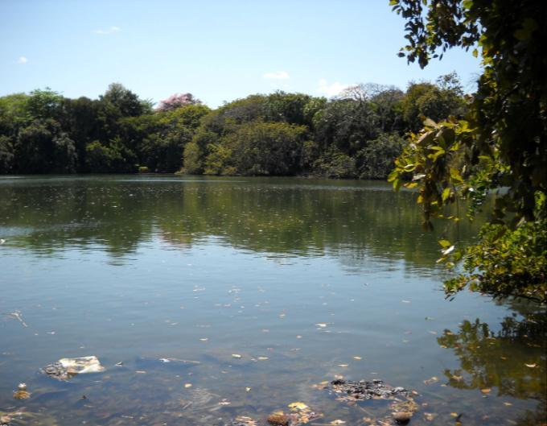
Lake
Hazards:
4 to find!
Resetting Hazards
Reveal All
Reset
Menu
Exit
Notes:
Spot the Dangers Activity

Slide 10
Lake
Hazards:
4 to find!
Rocks
Vegetation
Rubbish/ Pollution
Rubbish/Pollution
Risk:
Broken bottles and cans can cause cuts. Pollutions such as sewage, and ‘run-off’ from farms and fields can cause serious health problems.
Precautions:
Look for rubbish and signs of pollution e.g waste water pipes.
Rocks
Risk:
Rocks pose a slip, trip, fall and entrapment. Cuts from rock can become seriously infected if the water is polluted.
Precautions:
Be careful when moving in shallow water and do not jump into water when you cannot see what is underneath.
Vegetation
Risk:
Blue-Green Algae produces toxins which can cause allergic reactions and potentially serious medical conditions.
Vegetation can make rocks slippery and can hide sharp debris in the water (glass bottles are common).
Precautions:
Do not enter water which has Blue Green Algae.
Be careful when paddling and walking over vegetation. Wear some footwear in the water if possible.
Hidden Features
Hidden Features
Risk:
You cannot see what is below the water in a lake. Possible hazards include glass, sharp rocks & uneven ground.
Precautions:
If you cannot see below the surface, do not jump in. Check for warning signs.
Reveal All
Reset
Menu
Exit
Notes:
Spot the Dangers Activity

Slide 11
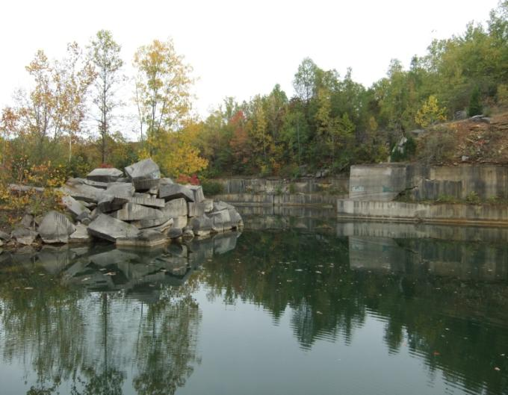
Quarry
Hazards:
6 to find!
Resetting Hazards
Reveal All
Reset
Menu
Exit
Notes:
Spot the Dangers Activity

Slide 12
Quarry
Hazards:
6 to find!
Trees on Bank
Risk:
The tree roots may destabilise the bank, making it more likely to collapse if you get near the edge.
Precautions:
Keep yourself, children, and pets away from the edge.
Unstable Bank
Risk:
The bank can erode and crumble under the top soil, becoming very ustable.
Precautions:
Keep yourself, children, and pets away from the edge.
Rocks
Deep & Cold Water
Risk:
Most quarries contain very deep water which does not warm up in summer due to its depth. The affects of submersion in cold water can be fatal.
Precautions:
Only swim in quarries that have been decommissioned and adapted for swimming, which should include the provision of safety cover. Be aware of the affect of cold water on your ability to swim and control your breathing.
Unstable bank
Underwater current
Hidden features
Hidden Features
Risk:
You cannot see what is below the water in a quarry. Possible hazards include mining/industrial waste products (including chemicals and machinery), dumped rubbish, pollution, highly variable depths, and sharp rocks.
Precautions:
Do not jump into quarries.
Rocks
Risk:
Rocks pose a slip, trip, fall, and entrapment hazard and may also be unstable.
Precautions:
Avoid climbing on rocks around quarries.
Vertical Bank
Risk:
Vertical walls make getting out difficult, especially in an emergency.
Precautions:
Keep yourself, children, and pets away from the edge, and do not jump into quarries.
Shear face
Trees on bank
Reveal All
Reset
Menu
Exit
Notes:
Spot the Dangers Activity

Slide 13
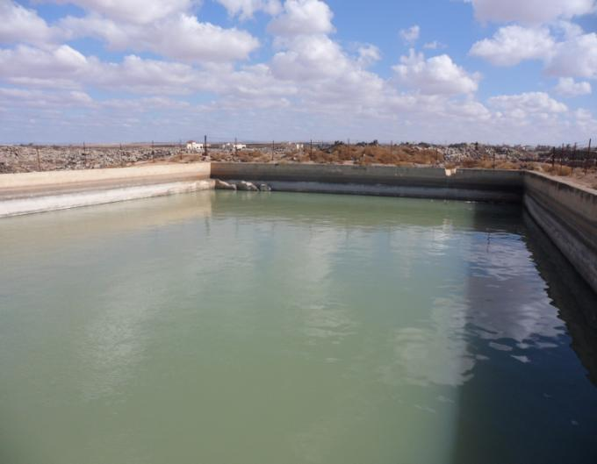
Reservoir
Hazards:
3 to find!
Resetting Hazards
Reveal All
Reset
Menu
Exit
Notes:
Spot the Dangers Activity

Slide 14
Reservoir
Hazards:
3 to find!
Deep & Cold Water
Risk:
Most reservoirs contain very deep water which does not warm up in summer due to its depth. The affects of submersion in cold water can be fatal.
Precautions:
Only enter reservoirs that have been approved for swimming or watersports, which should include the provision of safety cover. Be aware of the affect of cold water on your ability to swim and control your breathing.
Hidden Objects
Risk:
As reservoirs are often formed in flooded natural valleys, they often have a very variable waterbed (depth and composition), and also often contain debris.
Precautions:
If access to the water is permitted, be cautious when entering the water , and stay within permitted areas.
Hidden objects
Cold water
Shear Wall
Walls, Banks, & Beaches
Risk:
Reservoirs tend to be bordered by a mixture of high banks and sloped ‘beach’ areas. Beach areas are easier to get in and out of the water, but be aware that if you move away from where you enter the water you may also be moving away from the only way out.
Precautions:
If access to the water is permitted, make sure where you enter the water is safe, and that you also have an exit route planned.
Remember that the emergency services cannot always reach isolated water sites.
Reveal All
Reset
Menu
Exit
Notes:
Spot the Dangers Activity

Slide 15
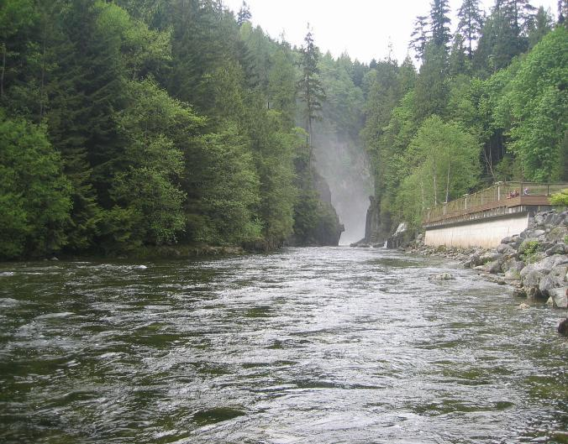
River
Hazards:
8 to find!
Resetting Hazards
Reveal All
Reset
Menu
Exit
Notes:
Spot the Dangers Activity

Slide 16
River
Hazards:
8 to find!
Currents
Risk:
Danger of being knocked off your feet and swept away.
Precautions:
Look for visible currents in the water and warning signs along the bank.
Hidden objects
Rocks
Risk:
Rocks pose a slip, trip, fall, and entrapment hazard and may be hidden beneath vegetation.
Precautions:
Be careful when moving on the bank and in shallow water. Do not jump into water when you cannot see what is underneath.
Cold water
Currents
Hidden Objects
Risk:
Cannot see what is under the water: it may shallow or be filled with rocks or rubbish.
Precautions:
If there is a safe place to enter the water, do so slowly and look closely for hazards as you enter.
Rocks
Waterfall
Risk:
Fast moving water with strong currents moving over rocks with a drop in height.
Precautions:
Approach with caution, if trying to cross the river do so further upstream or downstream in a place where the current is weaker.
White water
Cold water
Risk:
River water can be very cold, even in the summer. The affects of submersion in cold water can be fatal.
Precautions:
Do not get into water without testing its temperature first, whilst also looking out for potential hazards.
Trees on Bank
Risk:
The tree roots may destabilise the bank, making the bank more hazardous.
Precautions:
Approach the bank carefully, checking the ground conditions.
Safety Railings and Barriers
Risk:
In isolated areas, and areas exposed to the weather conditions railings often become damaged and weakened.
Precautions:
Don’t expect railings and barriers to be able to support your weight.
Mist - White Water Ahead
Risk:
Fast moving water with strong currents moving over rocks.
Precautions:
Avoid this area if you are swimming or walking. If you are rafting, kayaking, or gorge walking, approach with caution following the guidance of the activity leader.
Waterfall
Railings
Trees on bank
Reveal All
Reset
Menu
Exit
Notes:
Spot the Dangers Activity

Slide 17
Other sessions to look at
Introduction to Drowning and Cold Water
Inland Water Sites
Coastal and Beach Water Sites
Orienteering –
Hazard Hunt
Witness Statement
Notes:
There are 4 other sessions in this series.
Please complete as many of these sessions as you have time for, starting with the sessions which link most closely with your local environment.
Thank you for delivering this drowning prevention session on behalf of RLSS UK.

