Slide 1
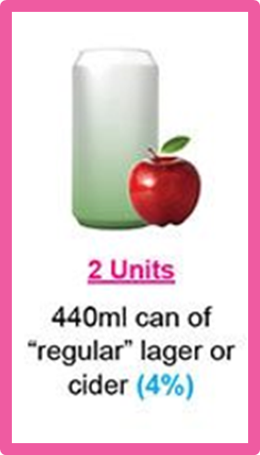
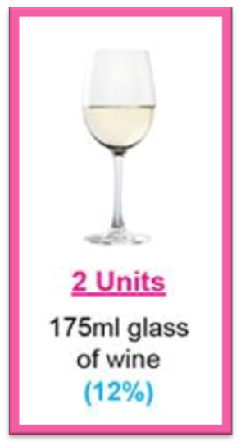
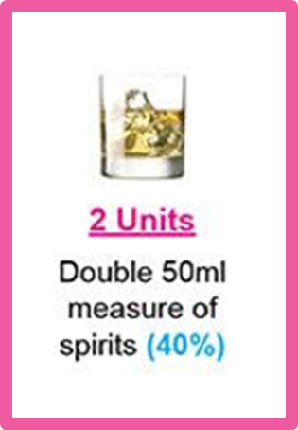
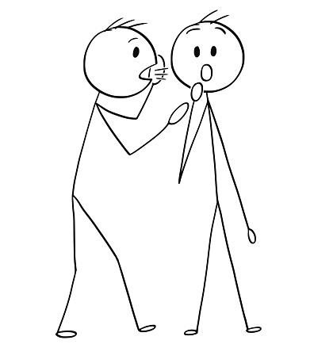
What is too much alcohol?
This is what 2 units looks like
The chief medical officer recommends drinking no more than 14 units per week
That amounts to 2-3 units a day and at least 2 alcohol free days per week
And if you drink all of this it is a binge!
Notes:
My name’s Liz Worrall, I’m a Recovery Co-Ordinator in the Change Grow Live Nottinghamshire Alcohol Team and I would like to help you have a better understanding of safe levels of drinking
So let’s take a look at what the government says about safe drinking levels
The chief medical officer recommends drinking no more than 14 units per week
That amounts to 2-3 units a day and at least 2 alcohol free days per week
This is what 2 units looks like ; a 175 ml glass of 12% wine, a 440 ml can of 4% lager or cider and a double measure of spirits at 40%
Remember drinking 6 units in one sitting is a binge

Slide 2
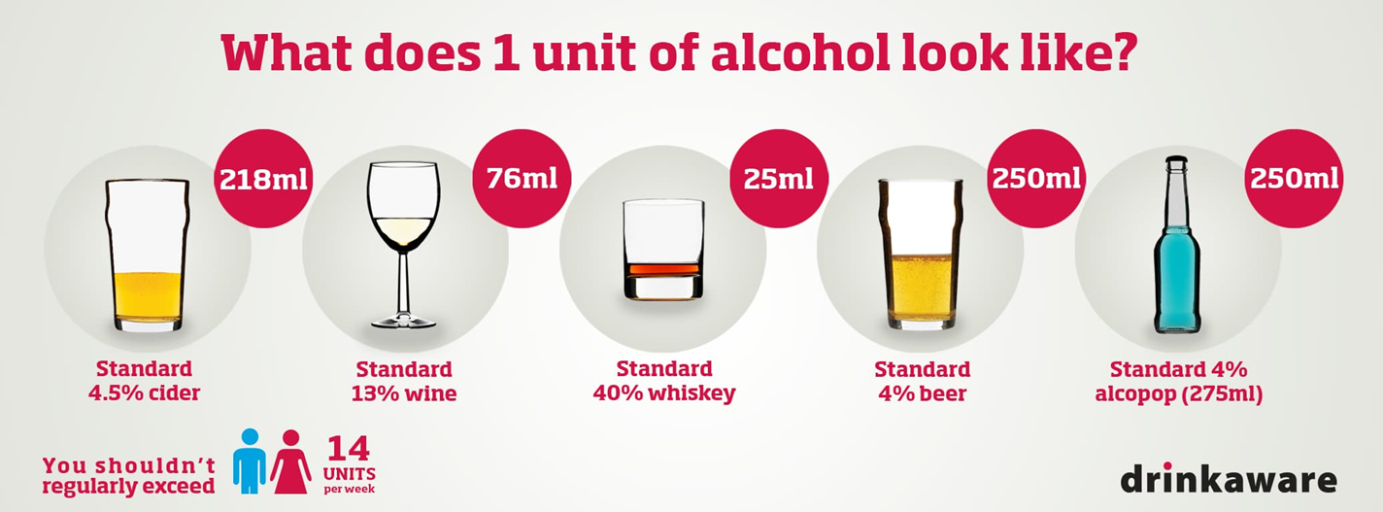
How do I know how much I’m drinking?
https://www.drinkaware.co.uk/understand-your-drinking/unit-calculator
Notes:
Understanding about units will help you to monitor your drinking
One unit is 10ml or 8g of pure alcohol.
Here we have 5 examples what one unit of alcohol looks like
An easy way to calculate units is to think about drinks in 1 litre measures so
1 litre of 12% wine = 12 units
1 litre of 4% beer = 4 units
1 litre of 7.5% cider = 7.5 units
1 litre of 40% vodka = 40 units
Take a moment to click on the link to assess your level of drinking to find out if you are drinking ‘too much’ that is drinking above safe recommended levels

Slide 3
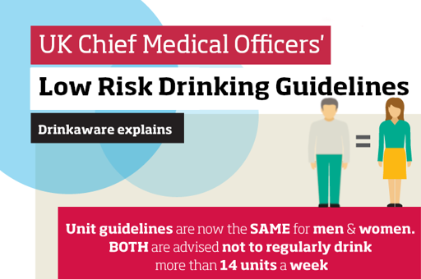
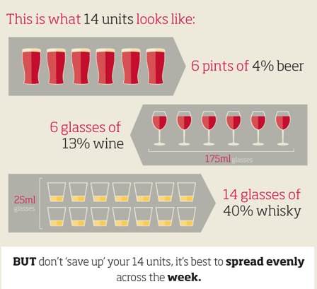
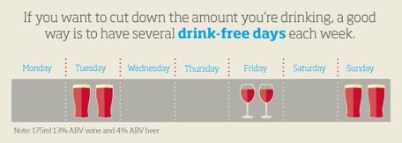
Notes:
So let’s have a look at the UK Chief Medical Officer’s Low Risk Drinking Guidelines.
Remember it’s the same for MEN and WOMEN – you are advised NOT to regularly drink more than 14 units a week
Take a look at how you might this and remember don’t save all your units for one day or the weekend , spread them out evenly and have several drink free days each week.
If you’re pregnant you shouldn’t drink at all

Slide 4
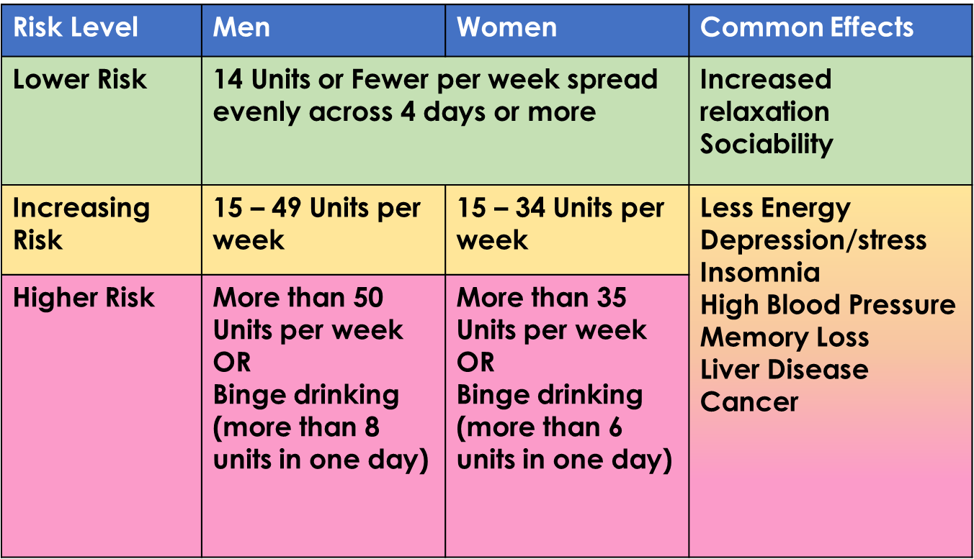
Why worry about units?
Notes:
So why worry about units?
Let’s take a closer look and see if you’re at risk
Both men and women are at LOWER risk if they are drinking 14 units a week or fewer spread evenly over 4 days or more.
If you are a a man drinking 15 to 49 units a week, or a woman drinking 15 to 34 units a week , you are at INCREASING risk.
Higher risk drinking is
If you are a man drinking more than 50 a week or binge drinking ( more than 8 units in one day)
OR if you are a woman drinking more than 35 units a week, or binge drinking more than 6 units in one day
Our lives will return to normality at some point in time so it is important that during COVID19 lock down we keep track of our drinking behaviour to avoid drinking at increasing or higher risk levels.

Slide 5
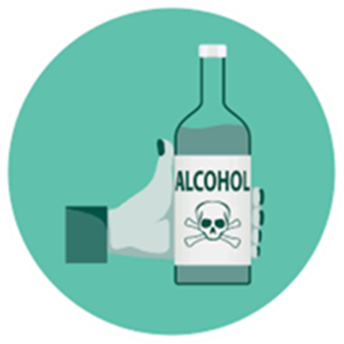
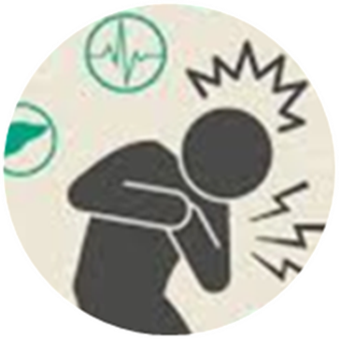
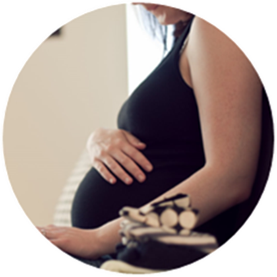
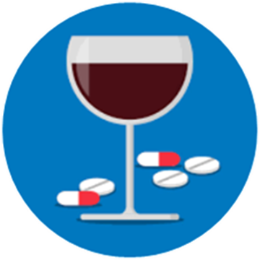
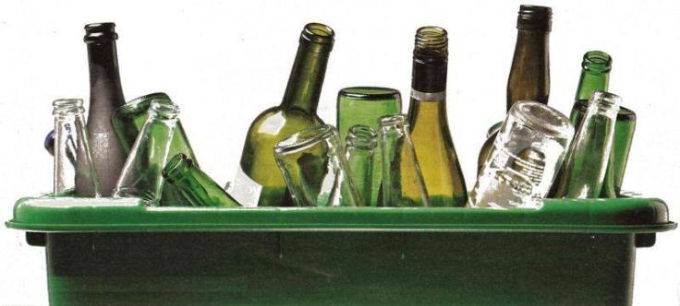
The more you drink the greater the risks
Notes:
Most people enjoy having a drink, it’s relaxing and sociable.
But this can quickly change if you drink excessively in a short space of time and can even lead to alcohol poisoning.
If you feel confused, vomit, feel cold, look pale, be breathing slowly, even be unresponsive you shouldn’t be left alone ; you need to get medical attention immediately.
If you’re on regular medication and your drinking is increasing a lot you’re medication might not be as effective and you may be at greater risk of overdose if you are taking opiate based medication like codeine.
If you are pregnant or planning on getting pregnant you should avoid drinking alcohol as per government guidelines
Long term effects of drinking at high risk levels can be more serious and lead to heart problems, high blood pressure, poor mental health, and cancer.

Slide 6
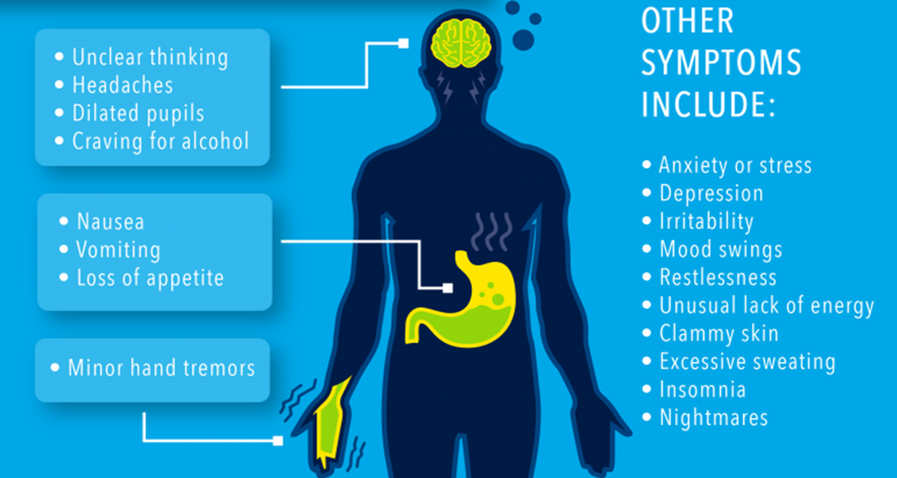
And what if I find I can’t stop?
Drinking more than 15 units a day?
Haven’t had a drink for 6 – 12 hours and having any of the symptoms described here.
Don’t stop suddenly or reduce by more than 10% a day
Drink 2 units of alcohol to alleviate the symptoms, wait 20 minutes and repeat if necessary until you feel well
You might be physically alcohol dependent
Click this link for further important advice
https://youtu.be/ydASwp9C_5c
Notes:
And what if I find I can’t stop drinking?
If you are you drinking more than 15 units a day?
And haven’t had a drink for 6 – 12 hours and are having any of the symptoms described here.
Then
Don’t stop suddenly or reduce by more than 10% a day
Drink 2 units of alcohol to alleviate the symptoms, wait 20 minutes and repeat if necessary until you feel well
You might be physically alcohol dependent so click this link for further important advice

Slide 7
Online alcohol Support Services
CGL - Change grow live offer support to people experiencing problematic alcohol use. CGL can be contacted via the website: https://www.changegrowlive.org
Alcohol Change: https://alcoholchange.org.uk/help-and-support/get-help-now
SMART recovery: https://smartrecovery.org.uk/
Drink Aware: https://www.drinkaware.co.uk
NHS: https://www.nhs.uk/live-well/alcohol-support/
NHS: https://www.nhs.uk/conditions/alcohol-misuse/
Alcoholics Anonymous: www.alcoholicsanonymous.org.uk
Notes:
Here are some online alcohol support services.
Please stay safe and well

