Slide 1
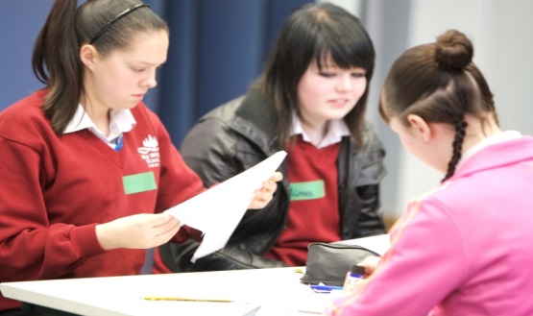
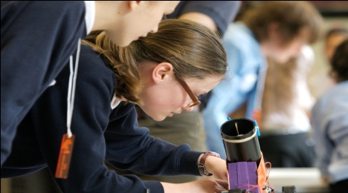
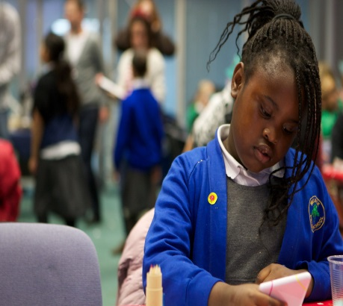
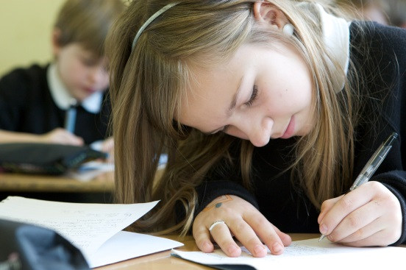
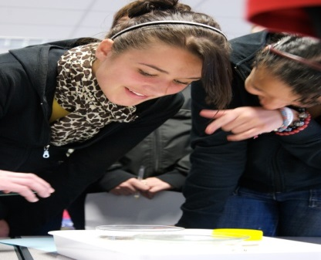
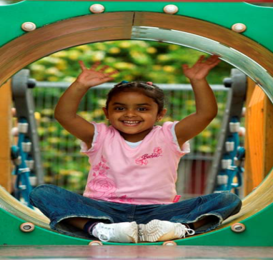
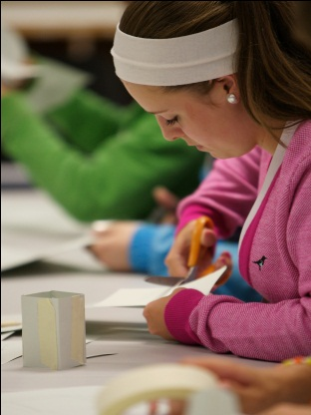
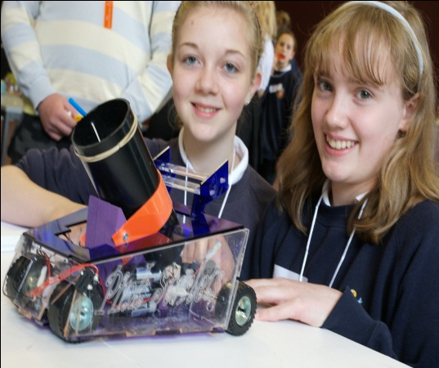
Impossible Dreams?

Slide 2
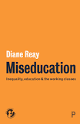
Implications of recent studies & reports?
“Isolation
“Inability to fit in”
“Patronised” “Looked down on by peers”
(Reay 2018)
Current rate of progress – take 80+ years to close attainment gap
(SMC 2017)
Social mobility may produce dislocation & isolation from family/friends
(Payne 2017)
Ability v attainment
Identification?
Intersectionality?
What works - lack of evidence
(Montacute 2018)

Slide 3
Closing the gap for girls?
Despite equality initiatives, many girls from ‘working-class’ backgrounds benefit less, still choose stereotypical careers (Ofsted, 2011; Sutton Trust, 2017)
Why do girls only ‘talk the talk’?
Pupils from working-class backgrounds – lowest achieving group in schools, girls from this group have greatest fear of failure (EHRC, 2011)
There is substantial evidence of cultural practices that constrain girls that we underestimate
(Staki & Baily, 2015)
Aspirations may increase significantly later in life
(Kintrea et al, 2011)
*Do student experiences within individual schools reflect national research findings?

Slide 4
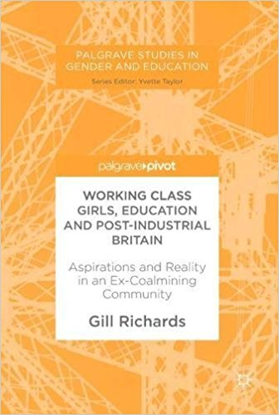
Research: ‘Girls’ aspirations & achievement’
Aims
Focus – aspirations, barriers and support, hopes/fears for the future
Understand any barriers from the girls’ perspectives
Use localised experiences to personalise school initiatives
The schools (89 girls)
Took students from an area of severe deprivation
3 primary schools – 2 had underachieving girls & 1 had girls achieving well (53: Year 6)
2 secondary schools – S1‘Satisfactory’/‘Inadequate’; S2 ‘Good’/‘Outstanding’ (36: Year 11)

Slide 5
Methods
Girls
Interviews (self-selected group/individual): Focus – aspirations and achievements, barriers and support
Anonymous ‘post-its’ – ‘Hopes’ and ‘Fears’ for the future
School staff
Interviews (individual): Focus – generic/historical background information on the local community and girls’ aspirations
NTU female students
Interviews (individual): Focus – personal journey into HE

Slide 6
Initial findings and follow up study
Primary girls all had similar aspirations
Significant differences found between both secondary schools
Six years later (64 girls)
What have you done?
What was your journey like?
What do you wish that you had done differently?
What could school have done to help you more?

Slide 7
Initial study: aspirations and achievement (S1 & S2)
Teachers and subjects
“Teachers more important than subjects”
Selected subjects taught by ‘liked’ teachers (S1)
Subjects for careers (S2)
Planning ahead
“No idea”, keeping with familiar (S1)
Research: careers, HEIs, CV (S2)
Aspirations
Mismatch with
GCSE grades (S1)
High expectations, but some understood – “not clever enough” (S2)
Advice
Discussed with friends & family (S1&2)
(Not teachers: S1)
“Feeling unimportant”
Family support
“Not bothered” , “Go for it” , “Hairdresser” (S1)
“Not an option, not going to uni” (S2)

Slide 8
Initial study: Girls’ experiences
“People like us don’t go to university” (S1)
“If teachers don’t believe in you it gives you no hope at all” (S2)
“I hope I don’t end up living in a council house, no money, no kids and parents aren’t pleased with what I have become” (S1)
“Teachers are more interested in our grades than us” (S2)
“Are we stupid to want this?” (S1)
“I fear that I won’t succeed in life .. and I will never live my life to its full potential” (S1)
“I want to be happy, financially and emotionally, waking up each morning and loving my life” (S2)
Notes:
School 1 – school concerned about girls – aspirations, achievement
School 2 – very successful with girls – highly aspirational and very successful achievement
Not trying to suggest these reflect national picture – identified important issues for individual schools/colleges to consider

Slide 9
Key themes from follow up study
Confidence and trust
Feeling valued
Achieving dreams
Understanding successful learning behaviour

Slide 10
Confidence and trust
“I needed more time with teachers who understood what I was feeling about what was happening at home” (S1)
“I wished I’d asked for more help with Maths, then I could have done pharmacy. School should have noticed I was struggling, but they didn’t know what I wanted to do” (S1)
“Teachers need to really know you, know when something is wrong. Teachers didn’t know who we were, [they were] just interested in the work we did or didn’t do” (S2)
‘Secret lives’, ‘signals’ & ‘part-stories’.
Teachers seen as ‘other’
Notes:
School 1 – school concerned about girls – aspirations, achievement
School 2 – very successful with girls – highly aspirational and very successful achievement
Not trying to suggest these reflect national picture – identified important issues for individual schools/colleges to consider

Slide 11
Feeling valued
“One teacher was amazing, but another said to me ‘You won’t pass’, made me feel there was no point” (S1)
“They pushed the elite students, but if you’re not one of those, it’s not the same. We had to push ourselves. It was hard” (S1)
Success was linked to ‘value’
“I wished school had helped me more, they didn’t help if you weren’t ‘super-clever’” (S2)
“My family put me down, said I wasn’t good enough to be a vet” (S1)
Notes:
School 1 – school concerned about girls – aspirations, achievement
School 2 – very successful with girls – highly aspirational and very successful achievement
Not trying to suggest these reflect national picture – identified important issues for individual schools/colleges to consider

Slide 12
Achieving dreams
“They don’t do the ‘A’ level I need, I don’t know what I’ll do now” (S1)
“I want to be successful for my little one. I want my son to see me working, not a ‘stay-at-home mum’ or a ‘benefit hugger’” (S2)
“School said I’d never get to uni. Teachers [at uni] put me down .. didn’t like the students on my course” (S1)
Resilience was a key factor
“Dad didn’t think I should go to uni. He just wants me to ‘get off my arse and get a job’ (S1)
“I want to go to college and be an air hostess, but mum wants me to do make up” (S1)
Notes:
School 1 – school concerned about girls – aspirations, achievement
School 2 – very successful with girls – highly aspirational and very successful achievement
Not trying to suggest these reflect national picture – identified important issues for individual schools/colleges to consider

Slide 13
Understanding successful learning behaviour
“I wished I hadn’t lied to my parents about doing revision” (S1)
“I didn’t believe it when they told me I had to do more work” (S1)
“I wish I’d worked harder but I had problems with my family” (S2)
“I wish I’d paid more attention – I concentrated on making friends, not working” (S2)
Realised after exam results
Notes:
School 1 – school concerned about girls – aspirations, achievement
School 2 – very successful with girls – highly aspirational and very successful achievement
Not trying to suggest these reflect national picture – identified important issues for individual schools/colleges to consider

Slide 14
What I wish school had done differently: Girls from S1
“Wish they had sat people down and talked to them about what they wanted to do. Really important, so many don’t know what they want to do, they’re on hairdressing courses – half don’t want to do it”
“School should have made me work harder”
“School should have made me go to revision classes. They gave us a choice, but I just wanted to go home after school”
“Teachers always off sick, got a load of supply teachers and we just ‘mucked about’”
“Talk to us after we leave school… I felt stranded”
“Organised more visits to university ‘Open Days’ and went with us”

Slide 15
What I wish school had done differently: Girls from S2
“Need teachers to really know you, know when something is wrong. Teachers didn’t know who we were, just interested in the work we did or didn’t do.”
“I wish school had got us more work experience. We’re just doing theory – fed the work for exams”
“Improve the support system. Two teachers were very supportive when I struggled, but another just wanted us all channelled to university”
“Helped me to work more independently for university”
“Get uni students in to talk about their experiences”

Slide 16
S1: Selecting university. What did they say?
Selected a local university – maintain family support or cultural expectations to remain at home
Selected university in small town
Selected course by Open Days or web information (often unsure but scared to ask more)
Families – some proud and excited, others shocked: “Isn’t .. [village] good enough for you?”
Friends – supportive, jealous, questioning why university rather than job
Petrified some-one would discover they weren’t clever enough

Slide 17
S2: Selecting university. What did they say?
Had help from family and teachers
Researched courses, tailored CV
Had received tailored support from teachers for their chosen university
Received parental support for work experience
Parents wanted them to choose ‘academic’ subjects
Those who moved away were glad they did, increased confidence

Slide 18
One view (S1)
“It wasn’t cool to be clever – cooler to be involved with things like beauty therapy and making yourself beautiful.
Now they say ‘Oh, she’s changed … she looks different and talks differently now’.
I feel distanced from the village now, the community is very small and friends and family are a strong part of your everyday life. You have to accept that to go to uni, you’ll have to be some-one different, give up everything in a way”

Slide 19
One view (S2)
“I put together a business plan and got support from a bank and my parents. I now own a shop and sell organic clothing that’s ethically sourced.
I’ve just moved to a better location and have pop up shops in different locations. I set up a traders’ association and got local shops together to promote our town at Christmas as a ‘destination town’. I’ve expanded into clothing from Italy and India. I’m trying to support the textile industry in other countries.
Mum works with me two days a week and Dad is a financial adviser – it’s a real family business”

Slide 20
NTU students: University experiences
Selected a local university – to maintain family support or cultural expectations to remain at home
Felt separate from peers and wider university life, daily struggle - ‘juggle’ of home & university expectations
Selected course by Open Days or web information (that was often misunderstood)
Struggled at the start, changed courses, left and restarted
Felt unprepared for university work expectations. Scared of discovery - a ‘fraud’ – not clever enough
Used to small ‘known’ groups, unsure of independent learning expectations/time demands
Met cultural expectations first.
‘New life’ offered new opportunities
‘Mature’ student

Slide 21
Interesting ‘discoveries’: S1 girls
Only 3 stayed at school for ‘A’ Levels, despite 11 stating 6 months earlier they intended to do this and go to university
2 went to local college for vocational courses, then university
3 had wanted to study law, psychology, interior design at university – 2 working locally in beauty therapy, the other??
1 had wanted to be a vet – lack of parental support, went to college, studied animal care – father got her a job in local pub
“All the clever ones did ‘A’ levels, but didn’t consider university”

Slide 22
Reflection
“Why are you encouraging her – she’ll leave you”
Excellent initiatives do not reach all young people
Danger in generalisations about disadvantage – seemingly common difficulties arise from different personal situations
‘Insider’ information is needed to individualise solutions. How can we move beyond statistical data?
Relationships were key to the girls’ decision-making. How can these be mobilised to develop personalised support?

Slide 23
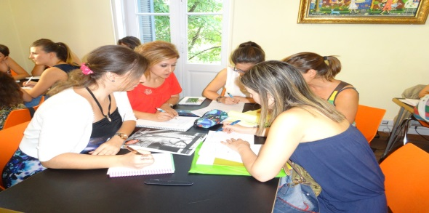
Final thoughts …….
How do we identify all students’ individual potential and support achievement of this? (How can we build up trust?)
One member of staff can make a difference (+/-). (How can we ensure a consistently positive response?)
How do we build resilience in students and their families to encourage widening of horizons and manage achievement of their ‘dreams’?
How can students who struggle with conflicting cultures be supported?
Can we customise other successful strategies? (*Harlem Children’s Zone, The Girls’ Network, Inspiring Girls)
Danger in ‘I did it, so can you’ stories – great message, BUT…
How can all girls face the future: “Passionate and ready”

Slide 24
References
Equality and Human Rights Commission (2009) Staying On, London: Equality and Human Rights Commission
Kintrea, K., St. Clair, R. & Houston, M. (2011) The influence of parents, places and poverty on educational attitude and aspirations, York: Joseph Rowntree Foundation
Montacute, R. (2018) Potential for Success, London: Sutton Trust
Ofsted (2011) Girls’ career aspirations, Manchester: Ofsted
Payne, G. (2017) The new social mobility: How the politicians got it wrong, Bristol: Policy Press
Reay, D. (2018) Miseducation. Inequality, education and the working classes, Bristol: Policy Press
Social Mobility Commission (2017) Time for Change: An Assessment of Government Policies on Social Mobility 1997-2017, London: Social Mobility Commission
Staki, S. & Baily, S. (2015) Educating Adolescent Girls around the Globe, Abingdon: Routledge
Sutton Trust (2017) The State of Social Mobility in the UK, London: Sutton Trust

